Slide 1
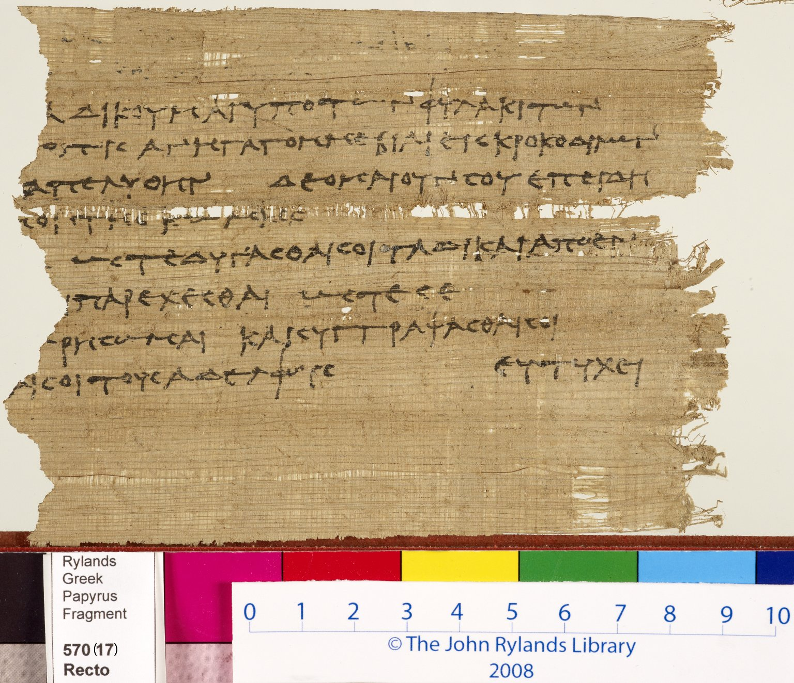
-------------
Image1
-------------
Field Data
Reference number Greek P 570
Side recto
Image Number JRL0907275dc
Image Title Petition to Zenon
Alternative Image Title Zenon Archive
Trismegistos Number <A href="http://www.trismegistos.org/text/2426"> 2426</a>
Subject Letters
Citation reference P. Ryl. 4 570
Description The petitioner had been accused of complicity in a robbery. He asked Zenon to procure his release and so allow him to fulfil his obligations.
People covered Zenon
Language Greek
Language code grc-EG
Item height 140 mm
Item width 105 mm
Technique used Handwriting
Support material Papyrus
Style Period Ptolemaic
Bibliography Hunt, Arthur S., et al. Catalogue of the Greek and Latin Papyri in the John Rylands Library, Manchester, University Press, 1911-1952
Current repository The University of Manchester Library, U.K.
Category Manuscripts
Sub-Category Fragments
Image rights The University of Manchester Library
Work rights The University of Manchester Library
Image sequence number grc0570r
Image technique Digital capture by Heritage Imaging, The University of Manchester Library
Date image captured 2008-12-02
Metadata language eng-GB

