Slide 1
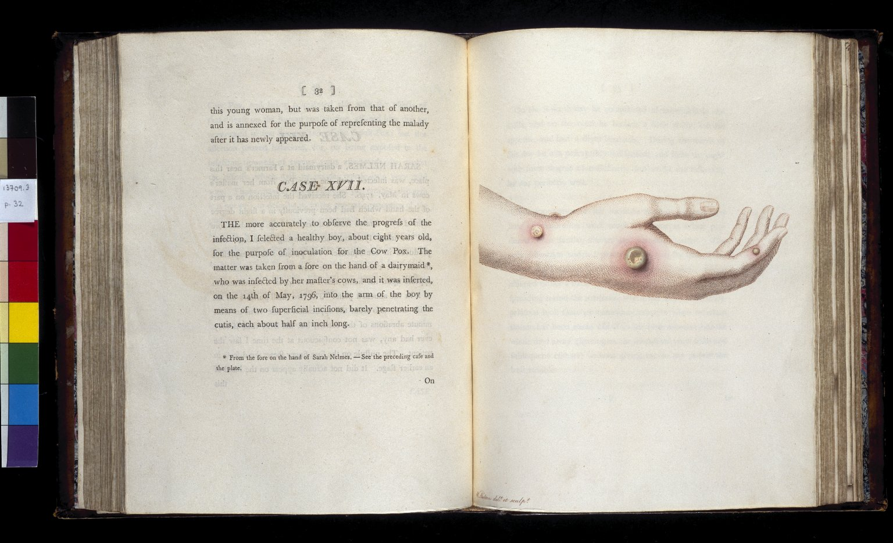
-------------
Image1
-------------
Field Data
Image Number JRL022642tr
Reference Number Spencer 13709.3
Link to Catalogue <A href=http://man-fe.hosted.exlibrisgroup.com/MU_VU1:BLENDED:44MAN_ALMA_DS21199664420001631>UoM online catalogue.</a>
Image Title Cow-pox sore
Parent Work Title An inquiry into the causes and effects of the variolæ vaccinae, a disease discovered in some of the western counties of England, ... and known by the name of the cow pox
Creator Jenner, Edward
Creator Role Author
Date Created 1798
Publication Details London: Sampson Low
Page/Sheet Opposite page 32
Description Political Tracts. Illustrated: Cow-pox sore.
Language Code eng-GB
Language English
Subject Medicine
Category of Material Printed
Sub-Category Illustrated works
Current Repository The University of Manchester Library, U.K.
Provenance Spencer, George John Spencer, Earl, 1758-1834, former owner
Rights Holder - Image The University of Manchester Library
Rights holder - Work The University of Manchester Library
Image Creation Technique Scanned from colour transparency by Gten, October 2003
Metadata Language eng-GB

Slide 3
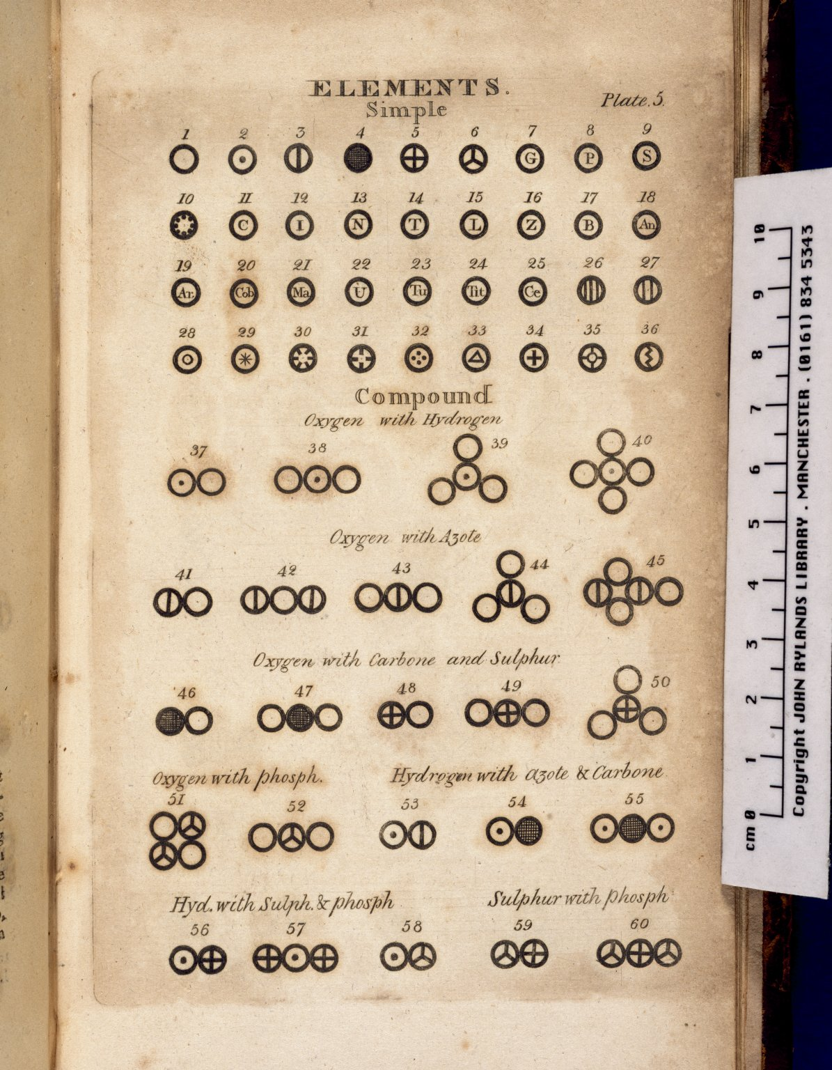
-------------
Image1
-------------
Field Data
Image Number JRL021194tr
Reference Number Partington 277-278
Link to Catalogue <A href=http://man-fe.hosted.exlibrisgroup.com/MU_VU1:BLENDED:44MAN_ALMA_DS21205694560001631>UoM online catalogue.</a>
Image Title The Elements
Parent Work Title A new system of chemical philosophy
Creator Dalton, John, 1766-1844
Creator Role Author
Date Created 1808
Publication Details Manchester : S. Russell for R. Bickerstaff
Volume 1
Page/Sheet Plate 5, opposite page 548
Image Sequence Number 548
Description Illustrated: the Elements, both simple and compound.
Language Code eng-GB
Language English
Subject Chemistry
Category of Material Printed
Sub-Category Illustrated works
Support Paper
Current Repository The University of Manchester Library, U.K.
Rights Holder - Image The University of Manchester Library
Rights holder - Work The University of Manchester Library
Image Creation Technique Scanned from colour transparency by Gten, May 2005
Metadata Language eng-GB

Slide 4
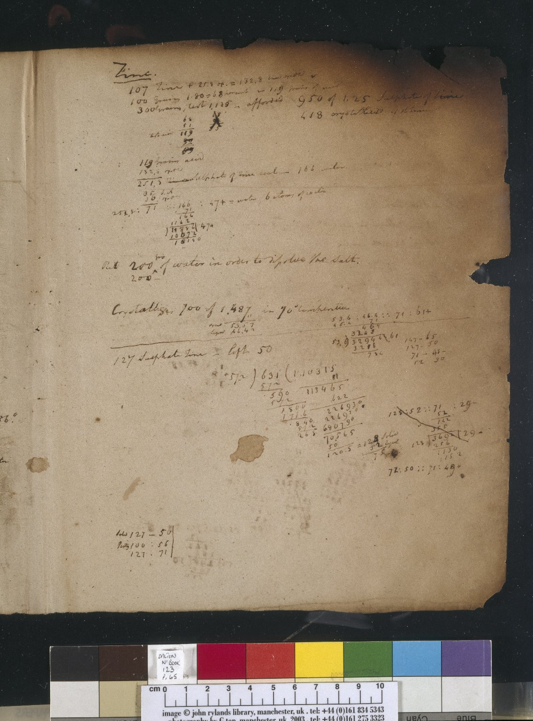
-------------
Image1
-------------
Field Data
Image Number JRL030525tr
Reference Number Dalton MS 123
Image Title Laboratory notes
Parent Work Title Laboratory notebook
Creator Dalton, John, 1766-1844
Creator Role Author
Date Created c1839-1841
Page/Sheet 65
Image Sequence Number 065
Description Fire damaged manuscript notes in John Dalton's own handwriting. Examination of Zinc.
Language Code eng-GB
Language English
Subject Science--Great Britain
Category of Material Archives
Sub-Category Codex
Technique Used Handwriting
Medium Ink
Support Paper
Time Period Covered 19th Century CE
Item Height 260 mm
Item Width 210 mm
Current Repository The University of Manchester Library, U.K.
Provenance Manchester Literary & Philosophical Society, former owner
Rights Holder - Image The University of Manchester Library
Rights holder - Work The University of Manchester Library
Access Rights <a rel="license" href="http://creativecommons.org/licenses/by-nc-sa/4.0/"><img alt="Creative Commons License" style="border-width:0" src="https://i.creativecommons.org/l/by-nc-sa/4.0/88x31.png"></a>
Image Creation Technique Scanned from colour transparency by Gten, June 2004
Metadata Language eng-GB

Slide 5
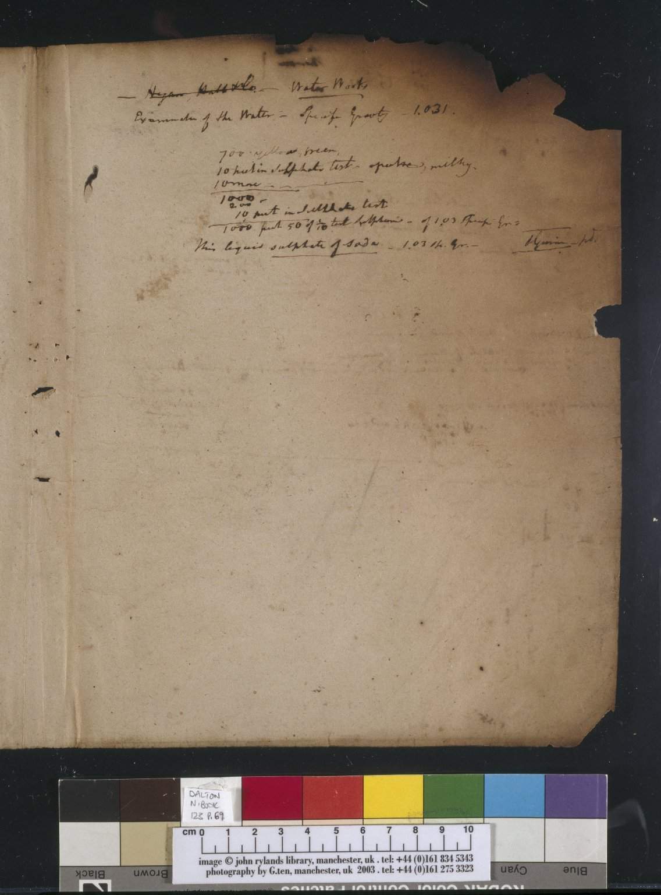
-------------
Image1
-------------
Field Data
Image Number JRL030524tr
Reference Number DAL/123
Image Title Laboratory notes
Parent Work Title Laboratory notebook
Creator Dalton, John, 1766-1844
Creator Role Author
Date Created c1839-1841
Page/Sheet 69
Image Sequence Number 069
Description Fire damaged manuscript notes in John Dalton's own handwriting. Examination of water.
Language Code eng-GB
Language English
Subject Science--Great Britain
Category of Material Archives
Technique Used Handwriting
Medium Ink
Support Paper
Time Period Covered 19th Century CE
Item Height 260 mm
Item Width 210 mm
Current Repository The University of Manchester Library, U.K.
Provenance Manchester Literary & Philosophical Society, former owner
Rights Holder - Image The University of Manchester Library
Rights holder - Work The University of Manchester Library
Access Rights <a rel="license" href="http://creativecommons.org/licenses/by-nc-sa/4.0/"><img alt="Creative Commons License" style="border-width:0" src="https://i.creativecommons.org/l/by-nc-sa/4.0/88x31.png"></a>
Image Creation Technique Scanned from colour transparency by Gten, June 2004
Metadata Language eng-GB

Slide 6
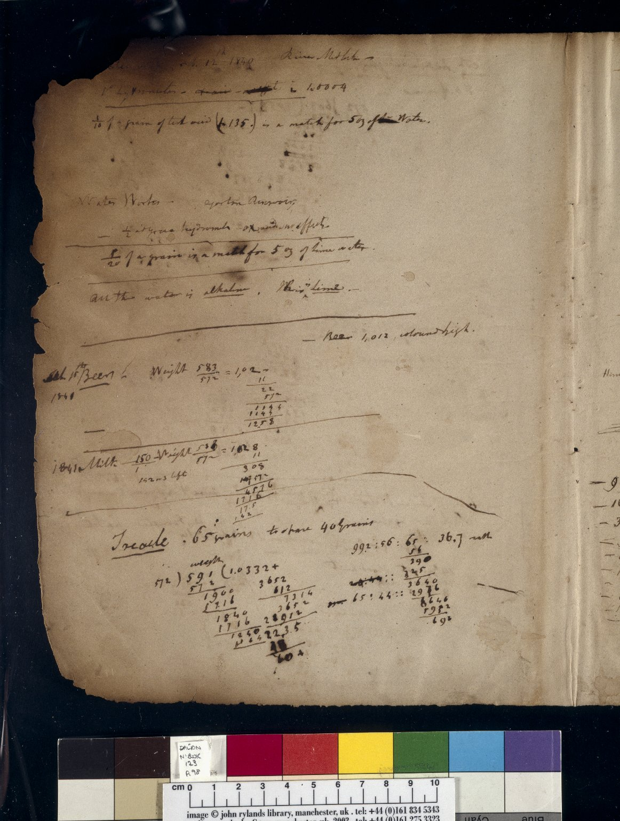
-------------
Image1
-------------
Field Data
Image Number JRL030523tr
Reference Number Dalton MS 123
Image Title Dalton notes
Parent Work Title Laboratory notebook
Creator Dalton, John, 1766-1844
Creator Role Author
Date Created 1840-02-12
Page/Sheet 98
Image Sequence Number 098
Description Fire damaged manuscript notes in John Dalton's own handwriting. Analysis of water, beer, milk and treacle.
Language Code eng-GB
Language English
Subject Science--Great Britain
Category of Material Archives
Technique Used Handwriting
Medium Ink
Support Paper
Time Period Covered 19th Century CE
Item Height 260 mm
Item Width 210 mm
Current Repository The University of Manchester Library, U.K.
Provenance Manchester Literary & Philosophical Society, former owner
Rights Holder - Image The University of Manchester Library
Rights holder - Work The University of Manchester Library
Access Rights <a rel="license" href="http://creativecommons.org/licenses/by-nc-sa/4.0/"><img alt="Creative Commons License" style="border-width:0" src="https://i.creativecommons.org/l/by-nc-sa/4.0/88x31.png"></a>
Image Creation Technique Scanned from colour transparency by Gten, January 2006
Date Image Added (yyyy-mm) 2006-01
Metadata Language eng-GB

Slide 7
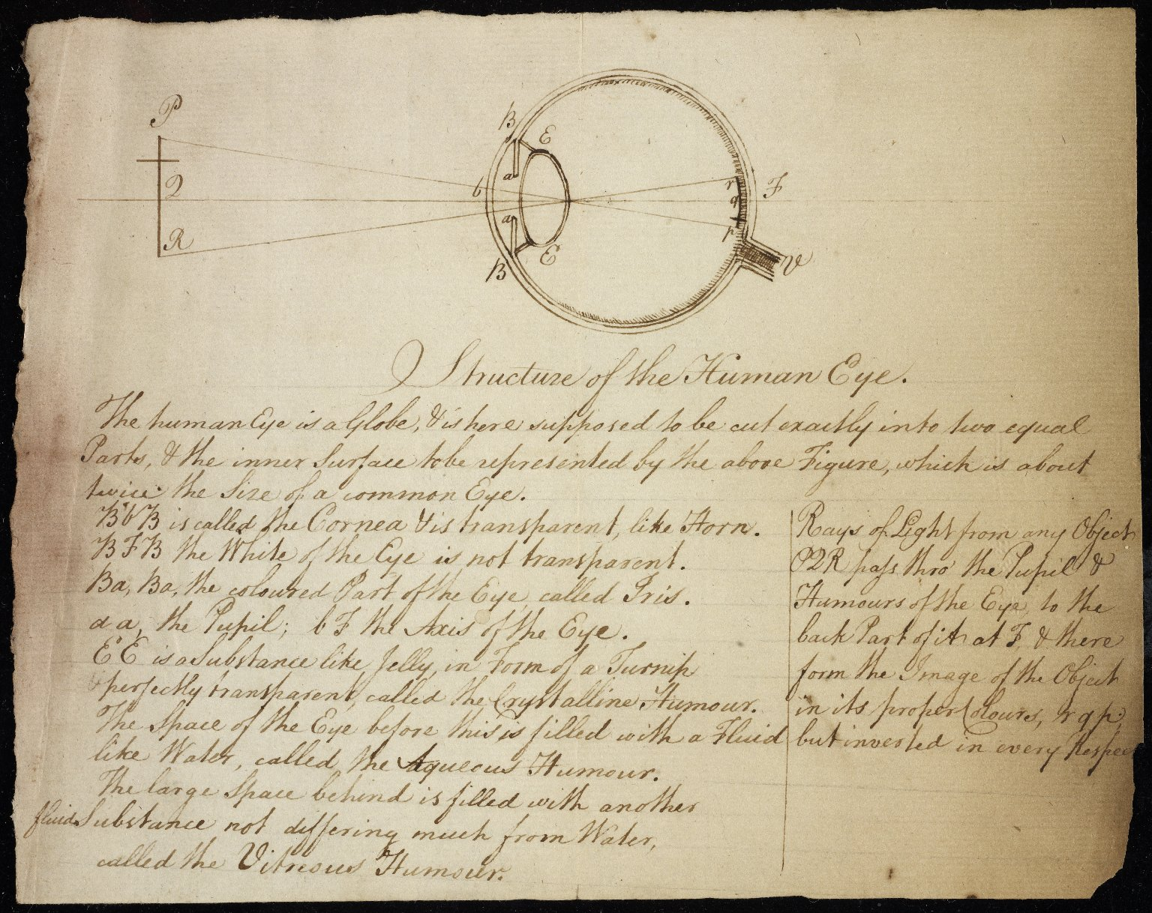
-------------
Image1
-------------
Field Data
Image Number JRL0901014dc
Reference Number Dalton MS 84
Image Title Structure of the human eye
Parent Work Title Lecture notes: Optics
Creator Dalton, John, 1766-1844
Creator Role Author
Date Created c1808
Description Illustration of the structure of the human eyeball, with Dalton's lecture notes.
Language Code eng-GB
Language English
Subject Medicine--History
Category of Material Archives
Sub-Category Illustrated works
Technique Used Drawing (image-making)
Technique Used Handwriting
Medium Ink
Support Paper
Time Period Covered 19th Century CE
People Covered Dalton, John, 1766-1844
Current Repository The University of Manchester Library, U.K.
Provenance Manchester Literary & Philosophical Society, former owner
Rights Holder - Image The University of Manchester Library
Rights holder - Work The University of Manchester Library
Access Rights <a rel="license" href="http://creativecommons.org/licenses/by-nc-sa/4.0/"><img alt="Creative Commons License" style="border-width:0" src="https://i.creativecommons.org/l/by-nc-sa/4.0/88x31.png"></a>
Date Captured (yyyy-mm-dd) 2008-08-13
Image Creation Technique Digital capture by Heritage Imaging, The University of Manchester Library
Date Image Added (yyyy-mm) 2008-11
Metadata Language eng-GB

Slide 8
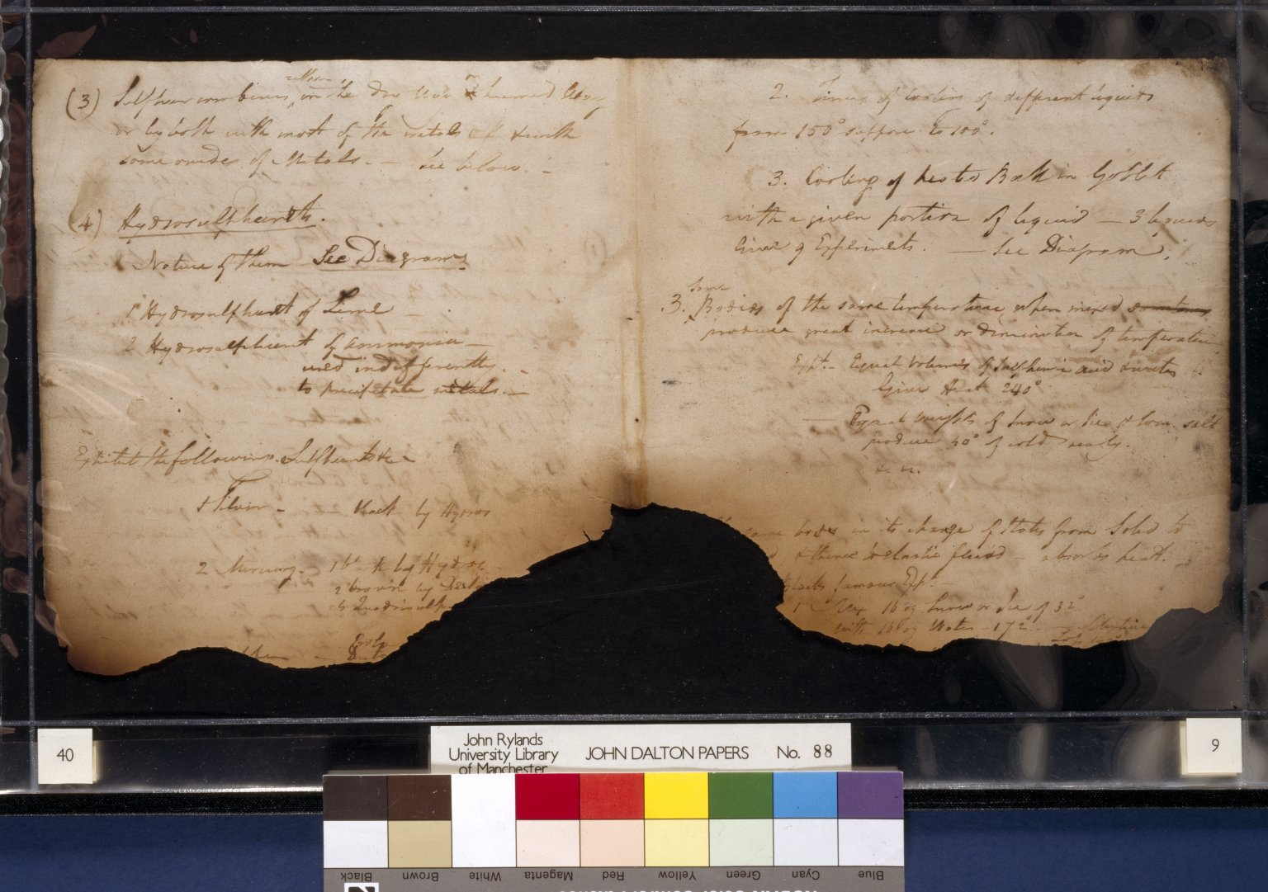
-------------
Image1
-------------
Field Data
Image Number JRL022890tr
Reference Number Dalton MS 88
Image Title Dalton manuscript notes
Parent Work Title Lecture notes: Chemistry
Creator Dalton, John, 1766-1844
Creator Role Author
Date Created 1827
Page/Sheet 9
Image Sequence Number 009
Description Fire damaged manuscript notes in John Dalton's own handwriting.
Language Code eng-GB
Language English
Subject Science--Great Britain
Category of Material Archives
Technique Used Handwriting
Medium Ink
Support Paper
Current Repository The University of Manchester Library, U.K.
Provenance Manchester Literary & Philosophical Society, former owner
Rights Holder - Image The University of Manchester Library
Rights holder - Work The University of Manchester Library
Access Rights <a rel="license" href="http://creativecommons.org/licenses/by-nc-sa/4.0/"><img alt="Creative Commons License" style="border-width:0" src="https://i.creativecommons.org/l/by-nc-sa/4.0/88x31.png"></a>
Image Creation Technique Digital capture by Heritage Imaging, The University of Manchester Library
Metadata Language eng-GB

Slide 9
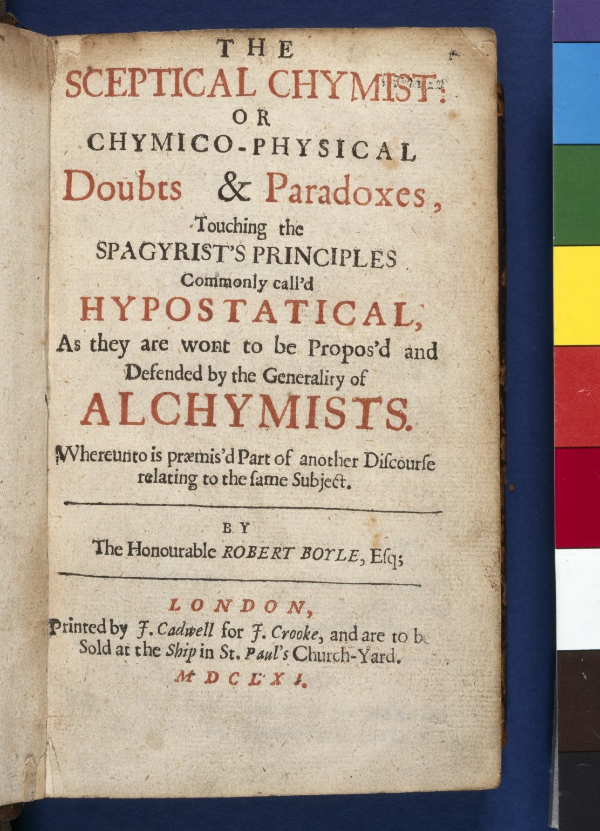
-------------
Image1
-------------
Field Data
Image Number JRL022891tr
Reference Number SC12901A
Link to Catalogue <A href=http://man-fe.hosted.exlibrisgroup.com/MU_VU1:BLENDED:44MAN_ALMA_DS21138865110001631>UoM online catalogue.</a>
Image Title Boyle's 'Sceptical chymist'
Parent Work Title Sceptical chymist: or Chymico-physical doubts & paradoxes
Creator Boyle, Robert, 1627-1691
Creator Role Author
Date Created 1661
Publication Details London: J. Cadwell for J. Crooke
Page/Sheet Title page
Description First edition of Boyle's best-known work.
Language Code eng-GB
Language English
Subject Chemistry
Category of Material Printed
Medium Ink
Support Paper
Time Period Covered 17th Century CE
Current Repository The University of Manchester Library, U.K.
Rights Holder - Image The University of Manchester Library
Rights holder - Work The University of Manchester Library
References 'Bulletin of the John Rylands University Library of Manchester', Vol. 82, Nos. 2 and 3, 2000.
Image Creation Technique Scanned from colour transparency by Gten, May 2005
Metadata Language eng-GB

Slide 10
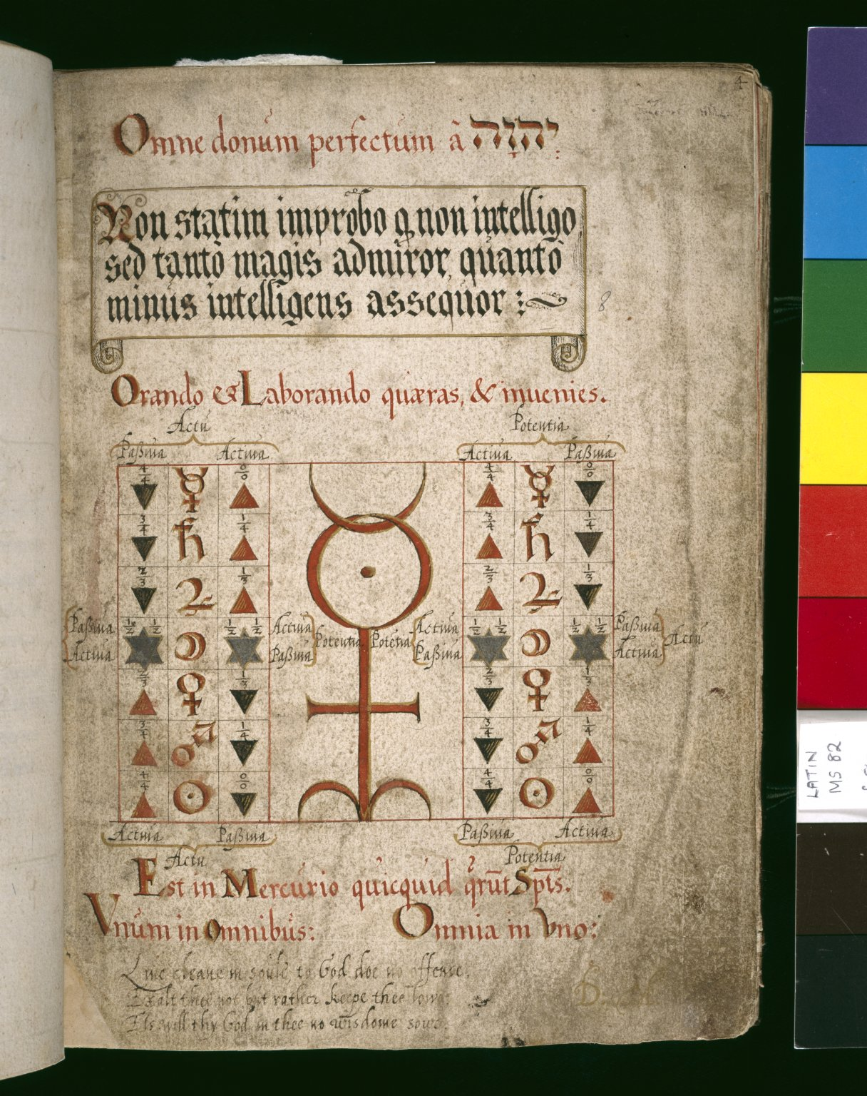
-------------
Image1
-------------
Field Data
Image Number JRL022344tr
Reference Number Latin MS 82
Image Title Alchemical symbols
Parent Work Title Alchimica
Creator Khunrath, Heinrich
Creator Role Author
Date Created 17th century [early]
Page/Sheet 8r
Image Sequence Number 008r
Description Various manuscript extracts on Alchemy. Whole page of text and symbols. Caligraphy is in black, red and gold ink, with a large symbol in centre of the page.
Language Code lat
Subject Alchemy
Category of Material Manuscripts
Sub-Category Codex
Technique Used Drawing (image-making)
Technique Used Handwriting
Support Paper
Time Period Covered 17th Century CE
Item Height 198 mm
Item Width 150 mm
Current Repository The University of Manchester Library, U.K.
Provenance Lindsay family Earls of Crawford and Balcarres, former owner
Rights Holder - Image The University of Manchester Library
Rights holder - Work The University of Manchester Library
Image Creation Technique Scanned from colour transparency by Gten, June 2005
Metadata Language eng-GB

Slide 11
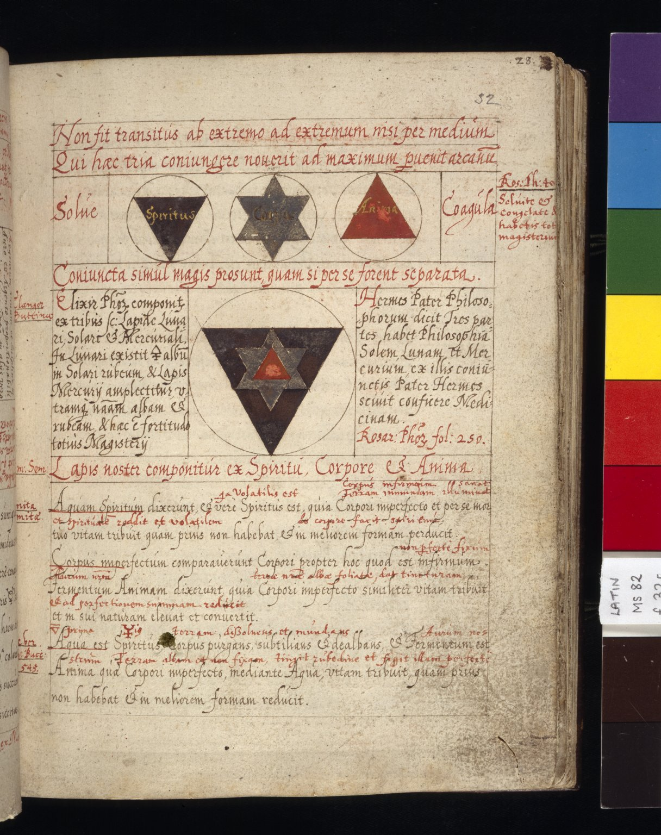
-------------
Image1
-------------
Field Data
Image Number JRL022346tr
Reference Number Latin MS 82
Image Title Alchemical symbols
Parent Work Title Alchimica
Creator Khunrath, Heinrich
Creator Role Author
Date Created 17th century [early]
Page/Sheet 32r
Image Sequence Number 032r
Description Various manuscript extracts on Alchemy. Whole page of text. The caligraphy is in black and red ink, there are three symbols at the top of the page and a larger triangular symbol in centre.
Language Code lat
Subject Alchemy
Category of Material Manuscripts
Sub-Category Codex
Technique Used Drawing (image-making)
Technique Used Handwriting
Support Paper
Time Period Covered 17th Century CE
Item Height 198 mm
Item Width 150 mm
Current Repository The University of Manchester Library, U.K.
Provenance Lindsay family Earls of Crawford and Balcarres, former owner
Rights Holder - Image The University of Manchester Library
Rights holder - Work The University of Manchester Library
Image Creation Technique Scanned from colour transparency by Gten, June 2005
Metadata Language eng-GB

Slide 12
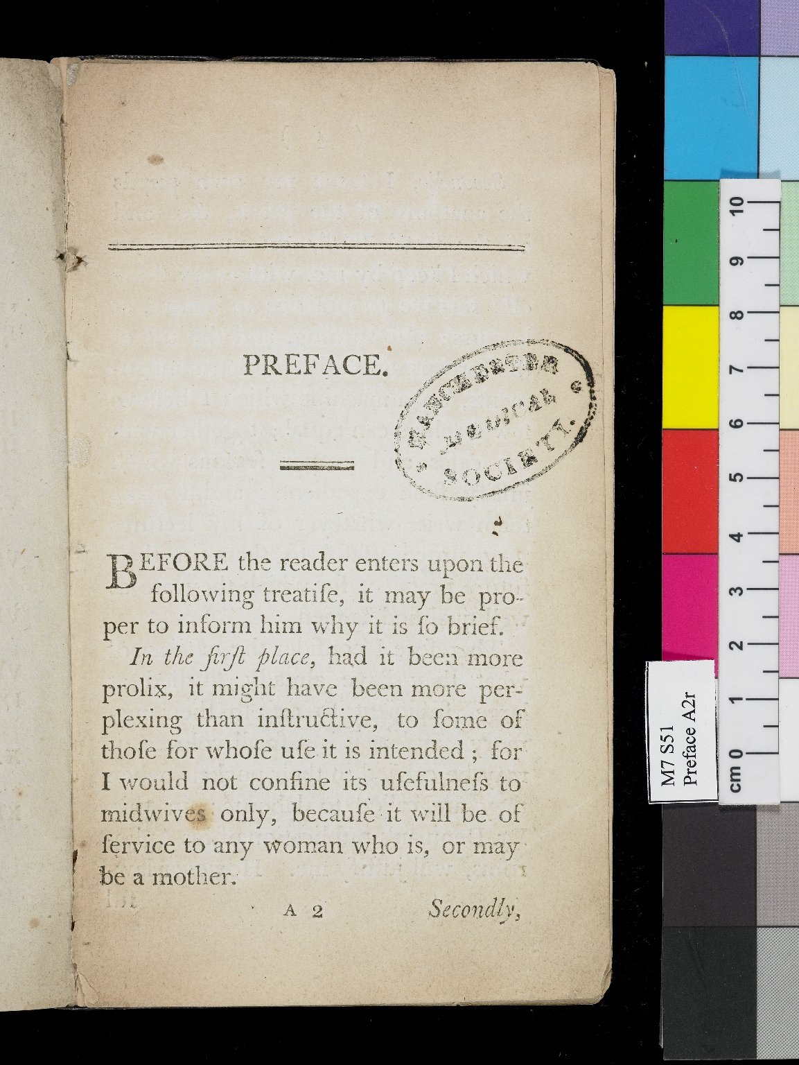
-------------
Image1
-------------
Field Data
Image Number JRL0803300dc
Reference Number Medical (1701-1800) M7 S51
Link to Catalogue <A href=http://man-fe.hosted.exlibrisgroup.com/MU_VU1:BLENDED:44MAN_ALMA_DS21180066400001631>UoM online catalogue.</a>
Image Title Preface
Parent Work Title Domestic midwife: or, the best means of preventing danger in child-birth
Creator Stephen, Margaret
Creator Role Author
Date Created 1795
Publication Details London : printed by S. W. Fores
Page/Sheet A2r
Image Sequence Number 000c
Description Page from the preface of the Domestic midwife: or, the best means of preventing danger in child-birth, by Margaret Stephen, "teacher of midwifery to females".
Language Code eng-GB
Subject Medicine--History
Subject Midwifery
Category of Material Printed
Support Paper
Time Period Covered 18th Century CE
Item Height 174 mm
Item Width 105 mm
Current Repository The University of Manchester Library, U.K.
Provenance Manchester Medical Society, former owner
Rights Holder - Image The University of Manchester Library
Rights holder - Work The University of Manchester Library
Date Captured (yyyy-mm-dd) 2007-11-23
Image Creation Technique Digital capture by Gten
Date Image Added (yyyy-mm) 2008-03
Metadata Language eng-GB

Slide 13
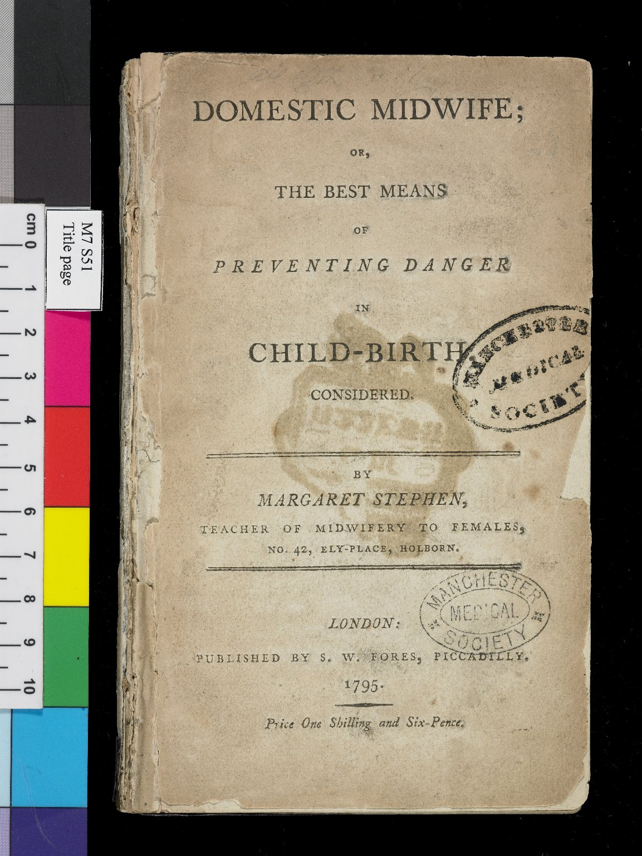
-------------
Image1
-------------
Field Data
Image Number JRL0803299dc
Reference Number Medical (1701-1800) M7 S51
Link to Catalogue <A href=http://man-fe.hosted.exlibrisgroup.com/MU_VU1:BLENDED:44MAN_ALMA_DS21180066400001631>UoM online catalogue.</a>
Image Title Title page
Parent Work Title Domestic midwife: or, the best means of preventing danger in child-birth
Creator Stephen, Margaret
Creator Role Author
Date Created 1795
Publication Details London : printed by S. W. Fores
Page/Sheet Title page
Image Sequence Number 000a
Description Title page of the Domestic midwife: or, the best means of preventing danger in child-birth, by Margaret Stephen, "teacher of midwifery to females".
Language Code eng-GB
Subject Medicine--History
Subject Midwifery
Category of Material Printed
Support Paper
Time Period Covered 18th Century CE
Item Height 174 mm
Item Width 105 mm
Current Repository The University of Manchester Library, U.K.
Provenance Manchester Medical Society, former owner
Rights Holder - Image The University of Manchester Library
Rights holder - Work The University of Manchester Library
Date Captured (yyyy-mm-dd) 2007-11-23
Image Creation Technique Digital capture by Gten
Date Image Added (yyyy-mm) 2008-03
Metadata Language eng-GB

Slide 14
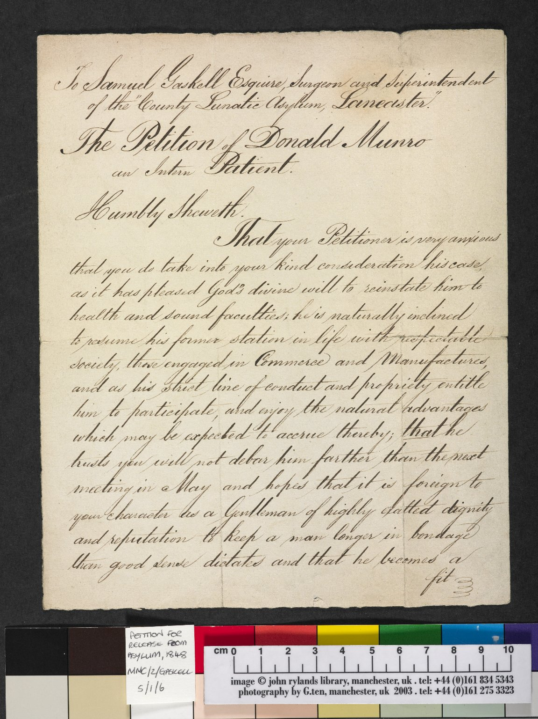
-------------
Image1
-------------
Field Data
Image Number JRL040070dc
Reference Number MMC/2/GaskellS/1/6
Link to Catalogue <a href="http://www.librarysearch.manchester.ac.uk/MU_VU1:BLENDED:44MAN_ELGAR_DSgb133mmc2a">Manchester Medical Collection: Biographical Files A-G</a>
Image Title Release Petition of Donald Munro
Parent Work Title Release Petition of Donald Munro
Date Created 1848
Page/Sheet 1
Image Sequence Number 001
Description Manchester Medical Collection. First page of a petition addressed to Samuel Gaskell, Surgeon and Superintendent of the County Lunatic Asylum in Lancaster for the release of intern patient Donald Munro.
Language Code eng-GB
Subject Medicine--History
Category of Material Archives
Technique Used Handwriting
Support Paper
Time Period Covered 19th Century CE
Current Repository The University of Manchester Library, U.K.
Rights Holder - Image The University of Manchester Library
Rights holder - Work The University of Manchester Library
Date Captured (yyyy-mm-dd) 2004-09-09
Image Creation Technique Digital capture by Gten
Metadata Language eng-GB

Slide 15
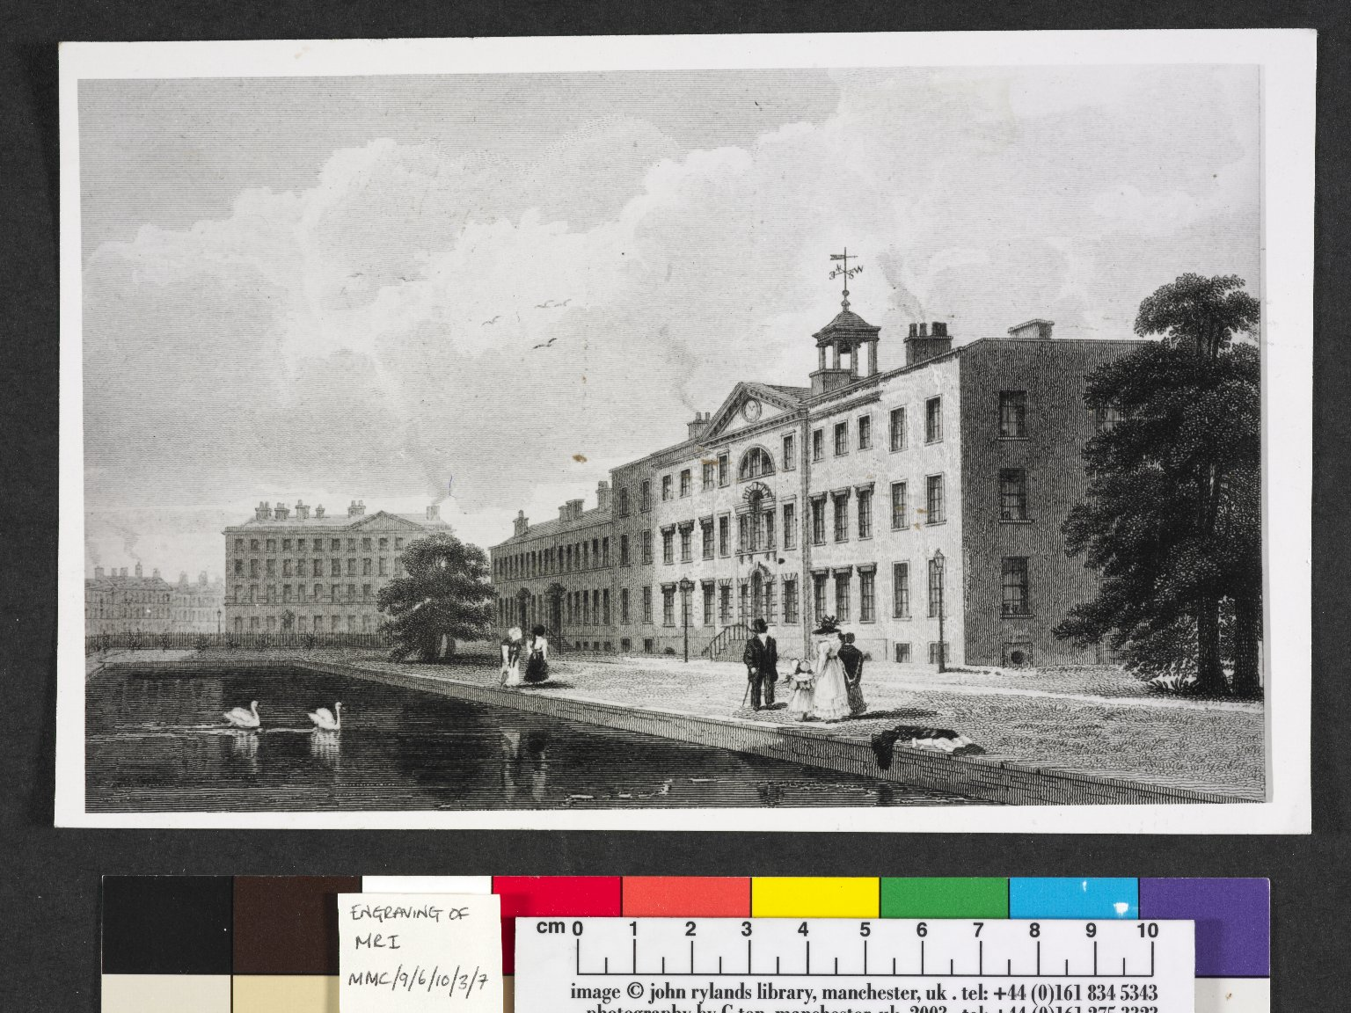
-------------
Image1
-------------
Field Data
Image Number JRL040060dc
Reference Number MMC/9/6/10/3/7
Link to Catalogue <a href="https://www.librarysearch.manchester.ac.uk/primo-explore/fulldisplay?docid=44MAN_ELGAR_DSead-gb133-mmc3-16#0000000&context=L&vid=MU_NUI&search_scope=BLENDED&tab=local&lang=en_US">The Manchester Medical Collection: Sections 3-16</a>
Image Title Manchester Royal Infirmary
Parent Work Title Manchester Royal Infirmary
Date Created [date not identified]
Description Engraving of Manchester Royal Infirmary, showing people walking in front of the Infirmary building, which has a pond with swans on situated in front of it.
Subject Hospitals
Subject Architecture
Subject Medicine
Category of Material Archives
Technique Used Engraving (printing process)
Places Covered England: Greater Manchester: Manchester
Current Repository The University of Manchester Library, U.K.
Rights Holder - Image The University of Manchester Library
Rights holder - Work The University of Manchester Library
Date Captured (yyyy-mm-dd) 2004-09-09
Image Creation Technique Digital capture by Gten
Metadata Language eng-GB

Slide 16
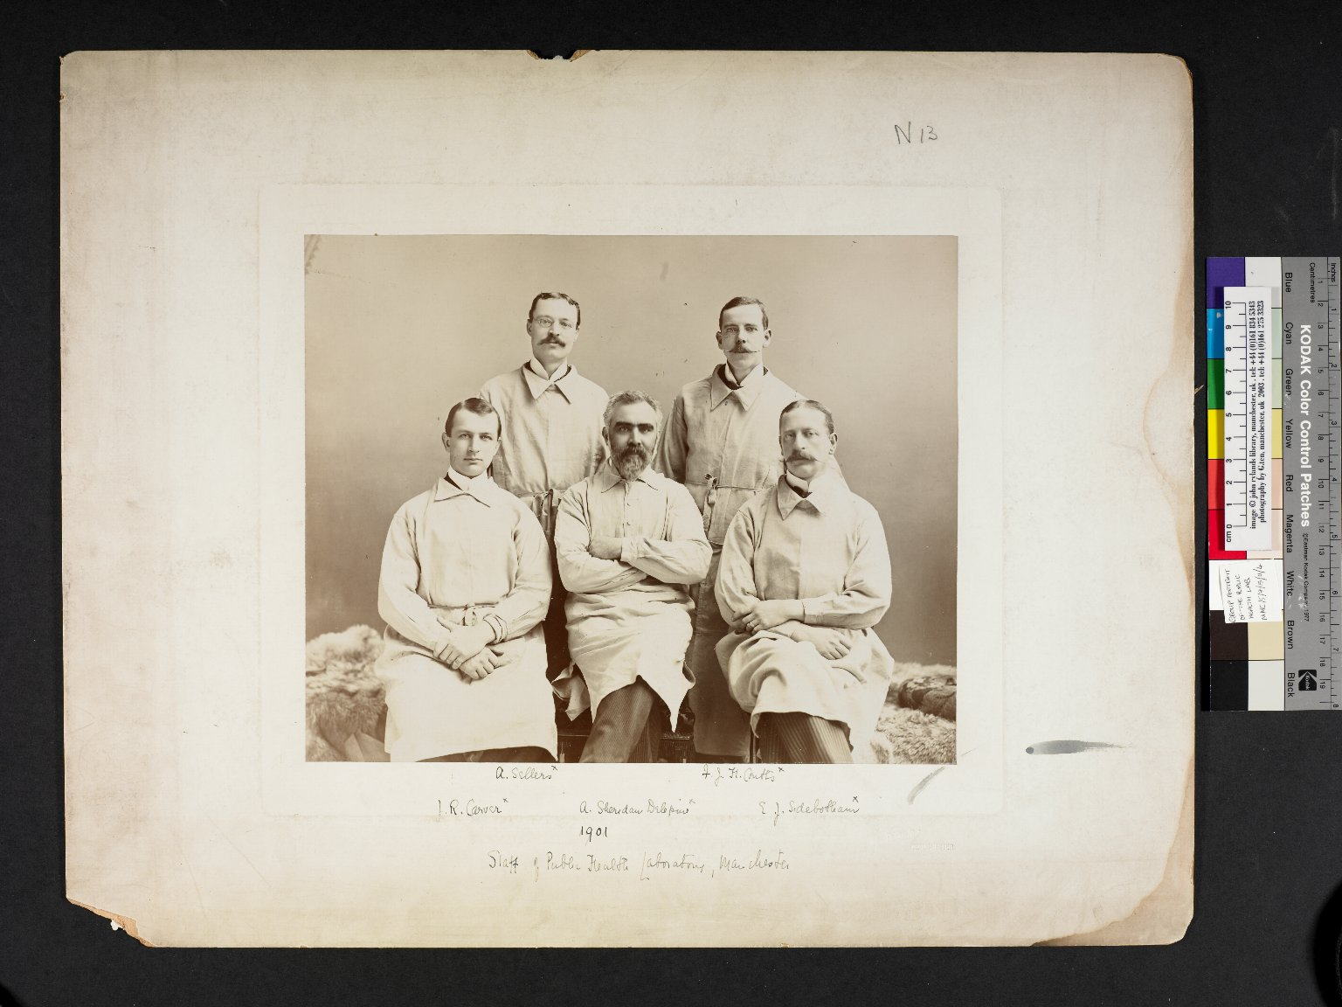
-------------
Image1
-------------
Field Data
Image Number JRL040066dc
Reference Number MMC/5/7/13/11/4
Link to Catalogue <a href="https://www.librarysearch.manchester.ac.uk/primo-explore/fulldisplay?docid=44MAN_ELGAR_DSead-gb133-mmc3-16#0000000&context=L&vid=MU_NUI&search_scope=BLENDED&tab=local&lang=en_US">The Manchester Medical Collection: Sections 3-16</a>
Image Title Staff of Public Health Laboratory, Manchester
Series Title Owens College/University of Manchester Medical School
Parent Work Title Public Health
Date Created 1901
Description Group portrait of five members of staff in the Public Health Labarotory, Manchester, in 1901. The photograph is annotated with the names of the five men: A. Sellers, J.R. Carver (d.1948), A. Sheridan Delepine (1855-1921), F.J.H. Coutts (1865-1949), E.J. Sidebotham (1860-1929).
Subject Medicine
Subject Medicine--History
Category of Material Archives
Sub-Category Analogue photography
Sub-Category Portraits
Support Paper
Time Period Covered 20th Century CE
Places Covered England: Greater Manchester: Manchester
Current Repository The University of Manchester Library, U.K.
Rights Holder - Image The University of Manchester Library
Rights holder - Work The University of Manchester Library
Access Rights <a rel="license" href="http://creativecommons.org/licenses/by-nc-sa/4.0/"><img alt="Creative Commons License" style="border-width:0" src="https://i.creativecommons.org/l/by-nc-sa/4.0/88x31.png" /></a><br />This work is licensed under a <a rel="license" href="http://creativecommons.org/licenses/by-nc-sa/4.0/">Creative Commons Attribution-NonCommercial-ShareAlike 4.0 International License.</a> Copyright of The University of Manchester
Image Creation Technique Digital capture by Gten
Metadata Language eng-GB

Slide 17
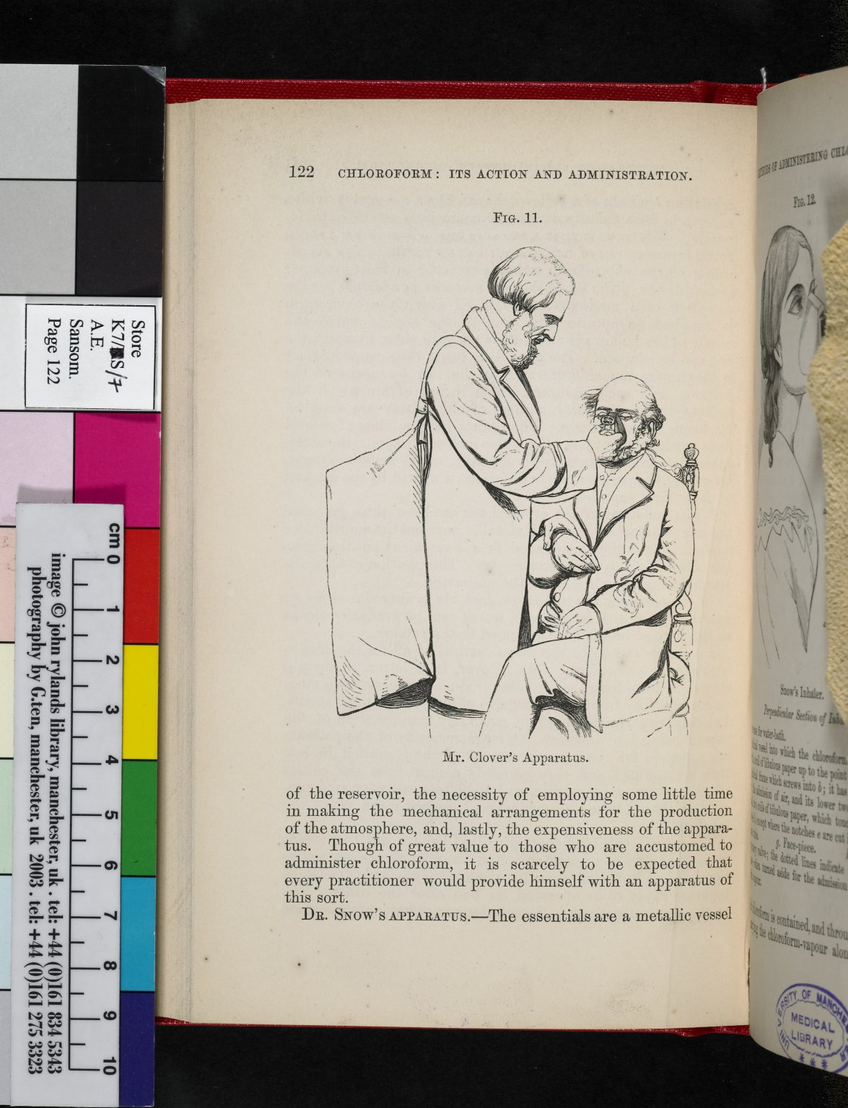
-------------
Image1
-------------
Field Data
Image Number JRL050327dc
Reference Number SCML Medical (1801-1949) K7 S7
Link to Catalogue <A href=http://man-fe.hosted.exlibrisgroup.com/MU_VU1:BLENDED:44MAN_ALMA_DS21211176930001631>UoM online catalogue.</a>
Image Title Mr Clover's apparatus
Parent Work Title Chloroform: it's action and administration, a handbook
Creator Sansom, Arthur Ernest
Creator Role Author
Date Created 1865
Page/Sheet 122
Image Sequence Number 122
Description Illustration: Depicting administration of chloroform to a patient via breathing apparatus.
Language Code eng-GB
Subject Anaesthetics
Subject Medicine
Subject Medicine--History
Category of Material Printed
Sub-Category Illustrated works
Support Paper
Time Period Covered 19th Century CE
Current Repository The University of Manchester Library, U.K.
Rights Holder - Image The University of Manchester Library
Rights holder - Work The University of Manchester Library
Date Captured (yyyy-mm-dd) 2005-01-18
Image Creation Technique Digital capture by Gten
Metadata Language eng-GB

Slide 18
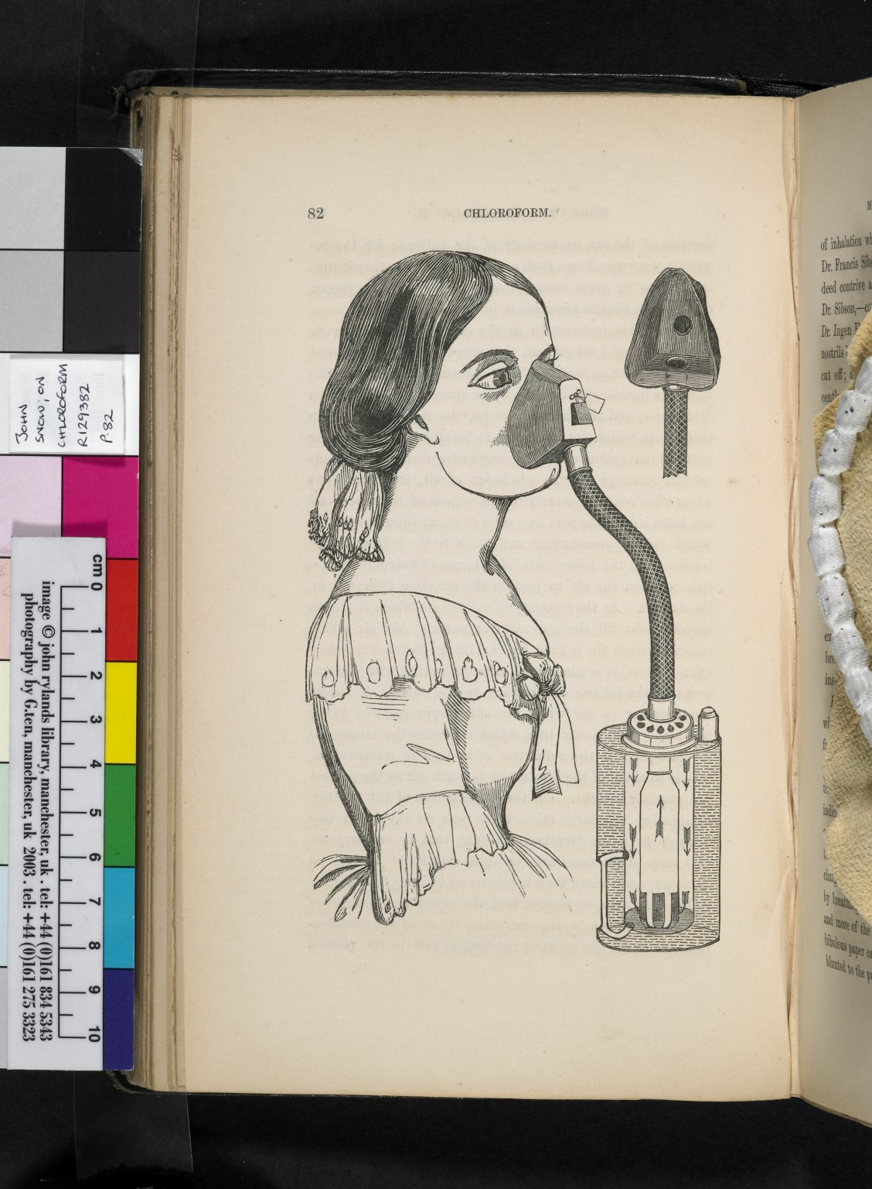
-------------
Image1
-------------
Field Data
Image Number JRL050324dc
Reference Number R129382
Link to Catalogue <A href=http://man-fe.hosted.exlibrisgroup.com/MU_VU1:BLENDED:44MAN_ALMA_DS21179959510001631>UoM online catalogue.</a>
Image Title Chloroform inhaler
Parent Work Title On chloroform and other anaesthetics: their action and administration
Creator Snow, John, 1813-1858
Creator Role Author
Date Created 1858
Publication Details London: J. Churchill
Page/Sheet 82
Description illustration of a chloroform inhaler.
Language Code eng-GB
Subject Medicine
Subject Anaesthetics
Subject Medicine--History
Category of Material Printed
Sub-Category Illustrated works
Support Paper
Time Period Covered 19th Century CE
Current Repository The University of Manchester Library, U.K.
Rights Holder - Image The University of Manchester Library
Rights holder - Work The University of Manchester Library
Date Captured (yyyy-mm-dd) 2005-01-18
Image Creation Technique Digital capture by Gten
Metadata Language eng-GB

Slide 19
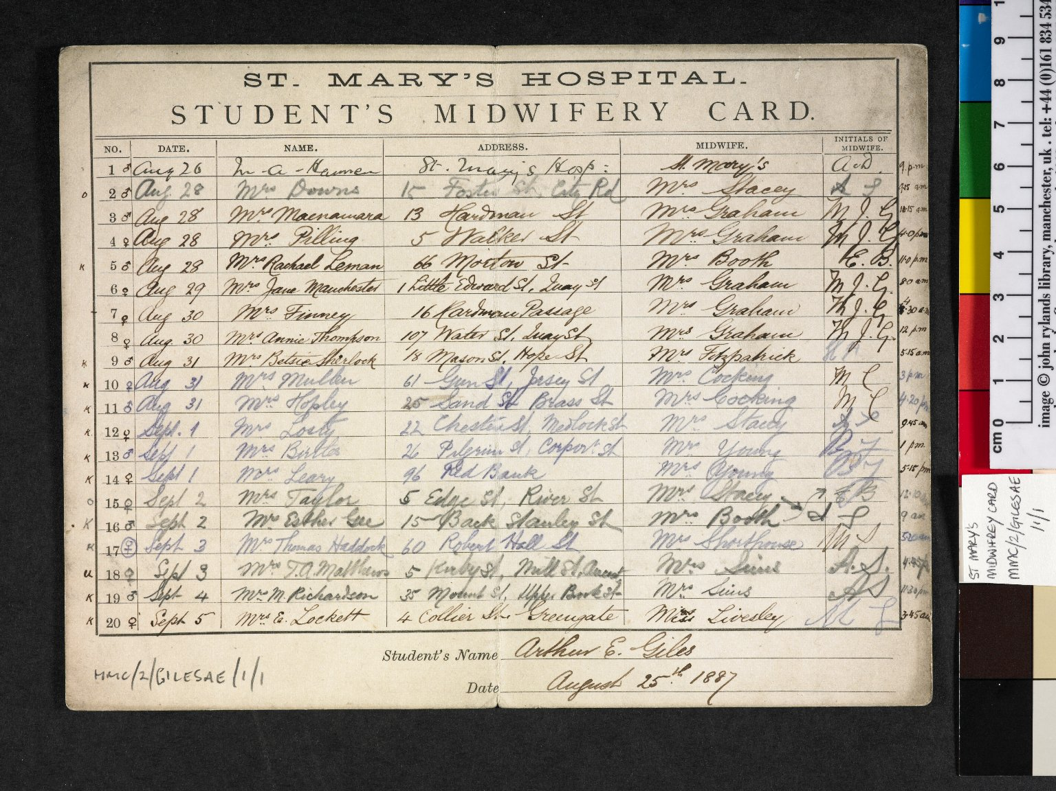
-------------
Image1
-------------
Field Data
Image Number JRL040071dc
Reference Number MMC/2/GilesAEJ/1/ 1
Link to Catalogue <a href="http://www.librarysearch.manchester.ac.uk/MU_VU1:BLENDED:44MAN_ELGAR_DSgb133mmc2a">Manchester Medical Collection: Biographical Files A-G</a>
Image Title St Mary's Hospital Student's Midwifery Card
Parent Work Title St Mary's Hospital Student's Midwifery Card
Date Created 1887-08-25
Description Carte de visite photographs of Bardsley by C.A. Duval and Co. , n.d. One signed by Bardsley. Slight differences in pose.
Language Code eng-GB
Subject Midwifery
Subject Medicine--History
Category of Material Archives
Technique Used Handwriting
Support Card
Time Period Covered 19th Century CE
Places Covered England: Greater Manchester: Manchester
Current Repository The University of Manchester Library, U.K.
Rights Holder - Image The University of Manchester Library
Rights holder - Work The University of Manchester Library
Date Captured (yyyy-mm-dd) 2004-09-09
Image Creation Technique Digital capture by Gten
Metadata Language eng-GB

Slide 20
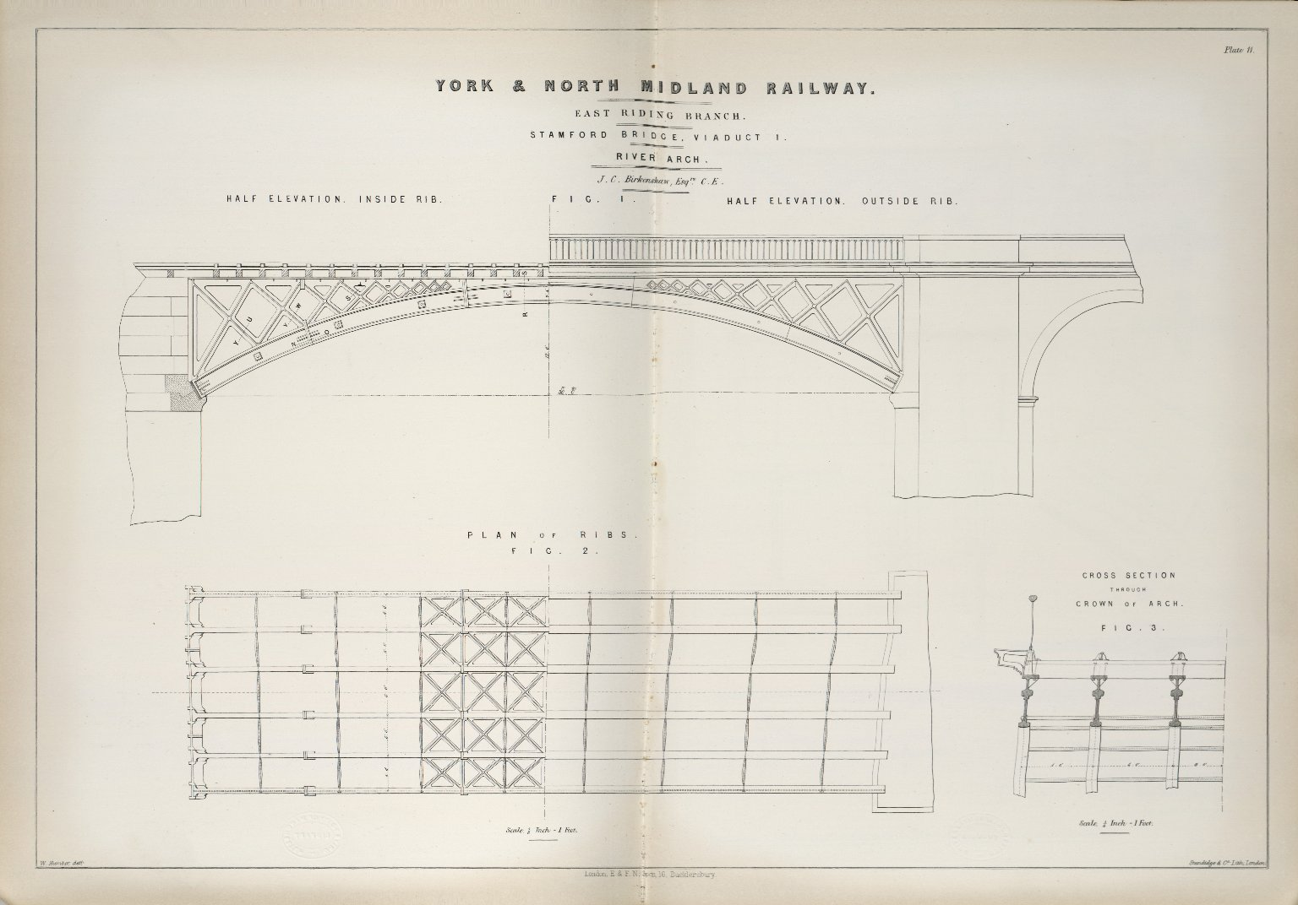
-------------
Image1
-------------
Field Data
Image Number JRL060238dc
Reference Number SCML UMIST 624.2 HUM
Link to Catalogue <A href=http://man-fe.hosted.exlibrisgroup.com/MU_VU1:BLENDED:44MAN_ALMA_DS21192883470001631>UoM online catalogue.</a>
Image Title Stamford Bridge, Viaduct 1: River Arch (York & North Midland Railway)
Parent Work Title A practical treatise on cast and wrought iron bridges and girders : as applied to railway structures, and to buildings generally, with numerous examples, drawn to a large scale, selected from the public works of the most eminent engineers
Creator Humber, William, 1821-1881
Creator Role Artist
Creator Role Author
Date Created 1857
Publication Details London: E. & F. N. Spon
Page/Sheet Plate 11
Image Sequence Number P011
Description York & North Midland Railway (East Riding Branch): Stamford Bridge, Viaduct 1: River Arch. Engineer: J.C. Birkenshaw.
Language Code eng-GB
Subject Girders
Subject Engineering
Subject Railroads
Subject Bridges
Category of Material Printed
Sub-Category Plans (drawings)
Technique Used Drawing (image-making)
Support Paper
Time Period Covered 19th Century CE
Places Covered England: Yorkshire: Stamford Bridge
People Covered Birkenshaw, J.C.
Item Height 366 mm
Item Width 526 mm
Current Repository The University of Manchester Library, U.K.
Provenance UMIST
Rights Holder - Image The University of Manchester Library
Rights holder - Work The University of Manchester Library
Date Captured (yyyy-mm-dd) 2005-08-12
Multi Page Number 65
Image Creation Technique Digital capture
Date Image Added (yyyy-mm) 2006-01
Metadata Language eng-GB

Slide 21
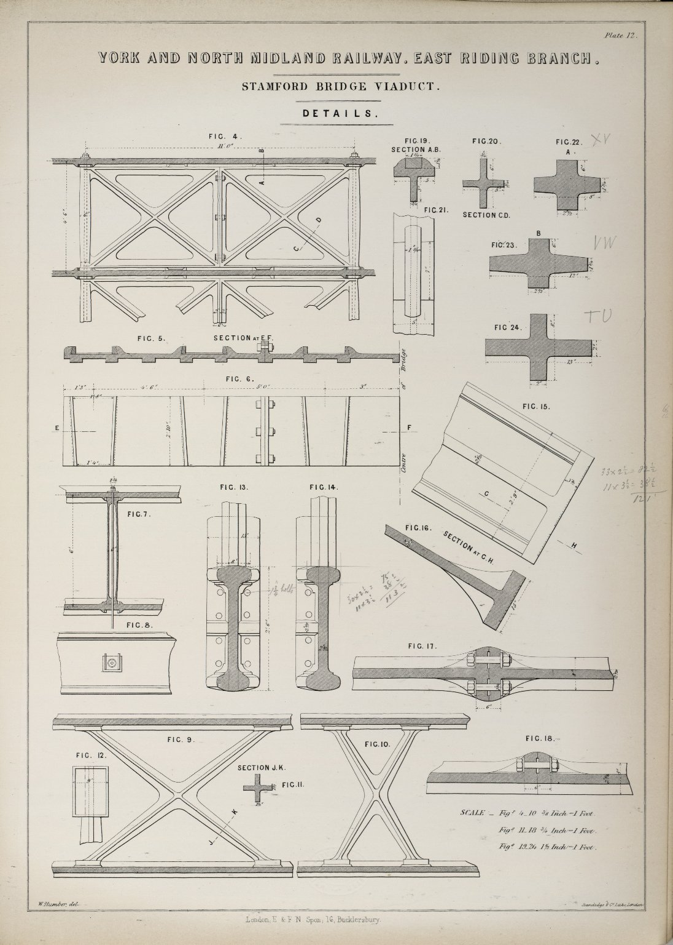
-------------
Image1
-------------
Field Data
Image Number JRL060239dc
Reference Number SCML UMIST 624.2 HUM
Link to Catalogue <A href=http://man-fe.hosted.exlibrisgroup.com/MU_VU1:BLENDED:44MAN_ALMA_DS21192883470001631>UoM online catalogue.</a>
Image Title Stamford Bridge Viaduct: Details (York & North Midland Railway)
Parent Work Title A practical treatise on cast and wrought iron bridges and girders : as applied to railway structures, and to buildings generally, with numerous examples, drawn to a large scale, selected from the public works of the most eminent engineers
Creator Humber, William, 1821-1881
Creator Role Artist
Creator Role Author
Date Created 1857
Publication Details London: E. & F. N. Spon
Page/Sheet Plate 12
Image Sequence Number P012
Description York & North Midland Railway (East Riding Branch): Stamford Bridge Viaduct: Details. Engineer: J.C. Birkenshaw.
Language Code eng-GB
Subject Girders
Subject Engineering
Subject Railroads
Subject Bridges
Category of Material Printed
Sub-Category Plans (drawings)
Technique Used Drawing (image-making)
Support Paper
Time Period Covered 19th Century CE
Places Covered England: Yorkshire: Stamford Bridge
People Covered Birkenshaw, J.C.
Item Height 366 mm
Item Width 263 mm
Current Repository The University of Manchester Library, U.K.
Provenance UMIST
Rights Holder - Image The University of Manchester Library
Rights holder - Work The University of Manchester Library
Date Captured (yyyy-mm-dd) 2005-08-12
Multi Page Number 70
Image Creation Technique Digital capture
Date Image Added (yyyy-mm) 2006-01
Metadata Language eng-GB

