Slide 1
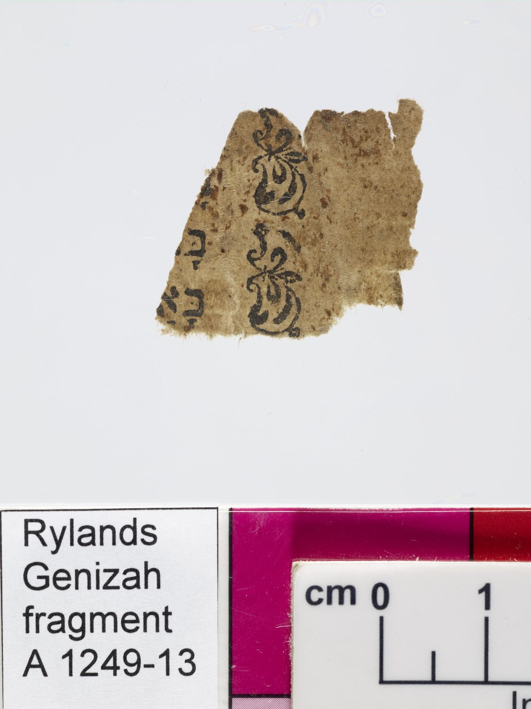
-------------
Image1
-------------
Field Data
Reference number A 1249 - 13
Obverse A 1249 - 14
Image Number JRL0800662dc
Image Title Printed text
Language Hebrew
Script Hebrew
Support material Paper
Item height 23 mm
Item width 25 mm
Folio 7 / 8 leaves, recto
Technique used Printing
Interrelation fragments A 1249-5/6 and A 1249-7/8 probably related; A 1249-9/10 and A 1249-13/14 from same print
Notes 2 lines. Includes doodles.
Discovery site Egypt: Cairo: Ben Ezra synagogue
Current repository The University of Manchester Library, U.K.
Former repository Moses Gaster
Category of Material Manuscripts
Sub-Category Fragments
Image rights The University of Manchester Library
Work rights The University of Manchester Library
Image sequence number A01249-013
Image technique Digital capture by Gten
Date image captured 2007-09-19
Date: added 2008-03
Metadata language eng-GB

Slide 2
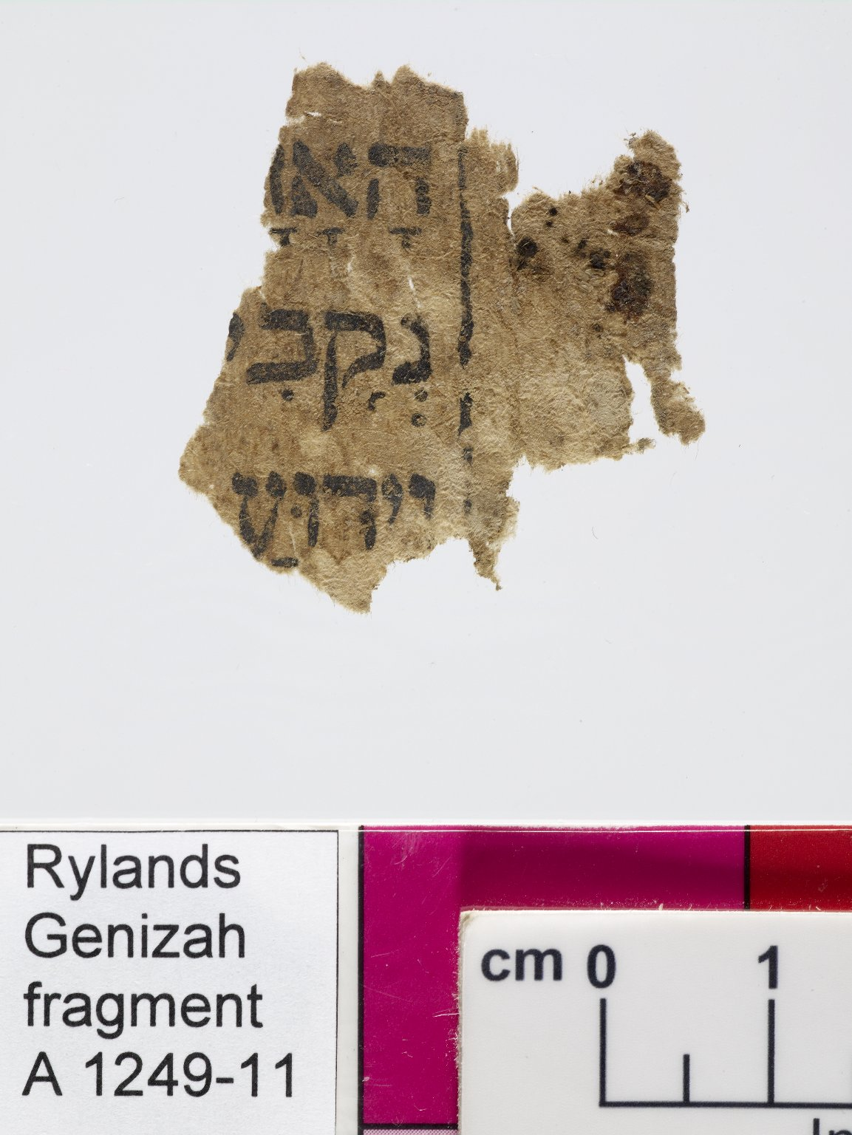
-------------
Image1
-------------
Field Data
Reference number A 1249 - 11
Obverse A 1249 - 12
Image Number JRL0800660dc
Image Title Printed text
Language Hebrew
Script Hebrew
Vocalisation Tiberian
Support material Paper
Item height 33 mm
Item width 40 mm
Folio 6 / 8 leaves, recto
Technique used Printing
Interrelation fragments A 1249-5/6 and A 1249-7/8 probably related; A 1249-9/10 and A 1249-13/14 from same print
Notes 3 lines
Discovery site Egypt: Cairo: Ben Ezra synagogue
Current repository The University of Manchester Library, U.K.
Former repository Moses Gaster
Category of Material Manuscripts
Sub-Category Fragments
Image rights The University of Manchester Library
Work rights The University of Manchester Library
Image sequence number A01249-011
Image technique Digital capture by Gten
Date image captured 2007-09-19
Date: added 2008-03
Metadata language eng-GB

Slide 3
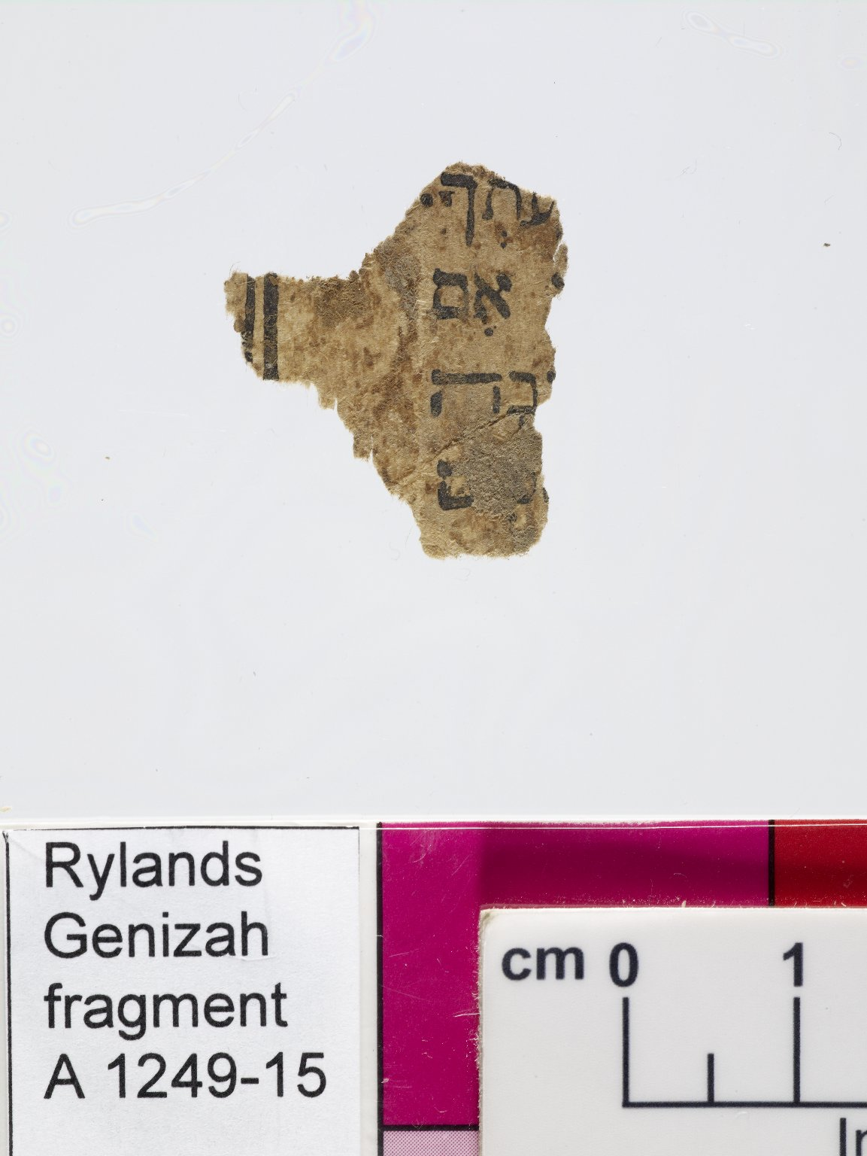
-------------
Image1
-------------
Field Data
Reference number A 1249 - 15
Obverse A 1249 - 16
Image Number JRL0800664dc
Image Title Printed text
Language Hebrew
Script Hebrew
Vocalisation Tiberian
Support material Paper
Item height 23 mm
Item width 24 mm
Folio 8 / 8 leaves, recto
Technique used Printing
Interrelation fragments A 1249-5/6 and A 1249-7/8 probably related; A 1249-9/10 and A 1249-13/14 from same print
Notes 4 lines
Discovery site Egypt: Cairo: Ben Ezra synagogue
Current repository The University of Manchester Library, U.K.
Former repository Moses Gaster
Category of Material Manuscripts
Sub-Category Fragments
Image rights The University of Manchester Library
Work rights The University of Manchester Library
Image sequence number A01249-015
Image technique Digital capture by Gten
Date image captured 2007-09-19
Date: added 2008-03
Metadata language eng-GB

Slide 4
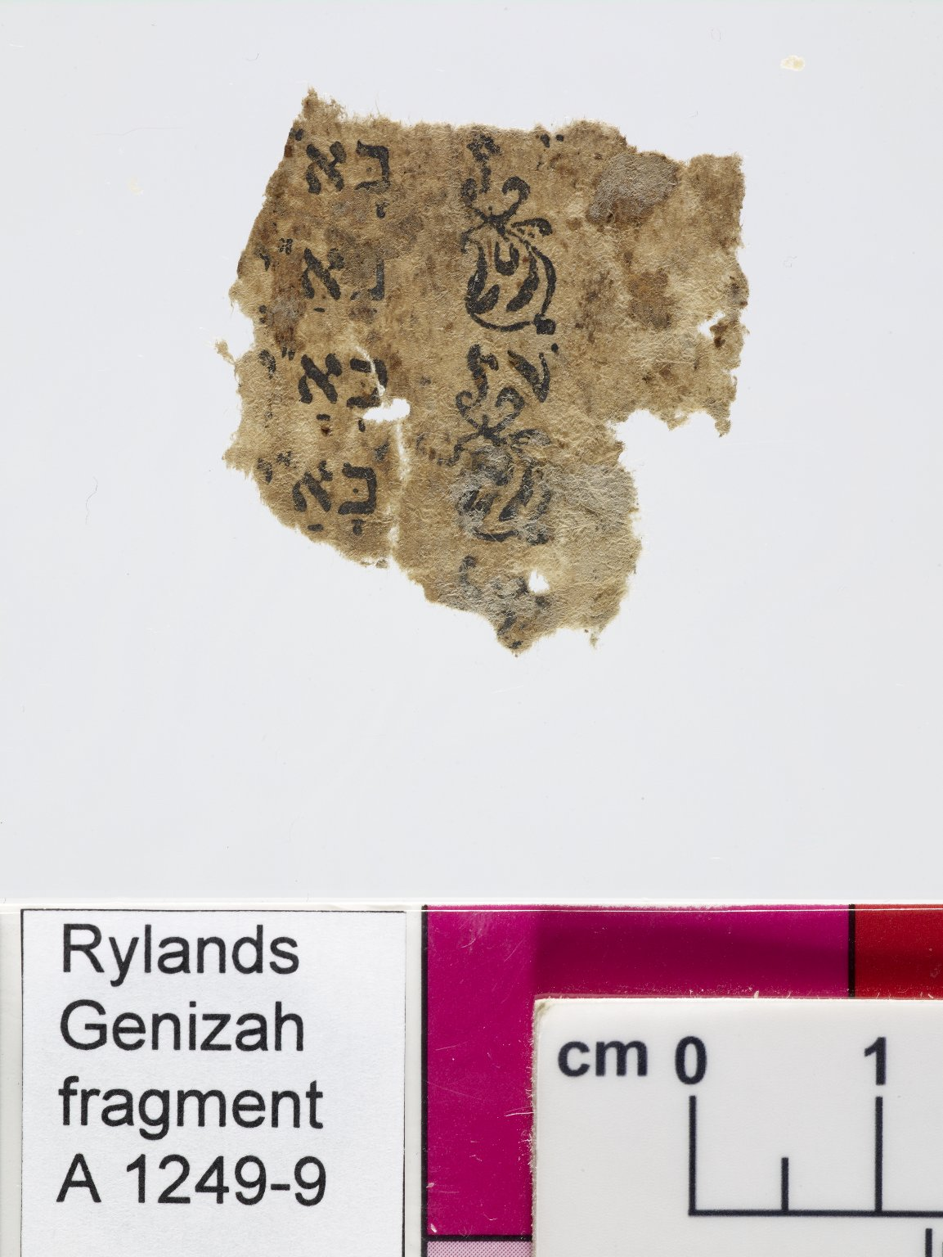
-------------
Image1
-------------
Field Data
Reference number A 1249 - 9
Obverse A 1249 - 10
Image Number JRL0800658dc
Image Title Printed text
Language Hebrew
Script Hebrew
Vocalisation Tiberian
Support material Paper
Item height 29 mm
Item width 28 mm
Folio 5 / 8 leaves, recto
Technique used Printing
Interrelation fragments A 1249-5/6 and A 1249-7/8 probably related; A 1249-9/10 and A 1249-13/14 from same print
Notes 4 lines. Includes doodles.
Discovery site Egypt: Cairo: Ben Ezra synagogue
Current repository The University of Manchester Library, U.K.
Former repository Moses Gaster
Category of Material Manuscripts
Sub-Category Fragments
Image rights The University of Manchester Library
Work rights The University of Manchester Library
Image sequence number A01249-009
Image technique Digital capture by Gten
Date image captured 2007-09-19
Date: added 2008-03
Metadata language eng-GB

Slide 5
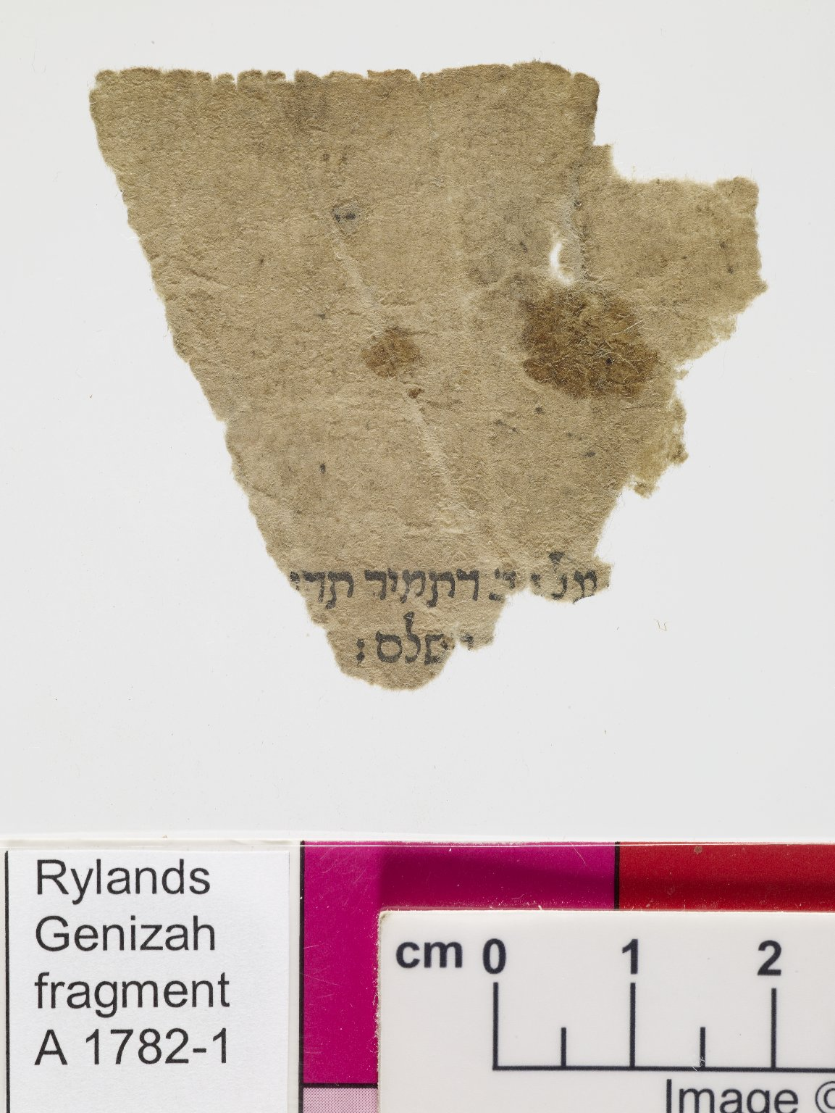
-------------
Image1
-------------
Field Data
Reference number A 1782 - 1
Obverse A 1782 - 2
Image Number JRL0801909dc
Image Title Printed text
Language Aramaic
Language Hebrew
Script Hebrew
Support material Paper
Item height 46 mm
Item width 48 mm
Folio 1 / 3 leaves, recto
Technique used Printing
Interrelation fragments Second and third A 1782 fragments from same manuscript
Notes 2 lines
Discovery site Egypt: Cairo: Ben Ezra synagogue
Current repository The University of Manchester Library, U.K.
Former repository Moses Gaster
Category of Material Manuscripts
Sub-Category Fragments
Image rights The University of Manchester Library
Work rights The University of Manchester Library
Access rights <a rel="license" href="http://creativecommons.org/licenses/by-nc-sa/4.0/"><img alt="Creative Commons License" style="border-width:0" src="https://i.creativecommons.org/l/by-nc-sa/4.0/88x31.png" /></a><br />This work is licensed under a <a rel="license" href="http://creativecommons.org/licenses/by-nc-sa/4.0/">Creative Commons Attribution-NonCommercial-ShareAlike 4.0 International License.</a> Copyright of The University of Manchester
Image sequence number A01782-1
Image technique Digital capture by Gten
Date image captured 2007-10-30
Date: added 2008-05
Metadata language eng-GB

Slide 6
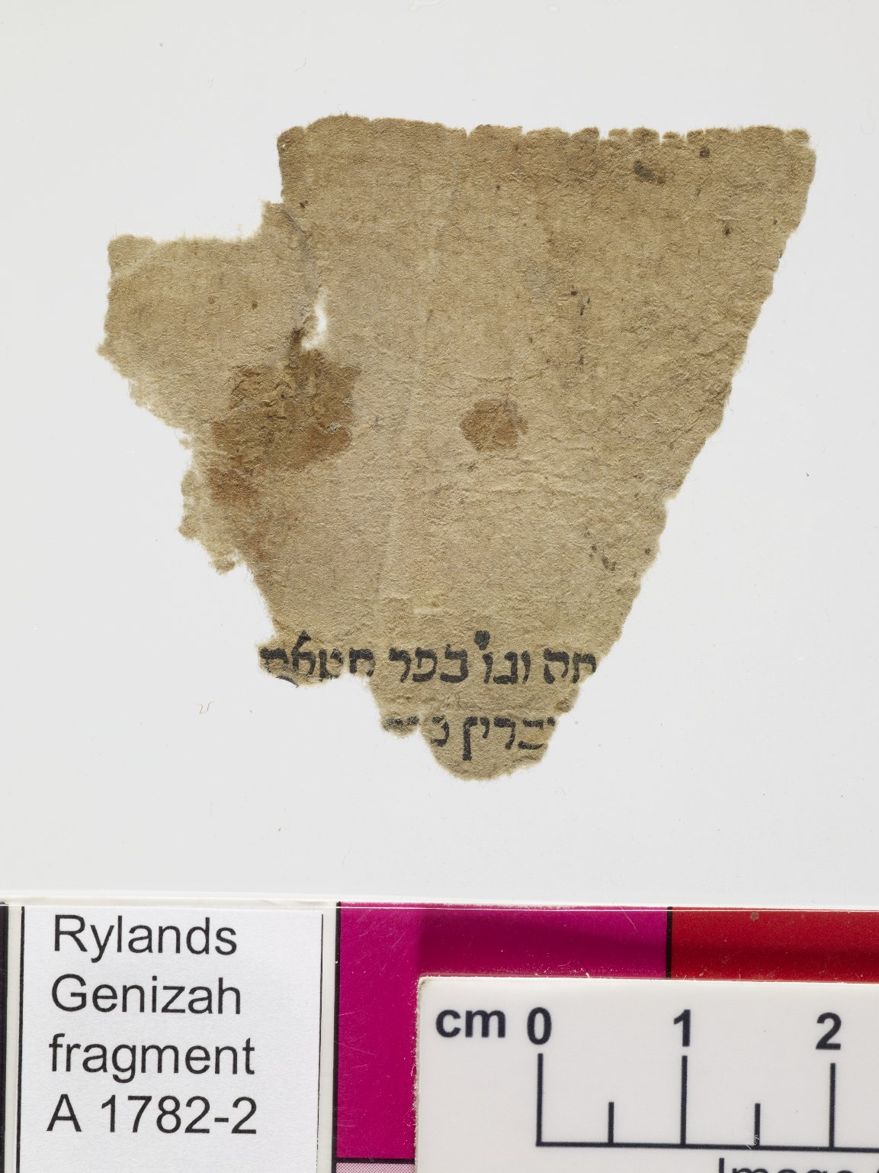
-------------
Image1
-------------
Field Data
Reference number A 1782 - 2
Obverse A 1782 - 1
Image Number JRL0801910dc
Image Title Printed text
Language Hebrew
Script Hebrew
Support material Paper
Item height 46 mm
Item width 48 mm
Folio 1 / 3 leaves, verso
Technique used Printing
Interrelation fragments Second and third A 1782 fragments from same manuscript
Notes 2 lines
Discovery site Egypt: Cairo: Ben Ezra synagogue
Current repository The University of Manchester Library, U.K.
Former repository Moses Gaster
Category of Material Manuscripts
Sub-Category Fragments
Image rights The University of Manchester Library
Work rights The University of Manchester Library
Access rights <a rel="license" href="http://creativecommons.org/licenses/by-nc-sa/4.0/"><img alt="Creative Commons License" style="border-width:0" src="https://i.creativecommons.org/l/by-nc-sa/4.0/88x31.png" /></a><br />This work is licensed under a <a rel="license" href="http://creativecommons.org/licenses/by-nc-sa/4.0/">Creative Commons Attribution-NonCommercial-ShareAlike 4.0 International License.</a> Copyright of The University of Manchester
Image sequence number A01782-2
Image technique Digital capture by Gten
Date image captured 2007-10-30
Date: added 2008-05
Metadata language eng-GB

Slide 7
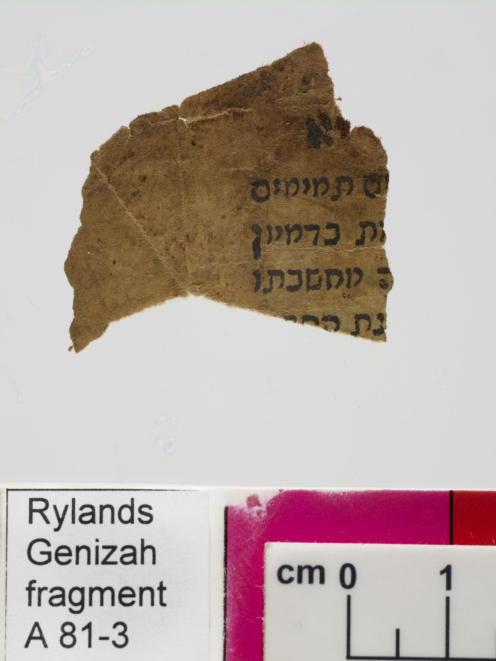
-------------
Image1
-------------
Field Data
Reference number A 81 - 3
Obverse A 81 - 4
Image Number JRL0708268dc
Image Title Printed text
Language Hebrew
Script Hebrew
Support material Paper
Item height 31 mm
Item width 23 mm
Folio 2 / 2 leaves, recto
Technique used Printing
Interrelation fragments A 81 fragments unrelated
Notes 5 lines
Discovery site Egypt: Cairo: Ben Ezra synagogue
Current repository The University of Manchester Library, U.K.
Former repository Moses Gaster
Category of Material Manuscripts
Sub-Category Fragments
Image rights The University of Manchester Library
Work rights The University of Manchester Library
Access rights <a rel="license" href="http://creativecommons.org/licenses/by-nc-sa/4.0/"><img alt="Creative Commons License" style="border-width:0" src="https://i.creativecommons.org/l/by-nc-sa/4.0/88x31.png" /></a><br />This work is licensed under a <a rel="license" href="http://creativecommons.org/licenses/by-nc-sa/4.0/">Creative Commons Attribution-NonCommercial-ShareAlike 4.0 International License.</a> Copyright of The University of Manchester
Image sequence number A00081-3
Image technique Digital capture by Gten
Date image captured 2007-06-05
Date: added 2007-10
Metadata language eng-GB

Slide 8
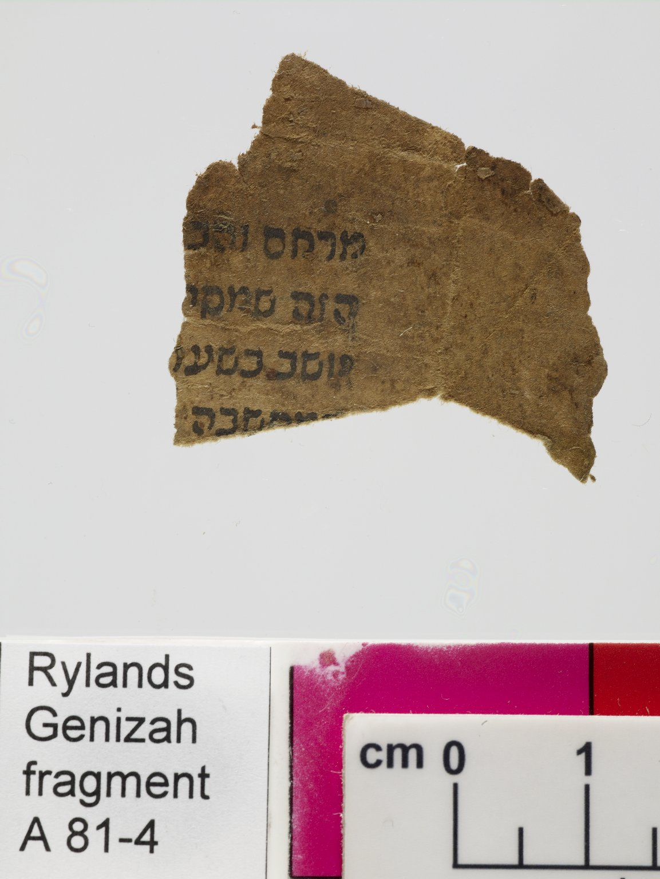
-------------
Image1
-------------
Field Data
Reference number A 81 - 4
Obverse A 81 - 3
Image Number JRL0708269dc
Image Title Printed text
Language Hebrew
Script Hebrew
Support material Paper
Item height 31 mm
Item width 23 mm
Folio 2 / 2 leaves, verso
Technique used Printing
Interrelation fragments A 81 fragments unrelated
Notes 4 lines
Discovery site Egypt: Cairo: Ben Ezra synagogue
Current repository The University of Manchester Library, U.K.
Former repository Moses Gaster
Category of Material Manuscripts
Sub-Category Fragments
Image rights The University of Manchester Library
Work rights The University of Manchester Library
Access rights <a rel="license" href="http://creativecommons.org/licenses/by-nc-sa/4.0/"><img alt="Creative Commons License" style="border-width:0" src="https://i.creativecommons.org/l/by-nc-sa/4.0/88x31.png" /></a><br />This work is licensed under a <a rel="license" href="http://creativecommons.org/licenses/by-nc-sa/4.0/">Creative Commons Attribution-NonCommercial-ShareAlike 4.0 International License.</a> Copyright of The University of Manchester
Image sequence number A00081-4
Image technique Digital capture by Gten
Date image captured 2007-06-05
Date: added 2007-10
Metadata language eng-GB

Slide 9
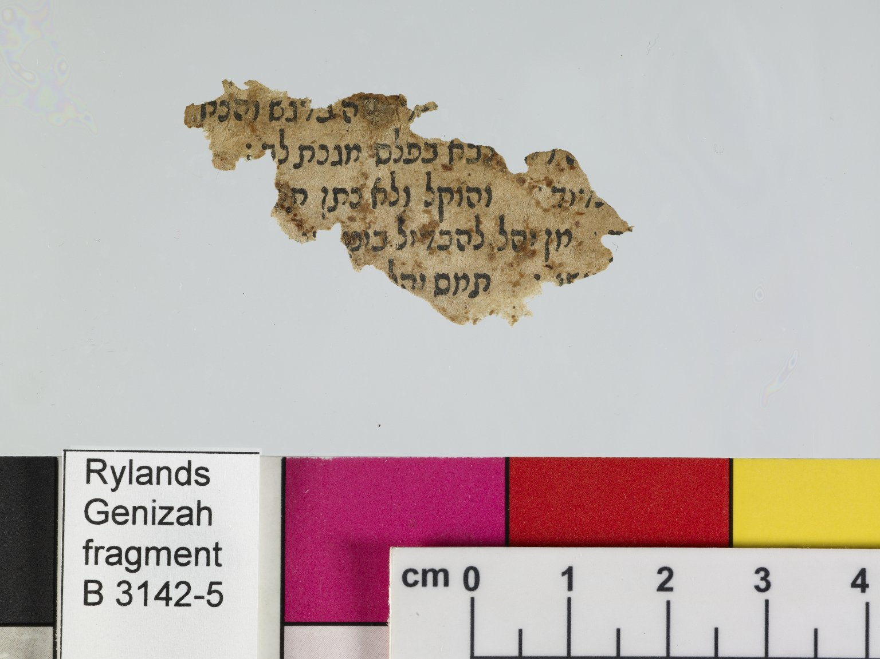
-------------
Image1
-------------
Field Data
Reference number B 3142 - 5
Obverse B 3142 - 6
Image Number JRL0702204dc
Image Title Printed text
Language Hebrew
Script Hebrew
Support material Paper
Item height 27 mm
Item width 45 mm
Folio 3 / 3 leaves, recto
Technique used Printing
Interrelation fragments B 3142 fragments unrelated
Notes 5 lines
Discovery site Egypt: Cairo: Ben Ezra synagogue
Current repository The University of Manchester Library, U.K.
Former repository Moses Gaster
Category of Material Manuscripts
Sub-Category Fragments
Image rights The University of Manchester Library
Work rights The University of Manchester Library
Access rights <a rel="license" href="http://creativecommons.org/licenses/by-nc-sa/4.0/"><img alt="Creative Commons License" style="border-width:0" src="https://i.creativecommons.org/l/by-nc-sa/4.0/88x31.png" /></a><br />This work is licensed under a <a rel="license" href="http://creativecommons.org/licenses/by-nc-sa/4.0/">Creative Commons Attribution-NonCommercial-ShareAlike 4.0 International License.</a> Copyright of The University of Manchester
Image sequence number B03142-5
Image technique Digital capture by Gten
Date image captured 2007-01-17
Date: added 2007-03
Metadata language eng-GB

Slide 10
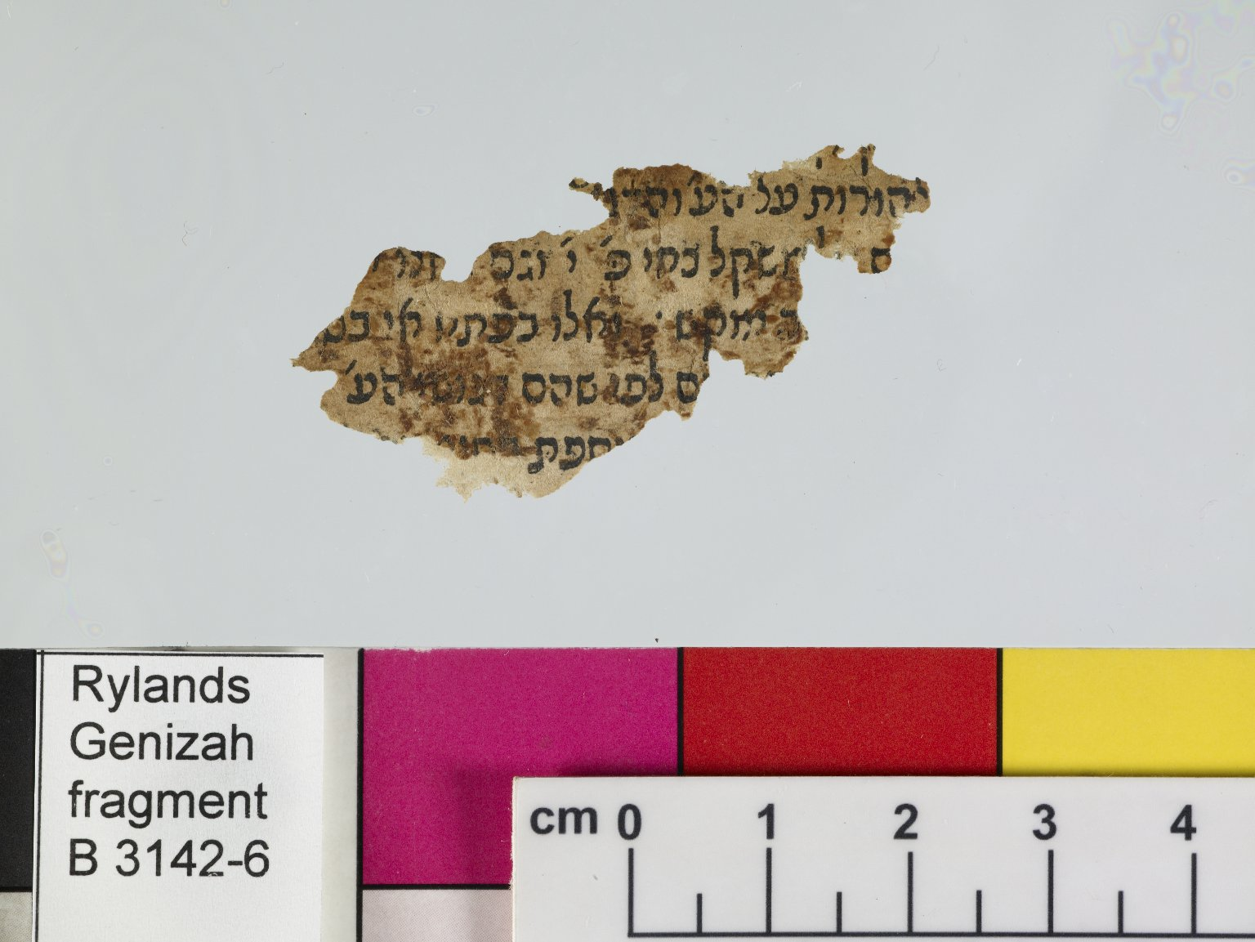
-------------
Image1
-------------
Field Data
Reference number B 3142 - 6
Obverse B 3142 - 5
Image Number JRL0702205dc
Image Title Printed text
Language Hebrew
Script Hebrew
Support material Paper
Item height 27 mm
Item width 45 mm
Folio 3 / 3 leaves, verso
Technique used Printing
Interrelation fragments B 3142 fragments unrelated
Notes 5 lines
Discovery site Egypt: Cairo: Ben Ezra synagogue
Current repository The University of Manchester Library, U.K.
Former repository Moses Gaster
Category of Material Manuscripts
Sub-Category Fragments
Image rights The University of Manchester Library
Work rights The University of Manchester Library
Access rights <a rel="license" href="http://creativecommons.org/licenses/by-nc-sa/4.0/"><img alt="Creative Commons License" style="border-width:0" src="https://i.creativecommons.org/l/by-nc-sa/4.0/88x31.png" /></a><br />This work is licensed under a <a rel="license" href="http://creativecommons.org/licenses/by-nc-sa/4.0/">Creative Commons Attribution-NonCommercial-ShareAlike 4.0 International License.</a> Copyright of The University of Manchester
Image sequence number B03142-6
Image technique Digital capture by Gten
Date image captured 2007-01-17
Date: added 2007-03
Metadata language eng-GB

Slide 11
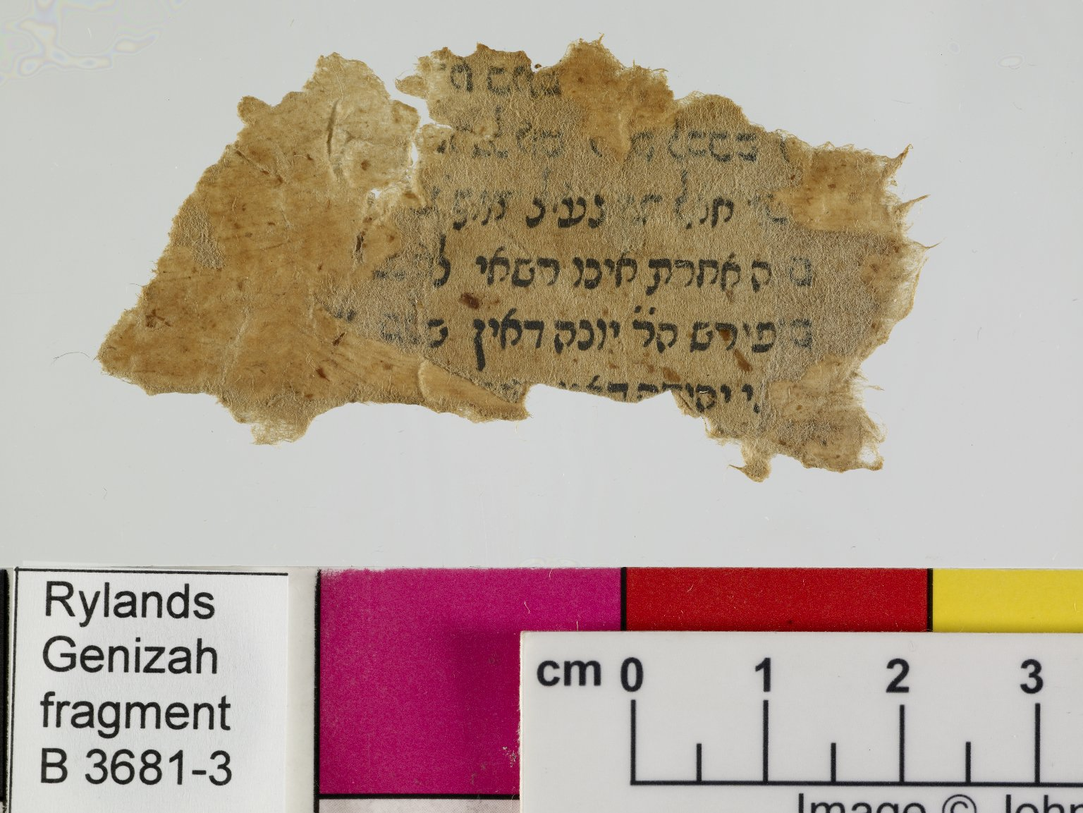
-------------
Image1
-------------
Field Data
Reference number B 3681 - 3
Obverse B 3681 - 4
Image Number JRL0703411dc
Image Title Printed text
Subject Talmud--Commentaries
Source title Tosafot?
Section Mo`ed katan 23a?
Language Aramaic
Language Hebrew
Script Hebrew
Support material Paper
Item height 33 mm
Item width 61 mm
Folio 2 / 2 leaves, recto
Technique used Printing
Interrelation fragments A 3681 fragments unrelated
Notes 6 lines
Discovery site Egypt: Cairo: Ben Ezra synagogue
Current repository The University of Manchester Library, U.K.
Former repository Moses Gaster
Category of Material Manuscripts
Sub-Category Fragments
Image rights The University of Manchester Library
Work rights The University of Manchester Library
Access rights <a rel="license" href="http://creativecommons.org/licenses/by-nc-sa/4.0/"><img alt="Creative Commons License" style="border-width:0" src="https://i.creativecommons.org/l/by-nc-sa/4.0/88x31.png" /></a><br />This work is licensed under a <a rel="license" href="http://creativecommons.org/licenses/by-nc-sa/4.0/">Creative Commons Attribution-NonCommercial-ShareAlike 4.0 International License.</a> Copyright of The University of Manchester
Image sequence number B03681-3
Image technique Digital capture by Gten
Date image captured 2007-02-14
Date: added 2007-06
Metadata language eng-GB

Slide 12
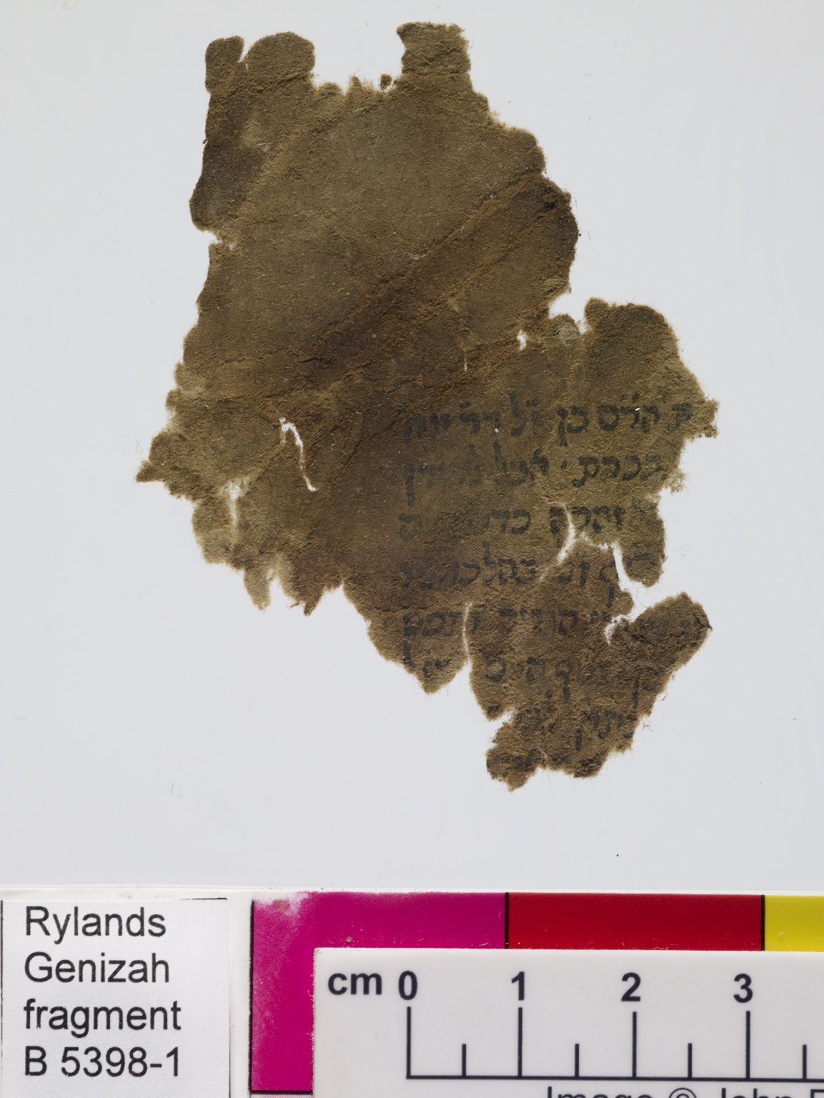
-------------
Image1
-------------
Field Data
Reference number B 5398 - 1
Obverse B 5398 - 2
Image Number JRL0707340dc
Image Title Printed text
Language Hebrew
Script Hebrew
Support material Paper
Item height 68 mm
Item width 52 mm
Folio 1 / 1 leaf, recto
Technique used Printing
Notes 7 lines
Discovery site Egypt: Cairo: Ben Ezra synagogue
Current repository The University of Manchester Library, U.K.
Former repository Moses Gaster
Category of Material Manuscripts
Sub-Category Fragments
Image rights The University of Manchester Library
Work rights The University of Manchester Library
Access rights <a rel="license" href="http://creativecommons.org/licenses/by-nc-sa/4.0/"><img alt="Creative Commons License" style="border-width:0" src="https://i.creativecommons.org/l/by-nc-sa/4.0/88x31.png" /></a><br />This work is licensed under a <a rel="license" href="http://creativecommons.org/licenses/by-nc-sa/4.0/">Creative Commons Attribution-NonCommercial-ShareAlike 4.0 International License.</a> Copyright of The University of Manchester
Image sequence number B05398-1
Image technique Digital capture by Gten
Date image captured 2007-05-16
Date: added 2007-09
Metadata language eng-GB

Slide 13
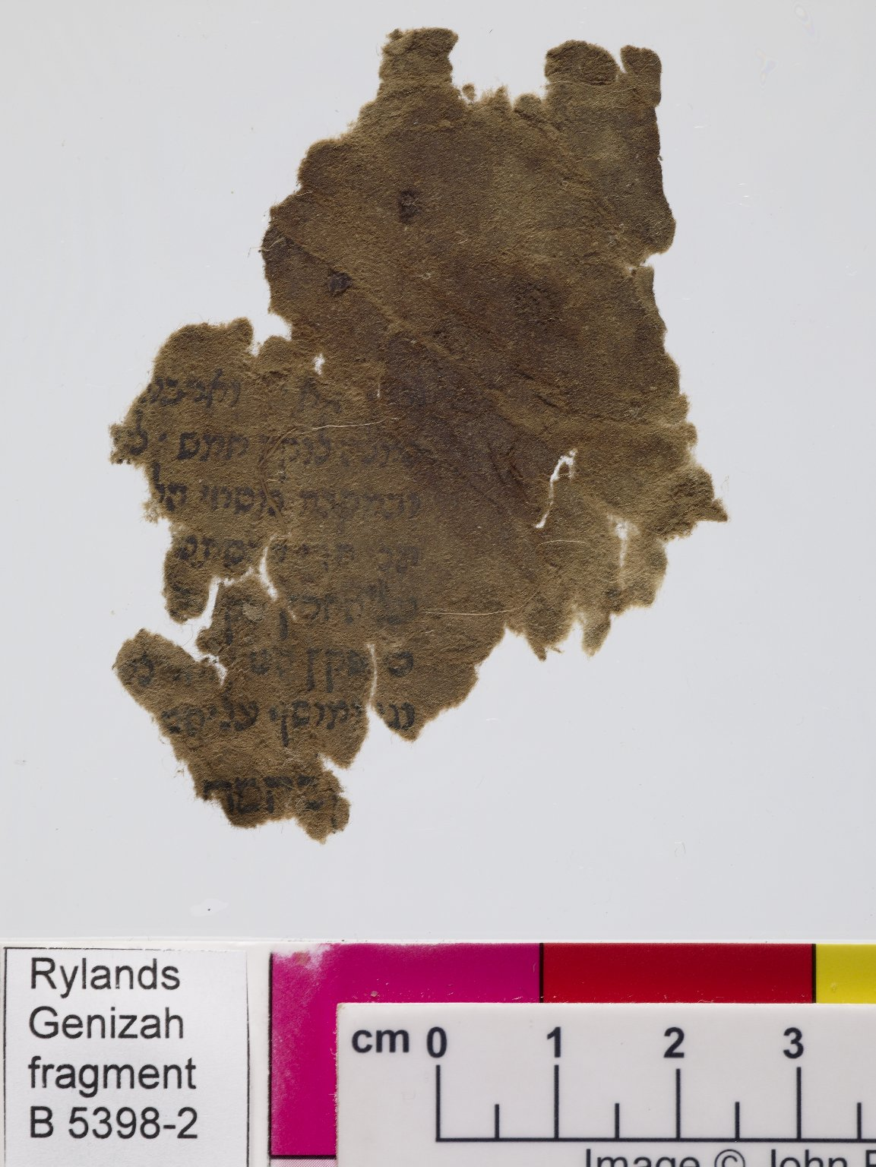
-------------
Image1
-------------
Field Data
Reference number B 5398 - 2
Obverse B 5398 - 1
Image Number JRL0707341dc
Image Title Printed text
Language Hebrew
Script Hebrew
Support material Paper
Item height 68 mm
Item width 52 mm
Folio 1 / 1 leaf, verso
Technique used Printing
Notes 8 lines
Discovery site Egypt: Cairo: Ben Ezra synagogue
Current repository The University of Manchester Library, U.K.
Former repository Moses Gaster
Category of Material Manuscripts
Sub-Category Fragments
Image rights The University of Manchester Library
Work rights The University of Manchester Library
Access rights <a rel="license" href="http://creativecommons.org/licenses/by-nc-sa/4.0/"><img alt="Creative Commons License" style="border-width:0" src="https://i.creativecommons.org/l/by-nc-sa/4.0/88x31.png" /></a><br />This work is licensed under a <a rel="license" href="http://creativecommons.org/licenses/by-nc-sa/4.0/">Creative Commons Attribution-NonCommercial-ShareAlike 4.0 International License.</a> Copyright of The University of Manchester
Image sequence number B05398-2
Image technique Digital capture by Gten
Date image captured 2007-05-16
Date: added 2007-09
Metadata language eng-GB

Slide 14
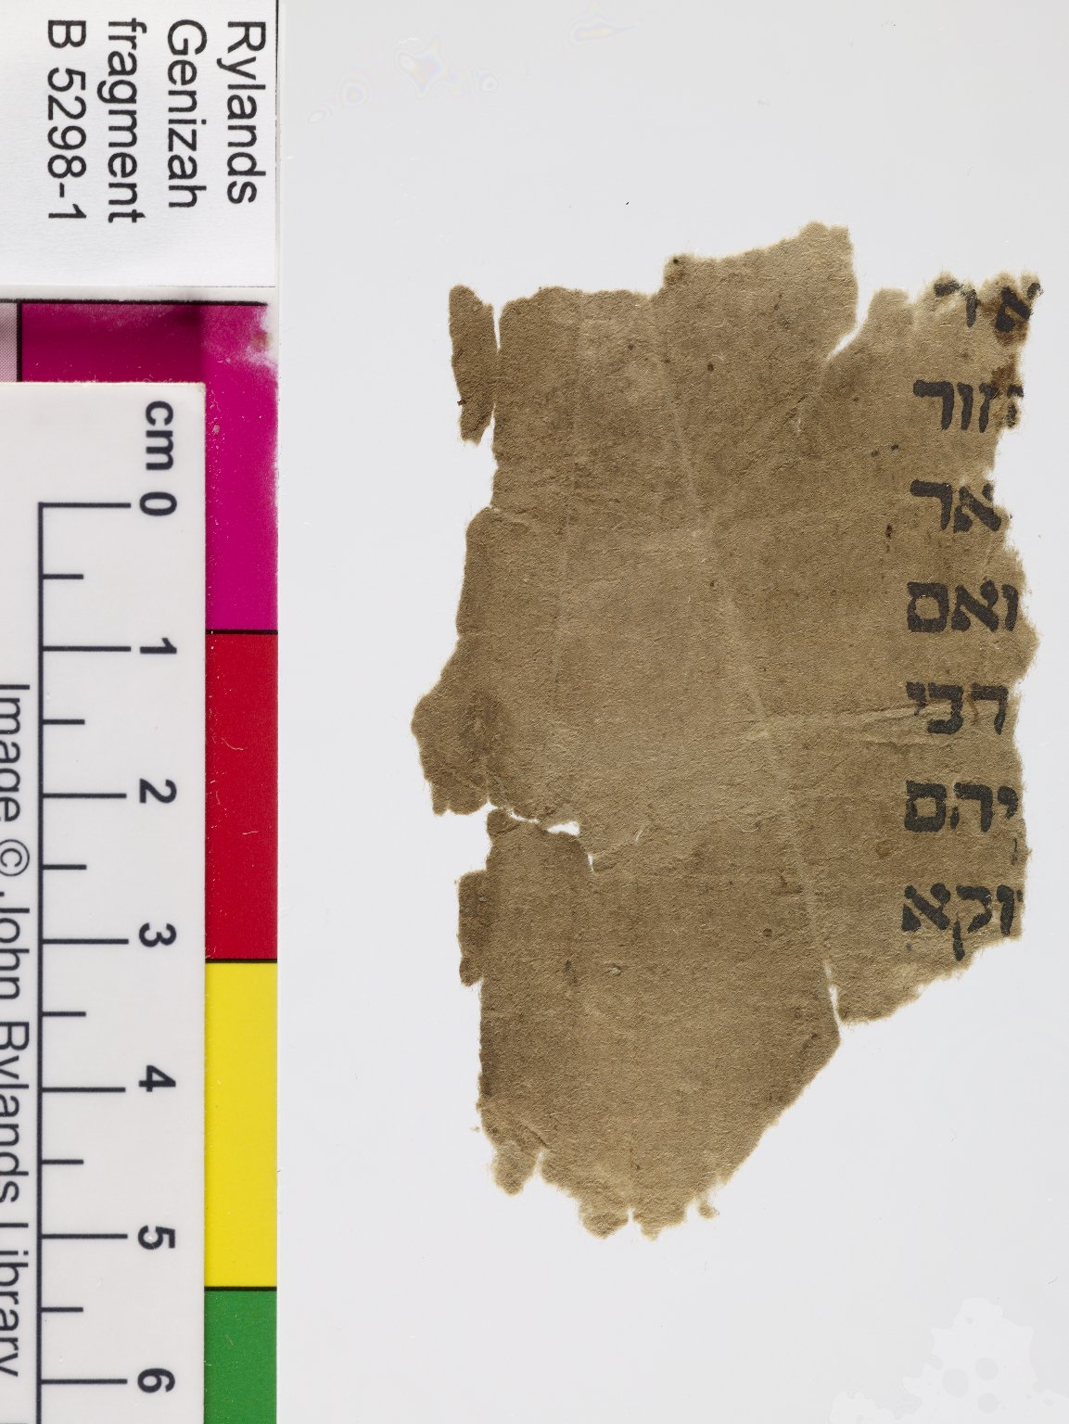
-------------
Image1
-------------
Field Data
Reference number B 5298 - 1
Obverse B 5298 - 2
Image Number JRL0707132dc
Image Title Printed text
Language Hebrew
Script Hebrew
Support material Paper
Item height 70 mm
Item width 43 mm
Folio 1 / 1 leaf, recto
Technique used Printing
Notes 7 lines
Discovery site Egypt: Cairo: Ben Ezra synagogue
Current repository The University of Manchester Library, U.K.
Former repository Moses Gaster
Category of Material Manuscripts
Sub-Category Fragments
Image rights The University of Manchester Library
Work rights JRUL
Access rights <a rel="license" href="http://creativecommons.org/licenses/by-nc-sa/4.0/"><img alt="Creative Commons License" style="border-width:0" src="https://i.creativecommons.org/l/by-nc-sa/4.0/88x31.png" /></a><br />This work is licensed under a <a rel="license" href="http://creativecommons.org/licenses/by-nc-sa/4.0/">Creative Commons Attribution-NonCommercial-ShareAlike 4.0 International License.</a> Copyright of The University of Manchester
Image sequence number B05298-1
Image technique Digital capture by Gten
Date image captured 2007-05-11
Date: added 2007-09
Metadata language eng-GB

