Slide 1
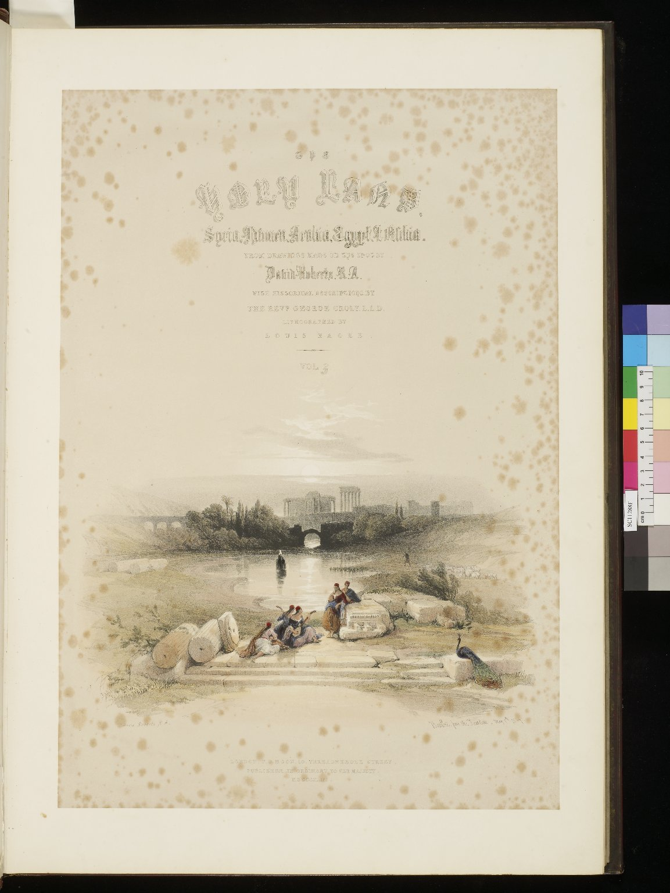
-------------
Image1
-------------
Field Data
Image Number JRL0806558dc
Reference Number SC11288F
Link to Catalogue <A href=http://man-fe.hosted.exlibrisgroup.com/MU_VU1:BLENDED:44MAN_ALMA_DS21155090390001631>UoM online catalogue.</a>
Image Title Baalbec from the fountain
Parent Work Title The Holy Land, Syria, Idumea, Arabia, Egypt & Nubia: from drawings made on the spot
Alternative Parent Work Title The Holy Land
Creator Roberts, David, 1796-1864
Creator Role Artist
Creator Haghe, Louis, 1806-1885
Creator Role Lithographer
Creator Croly, George, 1780-1860
Creator Role Author
Date Created 1839-05-07
Publication Details London : F.G. Moon
Volume 3
Page/Sheet Title page
Image Sequence Number 3-000
Description Title page to volume three: 'Baalbec from the fountain', depicting a group of people sat on ruins in the foreground; directly in the background is a small lake with more ruins visible behind it.
Language Code eng-GB
Subject Lebanon--Description and travel
Category of Material Printed
Sub-Category Illustrated works
Technique Used Lithography
Support Paper
Time Period Covered 19th Century CE
Places Covered Lebanon: Balabakk
Item Height 555 mm
Item Width 430 mm
Current Repository The University of Manchester Library, U.K.
Rights Holder - Image The University of Manchester Library
Rights holder - Work The University of Manchester Library
Notes Copy at SC11288F: This copy has the lithographs hand-coloured and mounted and is bound in 4 vol. The volumes are bound in red morocco, with elaborate gilt-tooled decorated spine and borders: as centrepiece one of the coats of arms of the Knights of Malta (reproducing one of the illustrations in the text).
Date Captured (yyyy-mm-dd) 2008-04-18
Image Creation Technique Digital capture by Gten
Date Image Added (yyyy-mm) 2008-08
Metadata Language eng-GB

Slide 2
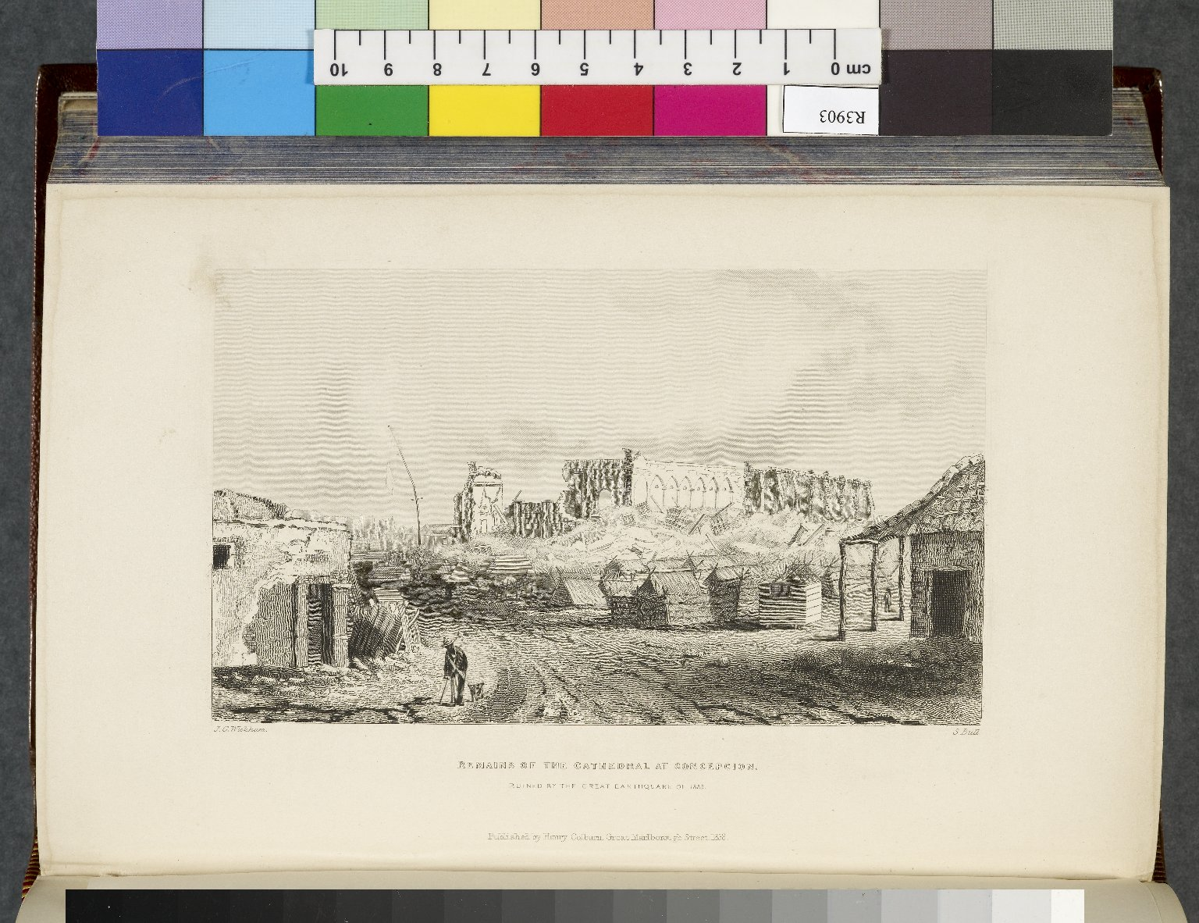
-------------
Image1
-------------
Field Data
Image Number JRL0807595dc
Reference Number R3903
Link to Catalogue <A href=http://man-fe.hosted.exlibrisgroup.com/MU_VU1:BLENDED:44MAN_ALMA_DS21134677540001631>UoM online catalogue.</a>
Image Title Remains of the Cathedral at Concepcion
Parent Work Title Narrative of the surveying voyages of His Majesty's ships Adventure and Beagle, between the years 1826 and 1836, : describing their examination of the southern shores of South America, and the Beagle's circumnavigation of the globe. In three volumes.
Creator Fitzroy, Robert, 1805-1865
Creator Role Author
Creator Wickham, John
Creator Role Artist
Date Created 1839
Publication Details London : H. Colburn
Volume 2
Page/Sheet Opposite page 405
Image Sequence Number 2-405
Description Illustration: Remains of the Cathedral at Concepcion, ruined by the great earthquake of 1835.
Language Code eng-GB
Subject Chile--Description and travel
Subject Church buildings
Subject Earthquakes
Category of Material Printed
Sub-Category Illustrated works
Technique Used Drawing (image-making)
Support Paper
Time Period Covered 19th Century CE
Places Covered Chile: Concepcion
Item Height 223 mm
Item Width 130 mm
Current Repository The University of Manchester Library, U.K.
Rights Holder - Image The University of Manchester Library
Rights holder - Work The University of Manchester Library
Date Captured (yyyy-mm-dd) 2008-05-16
Image Creation Technique Digital capture by Gten
Date Image Added (yyyy-mm) 2008-09
Metadata Language eng-GB

Slide 3
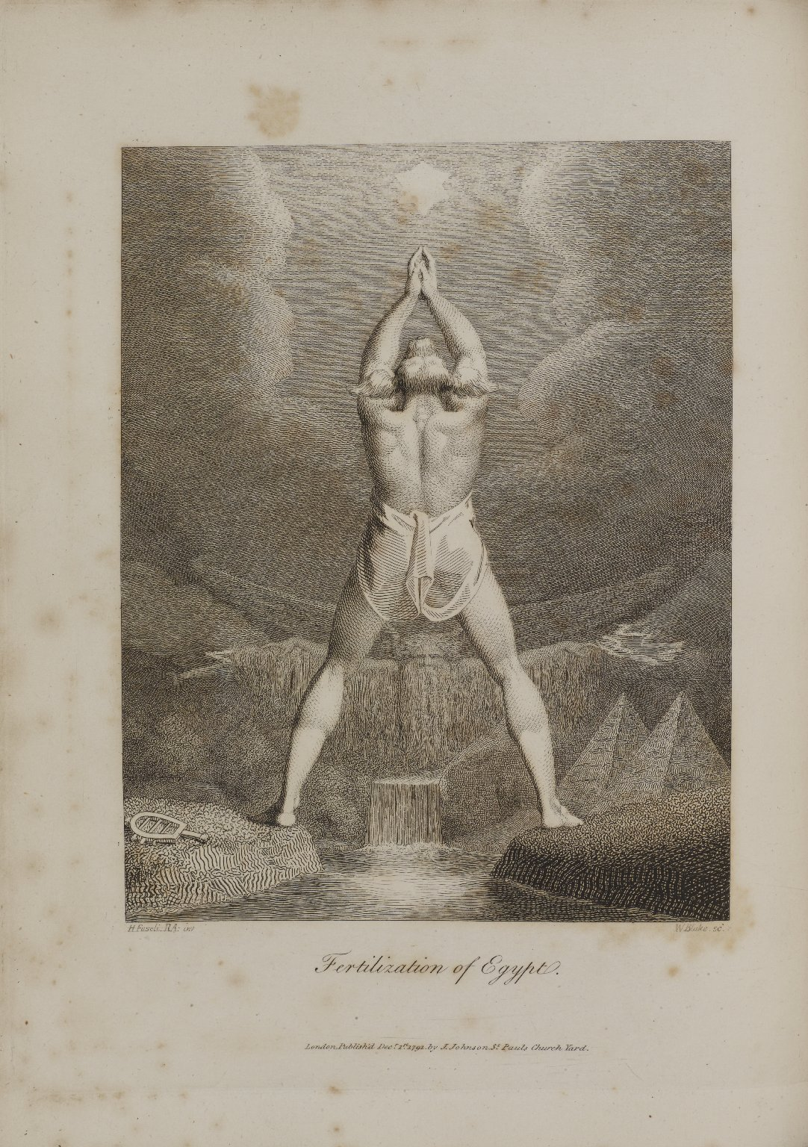
-------------
Image1
-------------
Field Data
Image Number JRL1310908
Reference Number Spencer 7969.1
Link to Catalogue <A href=http://man-fe.hosted.exlibrisgroup.com/MU_VU1:BLENDED:44MAN_ALMA_DS21157794940001631>UoM online catalogue</a>
Image Title Fertilization of Egypt
Parent Work Title The botanic garden: a poem, in two parts
Creator Darwin, Erasmus, 1731-1802
Creator Role Author
Creator Blake, William, 1757-1827
Creator Role Engraver
Creator Fuseli, Henry, 1741-1825
Creator Role Artist
Date Created 1791
Publication Details London: J. Johnson
Page/Sheet 127
Description Monochrome shaded line drawing from 'The Economy of Vegetation' in Darwin's 'Botanic Garden', The figure in the centre is the jackal-headed god Anubis, praying to the dog-star Sirius for rain. In his notes to the poem, Darwin explains that in Egyptian mythology, because the annual 'monsoon' of the Nile coincided with rise of the dog-Star, it was associated with the dog-god Anubis. In the background, above the river, is the figure of Jupitus Pluvius, the rain-giver. He is shown as a bearded old man with his arms outstretched. On the ground near Anubis' left foot is a sistrum, a musical instrument, included from Fuseli's drawing: Anubis has cast aside art to worship the rain-giver. Bottom left says: 'H. Fuseli RA: inv, bottom right says: 'W Blake, SC.' At the foot of the image is printed: 'London, Publish'd Dec.r 1st 1791. by J. Johnson, St Pauls Church .'.
Language Code eng-GB
Language English
Subject Mythology
Category of Material Printed
Sub-Category Bookplates
Medium Ink
Support Paper
Places Covered Egypt
Item Height 290 mm
Item Width 222 mm
Current Repository The University of Manchester Library, U.K.
Provenance Spencer, George John Spencer, Earl, 1758-1834, former owner
Rights Holder - Image The University of Manchester Library
Rights holder - Work The University of Manchester Library
Access Rights <a rel="license" href="http://creativecommons.org/licenses/by-nc-sa/4.0/"><img alt="Creative Commons License" style="border-width:0" src="https://i.creativecommons.org/l/by-nc-sa/4.0/88x31.png" /></a>
Date Captured (yyyy-mm-dd) 2013-05-20
Image Creation Technique Digital capture by Heritage Imaging, The University of Manchester Library
Date Image Added (yyyy-mm) 2013-06
Metadata Language eng-GB

