Slide 2
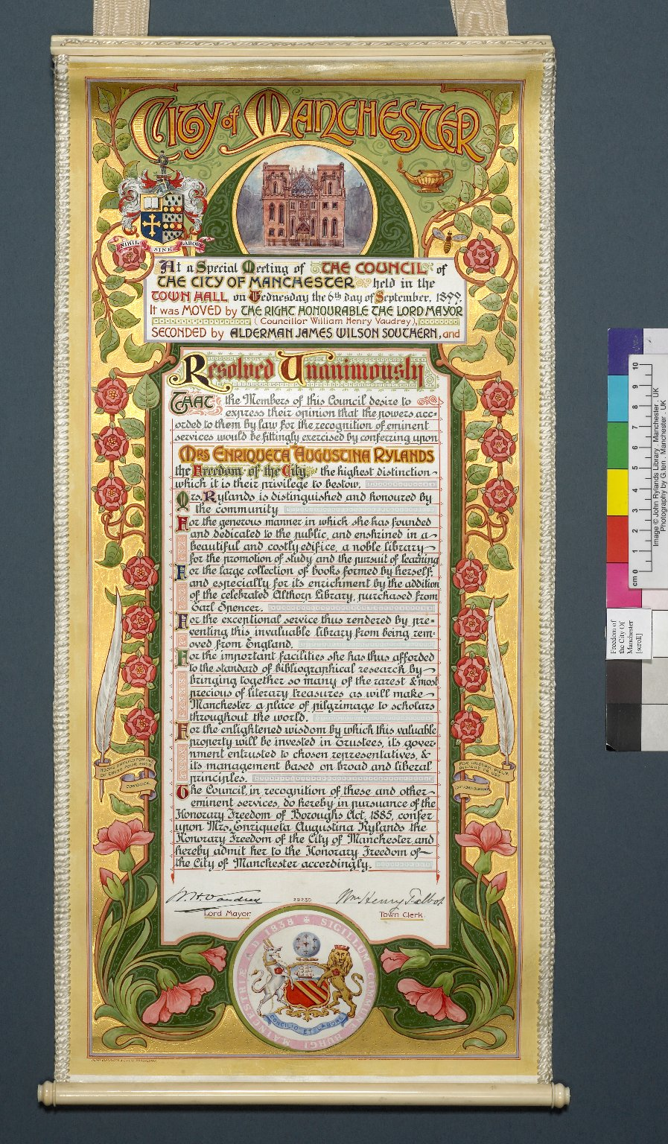
-------------
Image1
-------------
Field Data
Image Number JRL0701380dc
Image Title Freedom of the City of Manchester
Creator Manchester City Council
Creator Role Author
Date Created c1899
Description Scroll: Which bears the Freedom of the City of Manchester. At the top are paintings of the John Rylands Library and the Rylands crest. The scroll, along with a silver casket bearing engravings of the John Rylands Library, was presented to Mrs Enriqueta Augustina Rylands in October 1899.
Language Code eng-GB
Language English
Subject Legal documents
Subject John Rylands Library
Category of Material Archives
Sub-Category Rolls
Technique Used Painting
Technique Used Handwriting
Time Period Covered 19th Century CE
Places Covered England: Greater Manchester: Manchester
People Covered Rylands, Enriqueta Augustina, 1843-1908
Current Repository The University of Manchester Library, U.K.
Rights Holder - Image The University of Manchester Library
Rights holder - Work The University of Manchester Library
Access Rights <a rel="license" href="http://creativecommons.org/licenses/by-nc-sa/4.0/"><img alt="Creative Commons License" style="border-width:0" src="https://i.creativecommons.org/l/by-nc-sa/4.0/88x31.png"></a>
Date Captured (yyyy-mm-dd) 2006-12-01
Image Creation Technique Digital capture by Gten
Date Image Added (yyyy-mm) 2007-02
Metadata Language eng-GB

