Slide 1
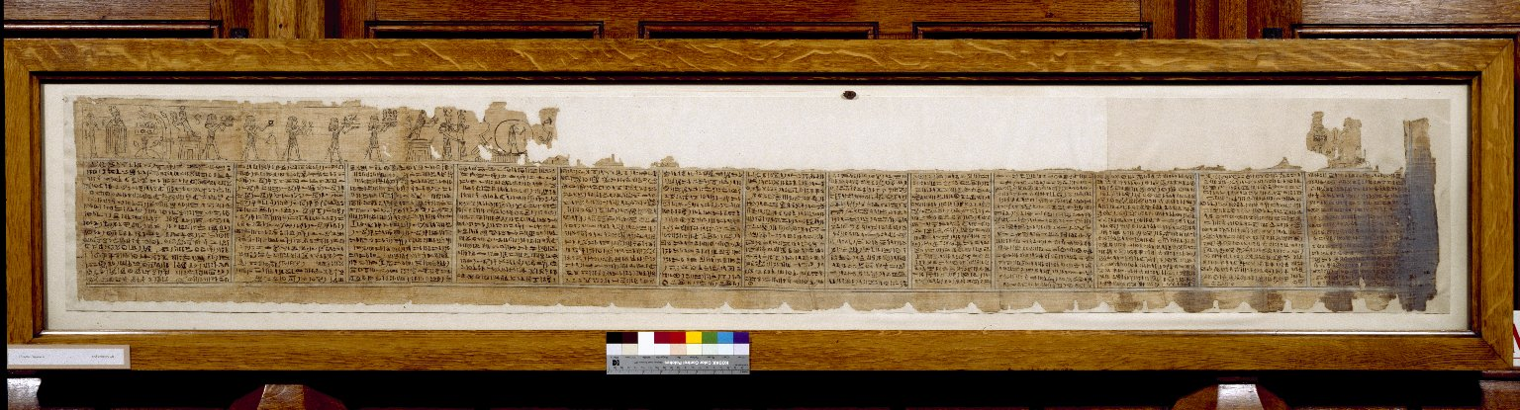
-------------
Image1
-------------
Field Data
Reference number Hieratic P 6
Side recto
Image Number JRL030595tr
Image Title Book of Breathing
Subject Death
Subject Funeral rites and ceremonies
Subject Religion
Subject Egypt--Antiquities
Description Book of Breathing written for a woman named Heryet, whose mother was named Tapelyet. Thirteen columns of text demarcated by black lines. There is some significant damage to the first column, which is blackened. Painted vignettes appear above the text. Unfortunately, damage to the upper section of the papyrus destroyed many of the scenes, leaving traces above column 1 and fully preserved scenes above columns 10-13. The Book of Breathing is an Ancient Egyptian funerary text.
Date created 2nd century
Time period covered 1 BCE - 500 CE
Place covered Egypt
Language Egyptian
Language code egy-EG
Technique used Handwriting
Support material Papyrus
Current repository The University of Manchester Library, U.K.
Category Manuscripts
Sub-Category Scrolls
Image rights The University of Manchester Library
Work rights The University of Manchester Library
Image sequence number hrt006r
Image technique Scanned from colour transparency by Gten, July 2004
Metadata language eng-GB

Slide 2
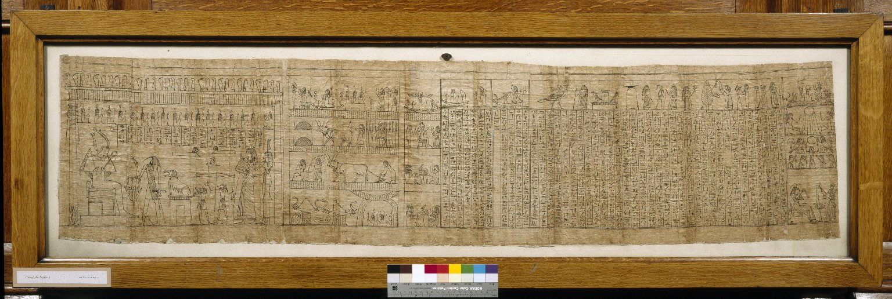
-------------
Image1
-------------
Field Data
Reference number Hieroglyphic P 3
Side recto
Image Number JRL030596tr
Image Title Book of the Dead
Subject Death
Subject Funeral rites and ceremonies
Subject Rites and ceremonies
Subject Magic
Description On the left hand side are drawings of the dead person being led before Osiris; his soul is weighed against the feather of Mat. On the right are spells to support him in the other world.
Creation site Egypt
Date created 1st-2nd century BCE
Time period covered 750 - 1 BCE
Place covered Egypt
Language Egyptian
Language code egy-EG
Technique used Handwriting
Support material Papyrus
Current repository The University of Manchester Library, U.K.
Category Manuscripts
Sub-Category Scrolls
Image rights The University of Manchester Library
Work rights The University of Manchester Library
Image sequence number hgl003r
Image technique Scanned from colour transparency by Gten, July 2004
Metadata language eng-GB

Slide 3
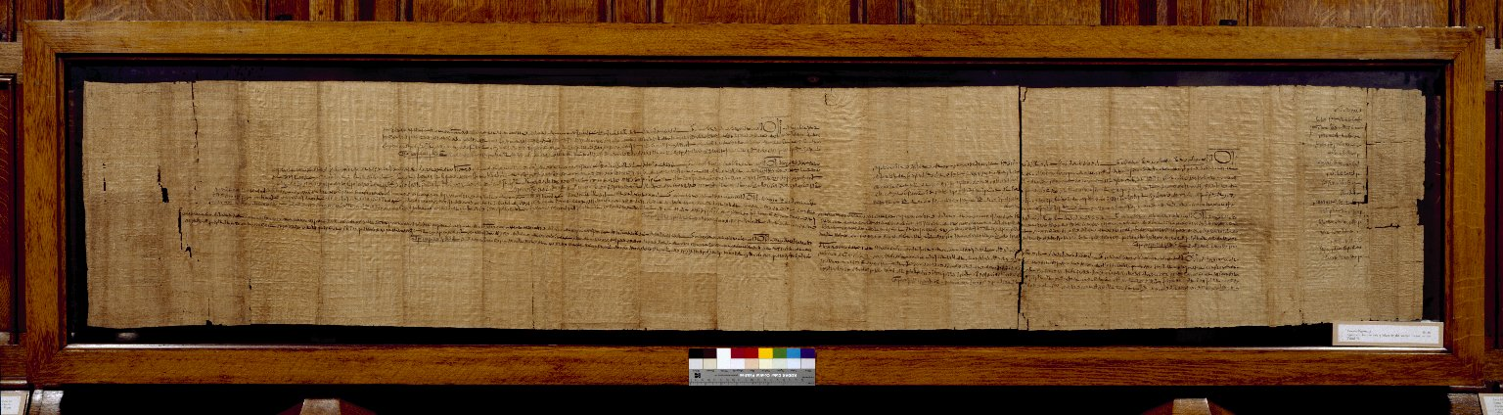
-------------
Image1
-------------
Field Data
Reference number Demotic P 12
Side recto
Image Number JRL030593tr
Image Title Agreement for Sale of Property
Subject Legal documents
Creator Role Scribe
Creator Peuhôr, son of Esmîn
Description Teihor, the legatee of Pleehe, sells the house which forms the chief item in Demotic Papyrus 11 to another woman, Teiant (?). The text is a list of the witnesses, followed by the sale and six witness copies. Demotic Papyrus 12 is the agreement for the sale, Demotic Papyrus 13 is the cession. In a separate document, Demotic Papyrus 14, the father of Teihor likewise makes a cession of the house to the same woman.
Creation site Egypt: Memnoneia - Djeme (mod. Thebes west)
Date created 281 BCE
Time period covered 750 - 1 BCE
Place covered Egypt: Dios Polis (mod. Thebes east)
Place covered Egypt: Memnoneia - Djeme (mod. Thebes west)
People covered Teihor
People covered Teiant
Language Demotic
Language code egy
Item height 390 mm
Item width 2160 mm
Technique used Handwriting
Support material Papyrus
Style Period Ptolemaic
Bibliographic Reference Catalogue of Demotic Papyri in the John Rylands Library, Manchester
Current repository The University of Manchester Library, U.K.
Former repository Lindsay family Earls of Crawford and Balcarres, former owner
Category Manuscripts
Sub-Category Scrolls
Image rights The University of Manchester Library
Work rights The University of Manchester Library
Image sequence number dem012r
Image technique Scanned from colour transparency by Gten, July 2004
Metadata language eng-GB

Slide 4
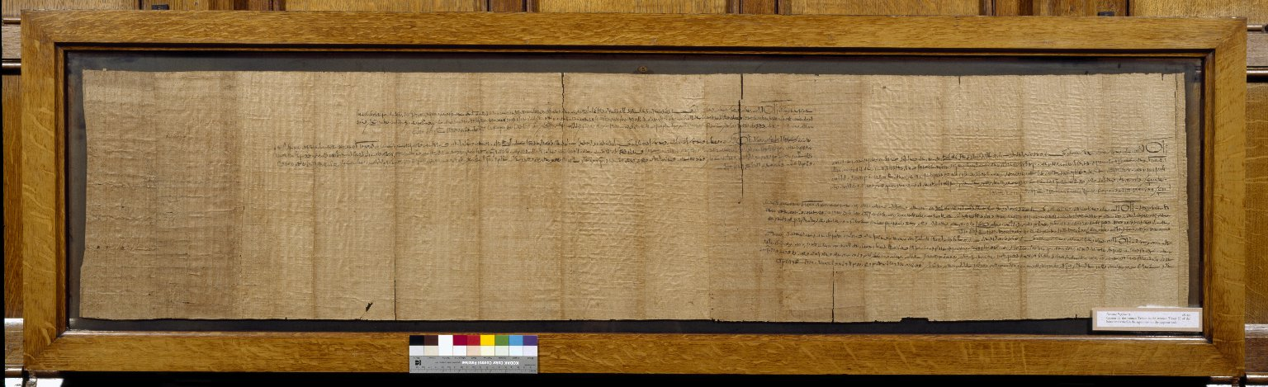
-------------
Image1
-------------
Field Data
Reference number Demotic P 13
Side recto
Image Number JRL030594tr
Image Title Cession of property
Subject Legal documents
Creator Role Scribe
Creator Peuhôr, son of Esmîn
Description Teihor, the legatee of Pleehe, sells the house which forms the chief item in Demotic Papyrus 11 to another woman, Teiant (?). The text consists of the 'writing of divestment', followed by four witness copies. Demotic Papyrus 12 is the agreement for the sale, Demotic Papyrus 13 is the cession. In a separate document, Demotic Papyrus 14, the father of Teihor likewise makes a cession of the house to the same woman.
Creation site Egypt: Memnoneia - Djeme (mod. Thebes west)
Date created 281 BCE
Time period covered 750 - 1 BCE
Place covered Egypt: Dios Polis (mod. Thebes east)
Place covered Egypt: Memnoneia - Djeme (mod. Thebes west)
People covered Teihor
People covered Teiant
Language Demotic
Language code egy
Item height 395 mm
Item width 1780 mm
Technique used Handwriting
Support material Papyrus
Style Period Ptolemaic
Bibliographic Reference Catalogue of Demotic Papyri in the John Rylands Library, Manchester
Current repository The University of Manchester Library, U.K.
Former repository Lindsay family Earls of Crawford and Balcarres, former owner
Category Manuscripts
Sub-Category Scrolls
Image rights The University of Manchester Library
Work rights The University of Manchester Library
Image sequence number dem013r
Image technique Scanned from colour transparency by Gten, July 2004
Metadata language eng-GB

Slide 5
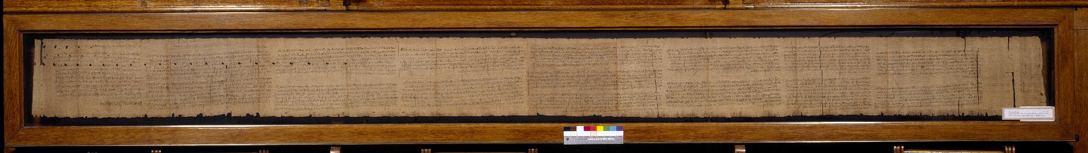
-------------
Image1
-------------
Field Data
Reference number Demotic P 1
Side recto
Image Number JRL030587tr
Image Title Sale of Priesthood
Subject Legal documents
Description Sections A-Q (complete papyrus). Sale to Essemteu of three priestley offices in the temple of Teuzoi. The text is (A) the sale subscribed by the vendor, Hor, son of Pemu, and his son, followed by fifteen copies (B-Q) of the same under the names of different witnesses. Papyrus of the Reign of Psammetichus I.
Creation site Egypt: Ankyropolis (mod. El-Hiba)
Date created c643 BCE
Time period covered 750 - 1 BCE
Place covered Egypt
People covered Essemteu
People covered Hôr, son of Pemû
Language Demotic
Language code egy
Item height 270 mm
Item width 3480 mm
Technique used Handwriting
Support material Papyrus
Bibliographic Reference Catalogue of Demotic Papyri in the John Rylands Library, Manchester
Current repository The University of Manchester Library, U.K.
Former repository Lindsay family Earls of Crawford and Balcarres, former owner
Category Manuscripts
Sub-Category Scrolls
Image rights The University of Manchester Library
Work rights The University of Manchester Library
Image sequence number dem001r-a
Image technique Scanned from colour transparency by Gten, July 2004
Metadata language eng-GB

