Slide 1
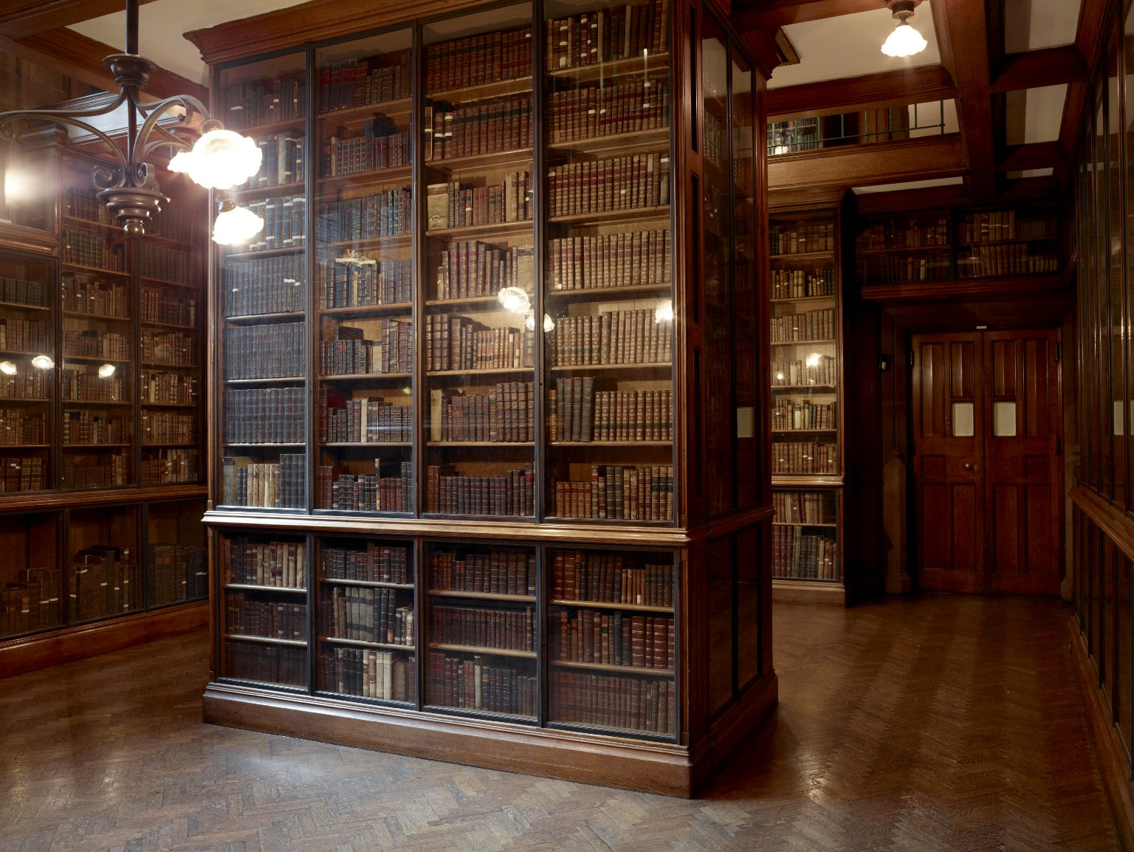
-------------
Image1
-------------
Field Data
Image Number JRL1101434
Image Title Spencer Room
Date Created 2010
Description Book island in the Spencer Room, the John Rylands Library, Deansgate, Manchester. The woodwork is Polish oak. The room is named after the second Earl of Spencer. The Spencer collection of printed books was one of the finest collections in private ownership, and was purchased by Mrs Rylands from the fifth Earl in 1892 and formed the core of her Library.
Subject Library buildings
Subject John Rylands Library
Subject Architecture
Category of Material Photography
Sub-Category Digital photography
Time Period Covered 21st Century CE
Places Covered England: Greater Manchester: Manchester
Current Site The John Rylands Library, Deansgate, Manchester, U.K.
Rights Holder - Image University of Manchester Library
Rights holder - Work The University of Manchester Library
Access Rights <a rel="license" href="http://creativecommons.org/licenses/by-nc-sa/4.0/"><img alt="Creative Commons License" style="border-width:0" src="https://i.creativecommons.org/l/by-nc-sa/4.0/88x31.png"></a>
Date Captured (yyyy-mm-dd) 2010-10-08
Image Creation Technique Digital capture by Heritage Imaging, The University of Manchester Library
Metadata Language eng-GB

Slide 2
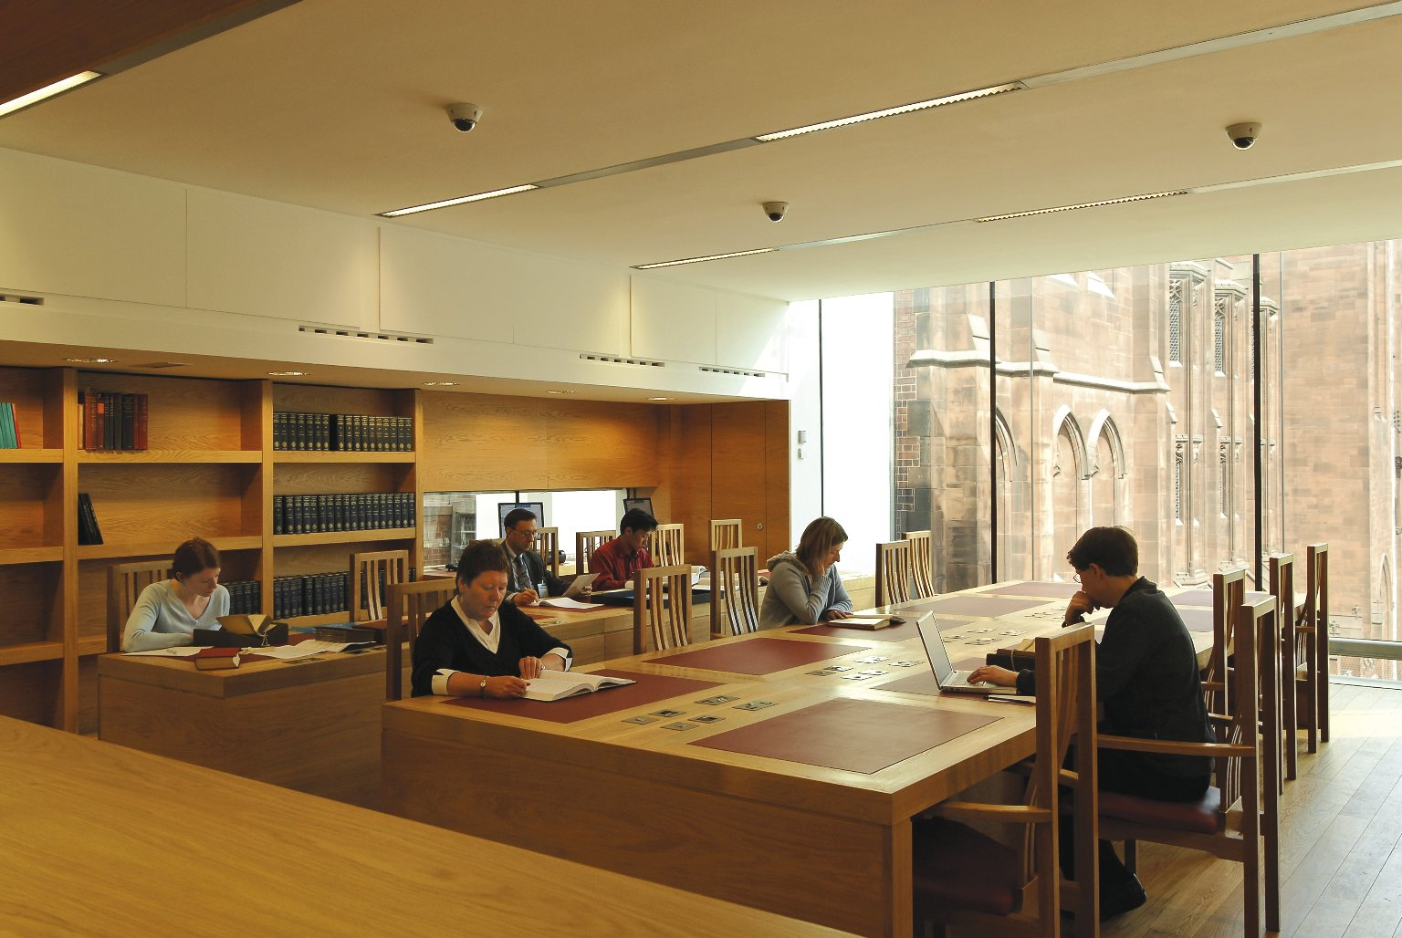
-------------
Image1
-------------
Field Data
Image Number JRL0710119dc
Image Title Elsevier Reading Room
Date Created 2007
Description Elsevier Reading Room of the John Rylands Library, Deansgate, Manchester, with a glimpse of the Spinningfield elevation of the original building through the glass panelled wall. The Library was built by Enriqueta Augustina Rylands in memory of her husband John, a Manchester cotton millionaire. It opened to the public on 1st January 1900. A major refurbishment to the original building took place during 2004-2006 and a new extension housing the Elsevier Reading Room opened in 2007. Architect: Austin-Smith: Lord.
Subject John Rylands Library
Subject Architecture
Subject Library buildings
Category of Material Photography
Sub-Category Digital photography
Time Period Covered 21st Century CE
Places Covered England: Greater Manchester: Manchester
Current Site The John Rylands Library, Deansgate, Manchester, U.K.
Rights Holder - Image University of Manchester Library
Rights holder - Work The University of Manchester Library
Access Rights <a rel="license" href="http://creativecommons.org/licenses/by-nc-sa/4.0/"><img alt="Creative Commons License" style="border-width:0" src="https://i.creativecommons.org/l/by-nc-sa/4.0/88x31.png"></a>
References The John Rylands Library: A Souvenir Guide (Fetherstonhaugh, 2007)
Date Captured (yyyy-mm-dd) 2007
Image Creation Technique Digital capture by Fetherstonhaugh
Date Image Added (yyyy-mm) 2007-06
Metadata Language eng-GB

Slide 3
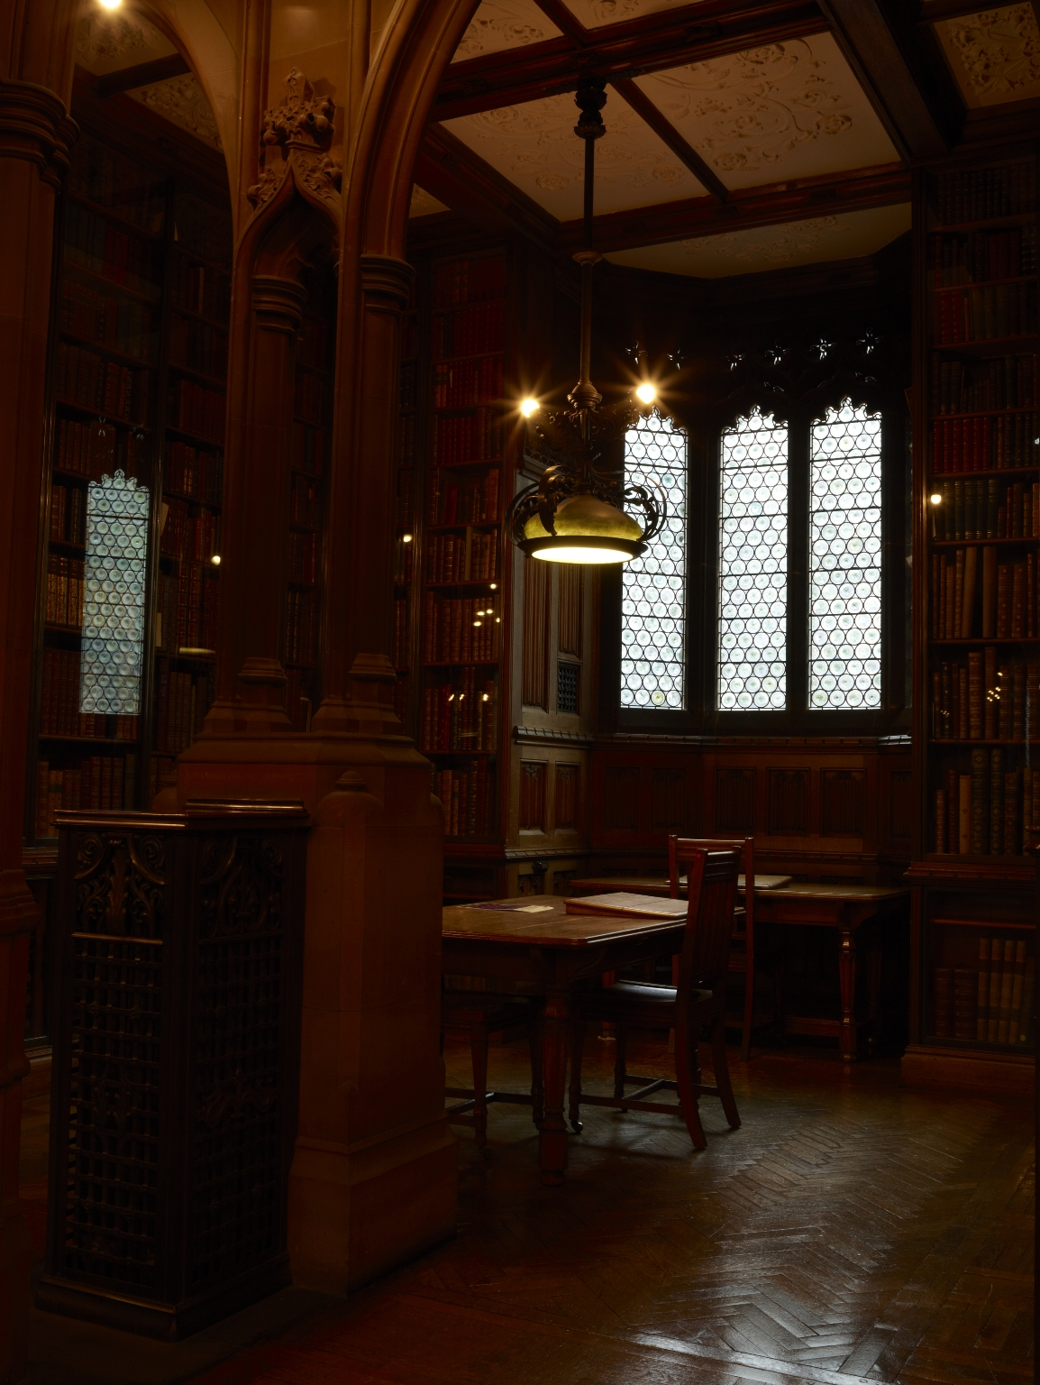
-------------
Image1
-------------
Field Data
Image Number JRL1212347
Image Title Study Alcove
Date Created 2012
Subject Sculpture
Subject Architecture
Subject Library buildings
Subject John Rylands Library
Category of Material Photography
Sub-Category Digital photography
Creation Site England: Manchester
Time Period Covered 21st Century CE
Places Covered England: Greater Manchester: Manchester
Current Site The John Rylands Library, Deansgate, Manchester, U.K.
Rights Holder - Image The University of Manchester Library
Rights holder - Work The University of Manchester Library
Access Rights <a rel="license" href="http://creativecommons.org/licenses/by-nc-sa/4.0/"><img alt="Creative Commons License" style="border-width:0" src="https://i.creativecommons.org/l/by-nc-sa/4.0/88x31.png"></a>
Date Captured (yyyy-mm-dd) 2012-02-13
Image Creation Technique Digital capture by Heritage Imaging, The University of Manchester Library
Metadata Language eng-GB

Slide 4
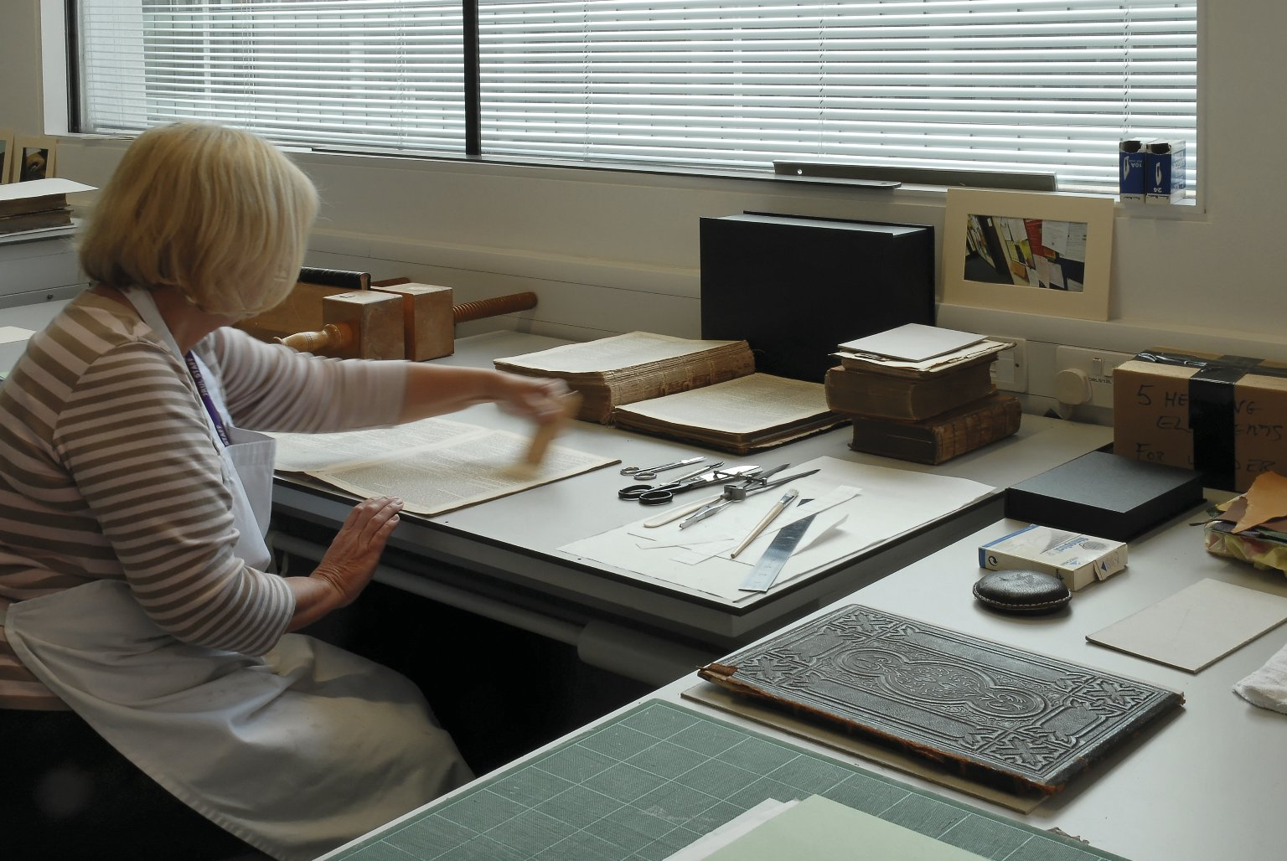
-------------
Image1
-------------
Field Data
Image Number JRL0710120dc
Image Title Conservation studio
Creator Austin-Smith: Lord
Date Created 2007
Description A conservator at work in the Conservation Studio of the John Rylands Library, Deansgate, Manchesterl. The Library was built by Enriqueta Augustina Rylands in memory of her husband John, a Manchester cotton millionaire. It opened to the public on 1st January 1900. A major refurbishment to the original building took place during 2004-2006 and a new extension housing the Conservation Studio opened in 2007. Architect: Austin-Smith: Lord
Subject John Rylands Library
Subject Architecture
Subject Library buildings
Category of Material Photography
Sub-Category Digital photography
Time Period Covered 21st Century CE
Places Covered England: Greater Manchester: Manchester
Current Site The John Rylands Library, Deansgate, Manchester, U.K.
Rights Holder - Image University of Manchester Library
Rights holder - Work The University of Manchester Library
References The John Rylands Library: A Souvenir Guide (Fetherstonhaugh, 2007)
Date Captured (yyyy-mm-dd) 2007
Image Creation Technique Digital capture by Fetherstonhaugh
Date Image Added (yyyy-mm) 2007-06
Metadata Language eng-GB

Slide 5
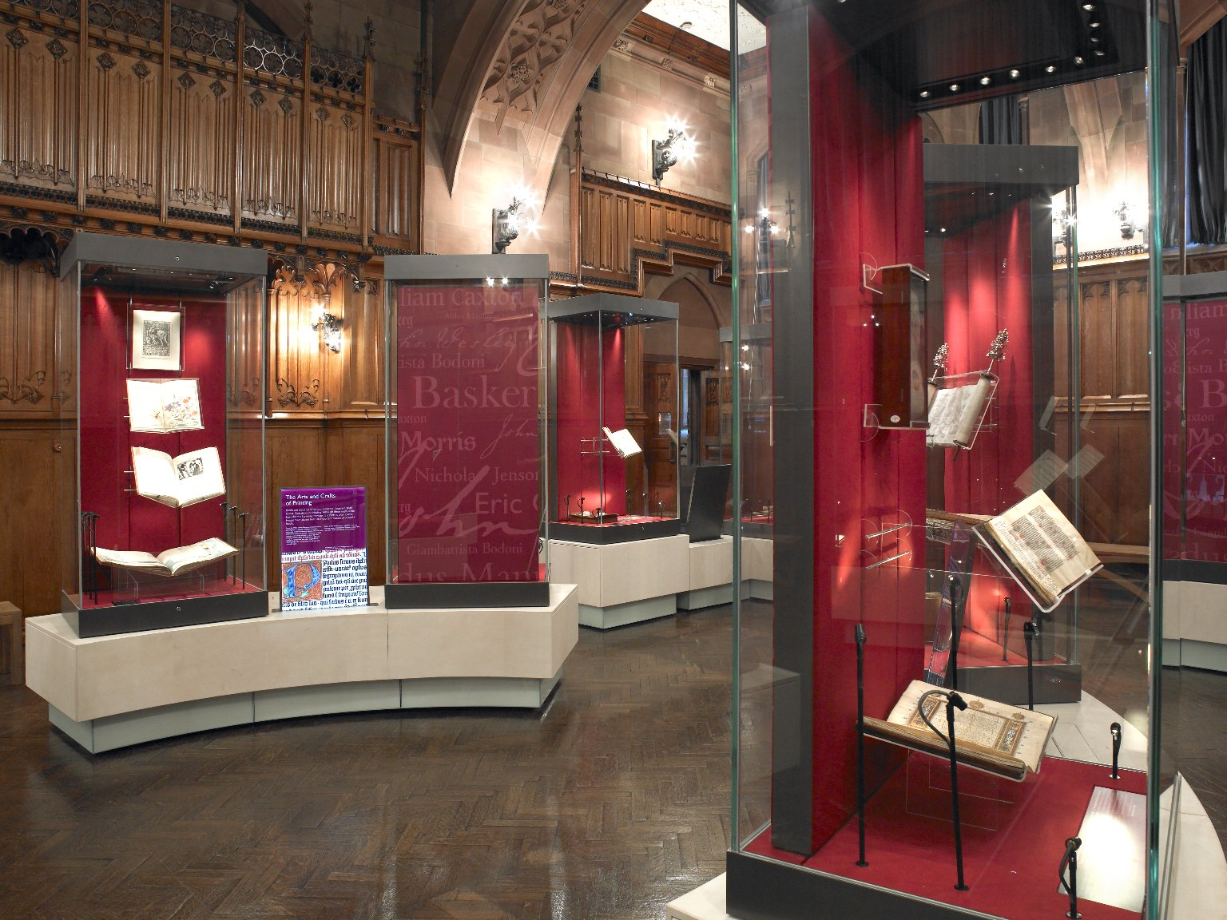
-------------
Image1
-------------
Field Data
Image Number JRL0812847dc
Image Title Rylands Gallery
Date Created 2007
Description View of the exhibition cases in the Rylands Gallery at the John Rylands Library, Deansgate, Manchester. The room is beautifully panelled in Polish oak, the stonework is shawk (sandstone) and the original Art Nouveau light fittings are cast in bronze and gunmetal.
Subject Library buildings
Subject Architecture
Subject John Rylands Library
Category of Material Photography
Sub-Category Digital photography
Time Period Covered 21st Century CE
Places Covered England: Greater Manchester: Manchester
Current Site The John Rylands Library, Deansgate, Manchester, U.K.
Rights Holder - Image University of Manchester Library
Rights holder - Work The University of Manchester Library
Access Rights <a rel="license" href="http://creativecommons.org/licenses/by-nc-sa/4.0/"><img alt="Creative Commons License" style="border-width:0" src="https://i.creativecommons.org/l/by-nc-sa/4.0/88x31.png"></a>
Date Captured (yyyy-mm-dd) 2007
Image Creation Technique Digital capture by Gten
Date Image Added (yyyy-mm) 2011-05
Metadata Language eng-GB

