Slide 1
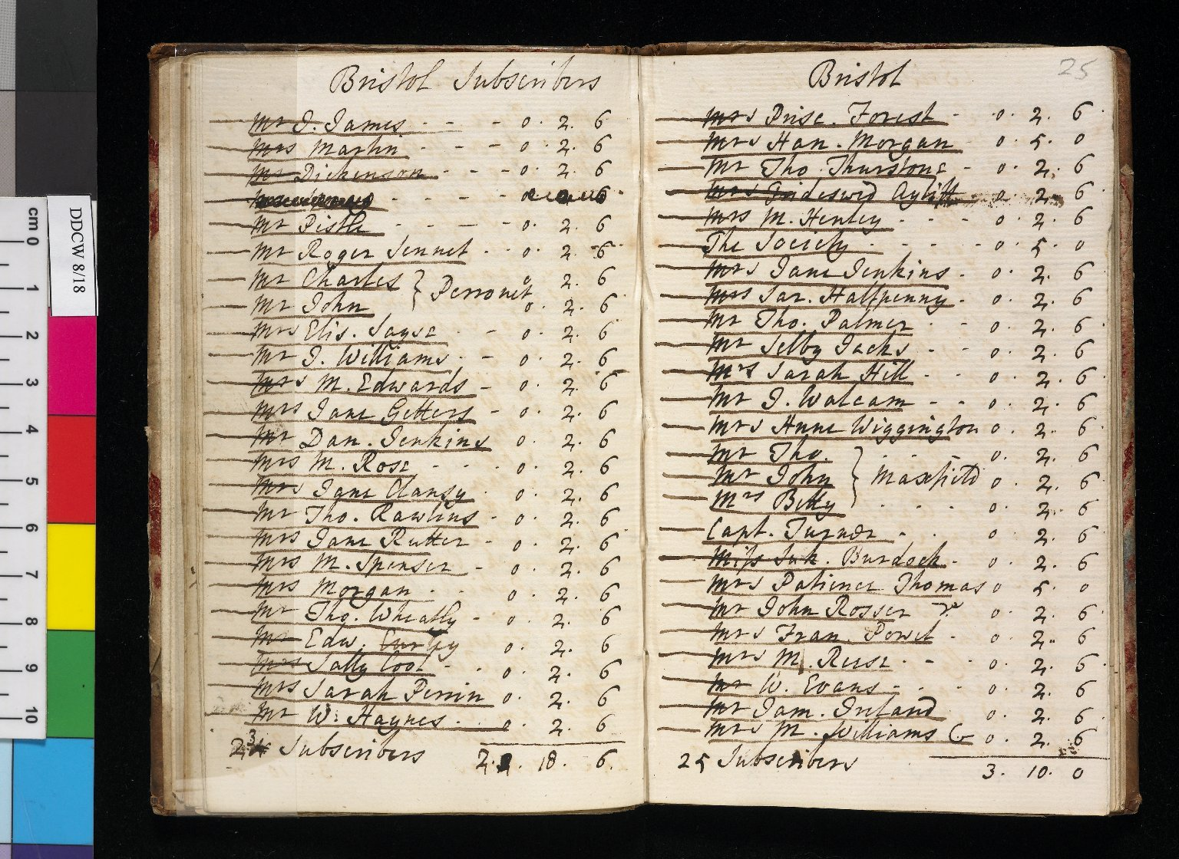
-------------
Image1
-------------
Field Data
Image Number JRL0803372dc
Reference Number DDCW/8/18
Link to Catalogue <A href="http://www.librarysearch.manchester.ac.uk/MU_VU1:BLENDED:44MAN_ELGAR_DSgb135ddcw">Charles Wesley Papers</a>
Image Title Bristol subscribers
Parent Work Title Manuscript list of subscribers to 'Hymns and Sacred Poems', 1749
Creator Wesley, Charles, 1707-1788
Creator Role Author
Date Created 1749
Description Manuscript list of subscribers to the Wesleys' 'Hymns and Sacred Poems', 1749. The ledger is open at the entry for Bristol. The Wesleys advertised for subscribers prior to the publication of early hymnbooks. Copies would be dispatched to the preachers, who would then distribute them. The original purchase price of the 1749 edition of Hymns and Sacred Poems was five shillings.
Language English
Subject Methodist Church
Subject Religion
Subject Christianity
Subject Hymns
Category of Material Archives
Technique Used Handwriting
Support Paper
Time Period Covered 18th Century CE
Places Covered England: Bristol
Item Height 155 mm
Item Width 189 mm
Current Repository The University of Manchester Library, U.K.
Provenance Methodist Church
Rights Holder - Image The University of Manchester Library
Rights Holder - Work Trustees for Methodist Church Purposes (TMCP)
Date Captured (yyyy-mm-dd) 2008-01-28
Image Creation Technique Digital capture by Gten
Date Image Added (yyyy-mm) 2008-05
Metadata Language eng-GB

Slide 2
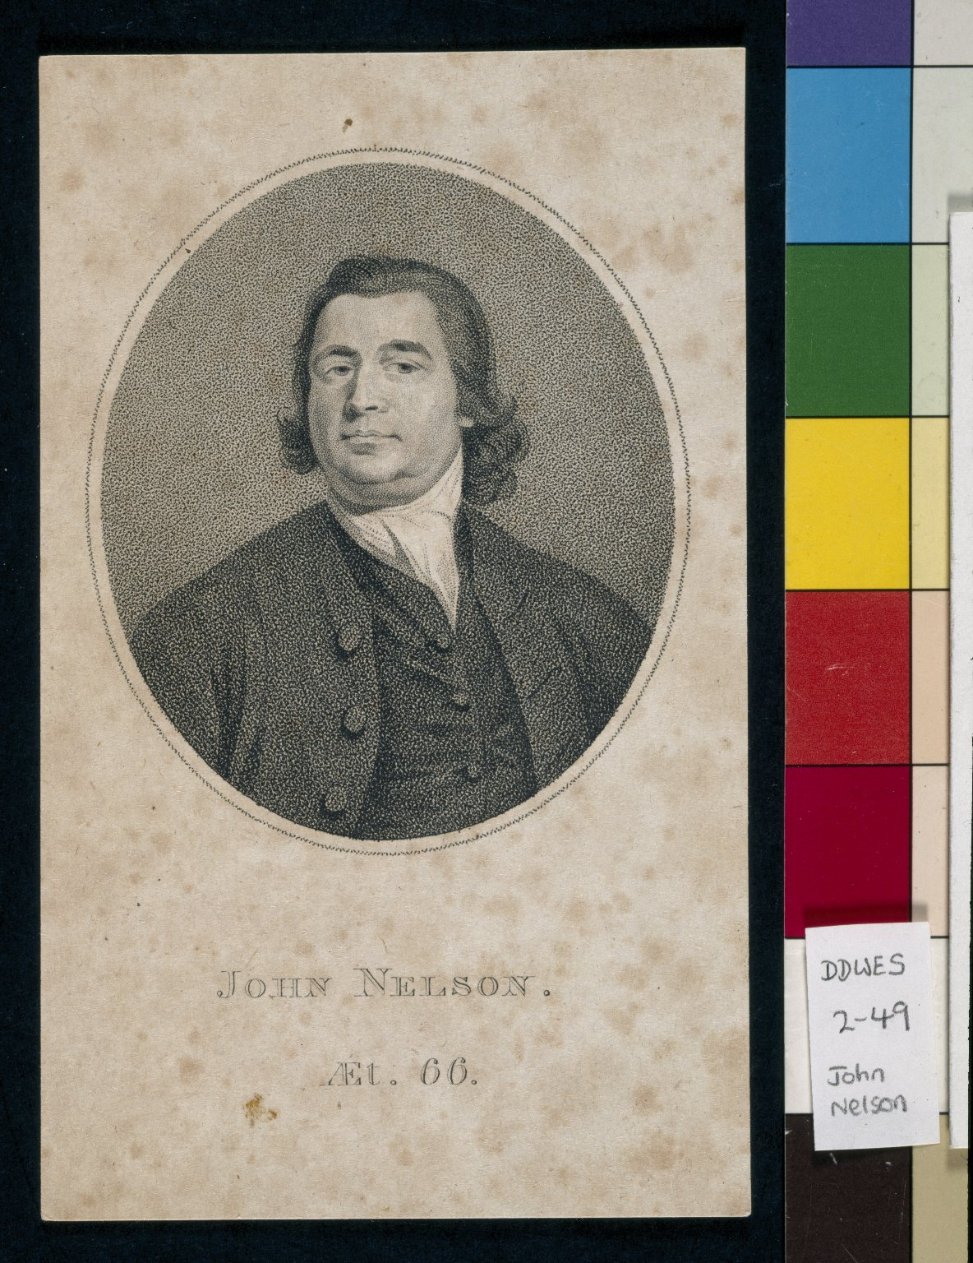
-------------
Image1
-------------
Field Data
Image Number JRL030353tr
Reference Number DDWes/2/49
Previous Accession Number Wesley Brown Folio 2, page 62
Link to Catalogue <A href="http://www.librarysearch.manchester.ac.uk/MU_VU1:BLENDED:44MAN_ELGAR_DSgb135ddwf">The Wesley Family Papers</a>
Image Title Engraving of John Nelson aged sixty-six
Series Title Wesley Family Letters (1739-1797)
Date Created [date not identified]
Description Portrait engraving of the itinerant preacher John Nelson, aged 66. John Nelson was one of the most famous of Wesley's preachers. A poorly educated stonemason, Nelson enjoyed such success as an evangelist in his native Yorkshire that he was nicknamed the 'Apostle of the North'.
Language English
Language Code eng
Subject Methodist Church
Category of Material Archives
Sub-Category Portraits
Technique Used Engraving
Support Paper
Time Period Covered 18th Century CE
Current Repository The University of Manchester Library, U.K.
Provenance Methodist Church
Rights Holder - Image The University of Manchester Library
Rights Holder - Work Trustees for Methodist Church Purposes (TMCP)
Notes See the Methodist Web Exhibitions
Image Creation Technique Digital capture by Heritage Imaging, The University of Manchester Library
Date Image Added (yyyy-mm) 2006-07
Metadata Language eng-GB

