Slide 1
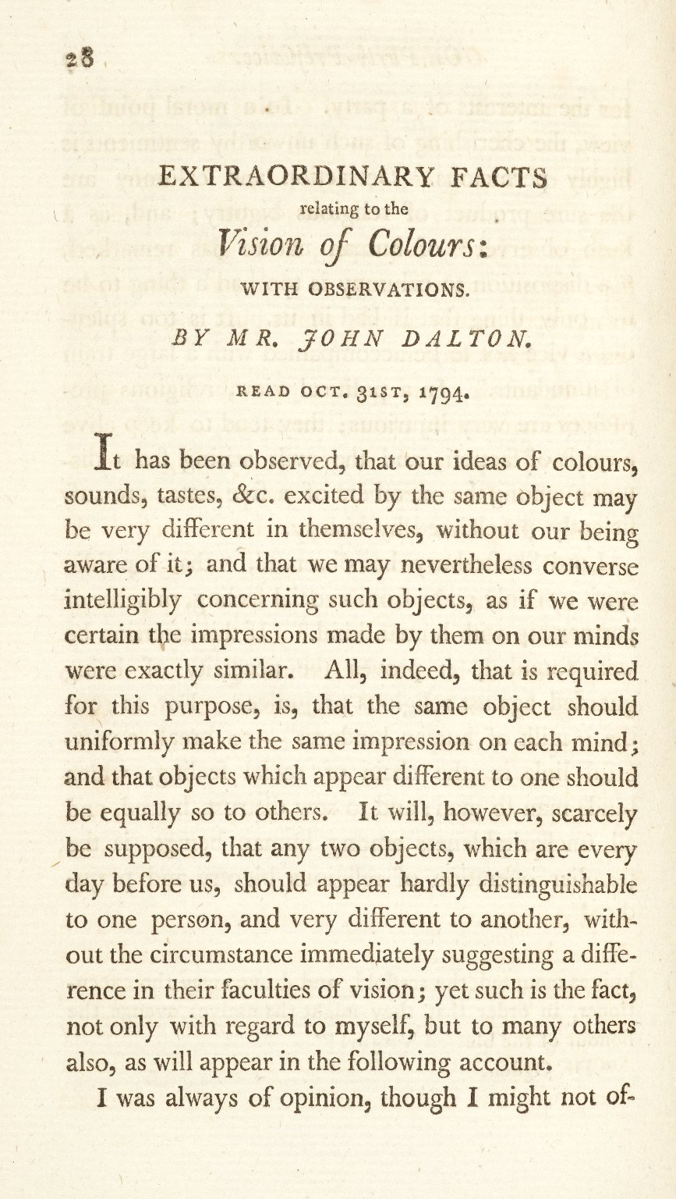
-------------
Image1
-------------
Field Data
Image Number JRL0923578dc
Reference Number J200061
Link to Catalogue <A href=http://man-fe.hosted.exlibrisgroup.com/MU_VU1:BLENDED:44MAN_ALMA_DS21150417930001631>UoM online catalogue.</a>
Image Title Extraordinary Facts relating to the Vision of Colours
Parent Work Title Memoirs of the Literary and Philosophical Society of Manchester
Creator Dalton, John, 1766-1844
Creator Role Author
Date Created 1798
Publication Details Manchester: Printed by George Nicholson for Cadell and Davies, London
Volume 5, Part 1
Page/Sheet 28
Image Sequence Number 5-1-028
Description Paper on 'Extraordinary Facts relating to the Vision of Colours: with observations' by John Dalton. Read October 31st 1794 by John Dalton to the Manchester Literary and Philosophical Society.
Language Code eng-GB
Subject Chemistry
Category of Material Printed
Time Period Covered 18th Century CE
Item Height 221 mm
Item Width 135 mm
Current Repository The University of Manchester Library, U.K.
Provenance Joule, James Prescott, 1818-1889, former owner
Rights Holder - Image The University of Manchester Library
Rights holder - Work The University of Manchester Library
Date Captured (yyyy-mm-dd) 2009-02-16
Multi Page Number 28
Image Creation Technique Digital capture by Heritage Imaging, The University of Manchester Library
Date Image Added (yyyy-mm) 2011-03
Metadata Language eng-GB

Slide 2
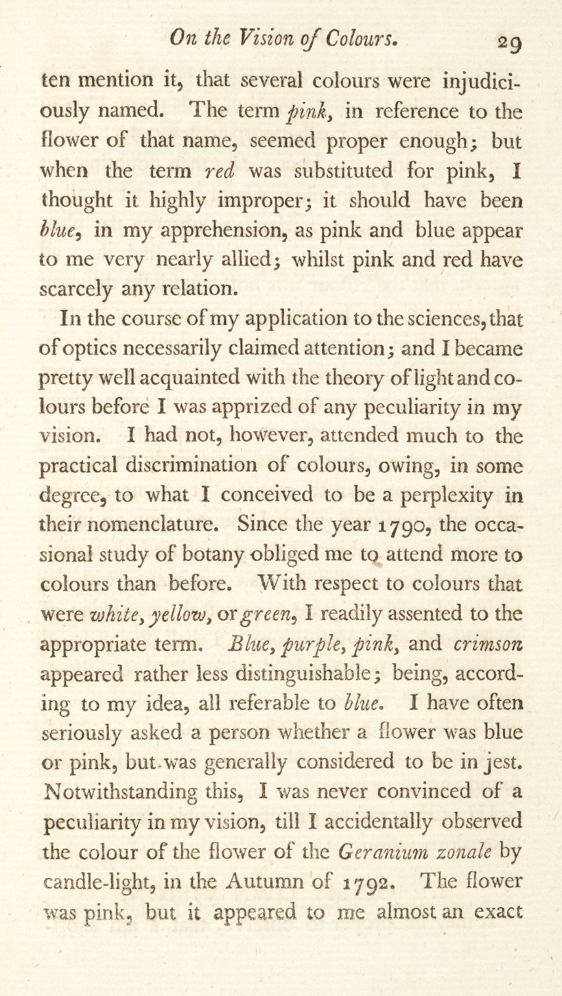
-------------
Image1
-------------
Field Data
Image Number JRL0923579dc
Reference Number J200061
Link to Catalogue <A href=http://man-fe.hosted.exlibrisgroup.com/MU_VU1:BLENDED:44MAN_ALMA_DS21150417930001631>UoM online catalogue.</a>
Image Title Extraordinary Facts relating to the Vision of Colours
Parent Work Title Memoirs of the Literary and Philosophical Society of Manchester
Creator Dalton, John, 1766-1844
Creator Role Author
Date Created 1798
Publication Details Manchester: Printed by George Nicholson for Cadell and Davies, London
Volume 5, Part 1
Page/Sheet 29
Image Sequence Number 5-1-029
Description Paper on 'Extraordinary Facts relating to the Vision of Colours: with observations' by John Dalton. Read October 31st 1794 by John Dalton to the Manchester Literary and Philosophical Society.
Language Code eng-GB
Subject Chemistry
Category of Material Printed
Time Period Covered 18th Century CE
Item Height 221 mm
Item Width 135 mm
Current Repository The University of Manchester Library, U.K.
Provenance Joule, James Prescott, 1818-1889, former owner
Rights Holder - Image The University of Manchester Library
Rights holder - Work The University of Manchester Library
Date Captured (yyyy-mm-dd) 2009-02-16
Multi Page Number 29
Image Creation Technique Digital capture by Heritage Imaging, The University of Manchester Library
Date Image Added (yyyy-mm) 2011-03
Metadata Language eng-GB

Slide 3
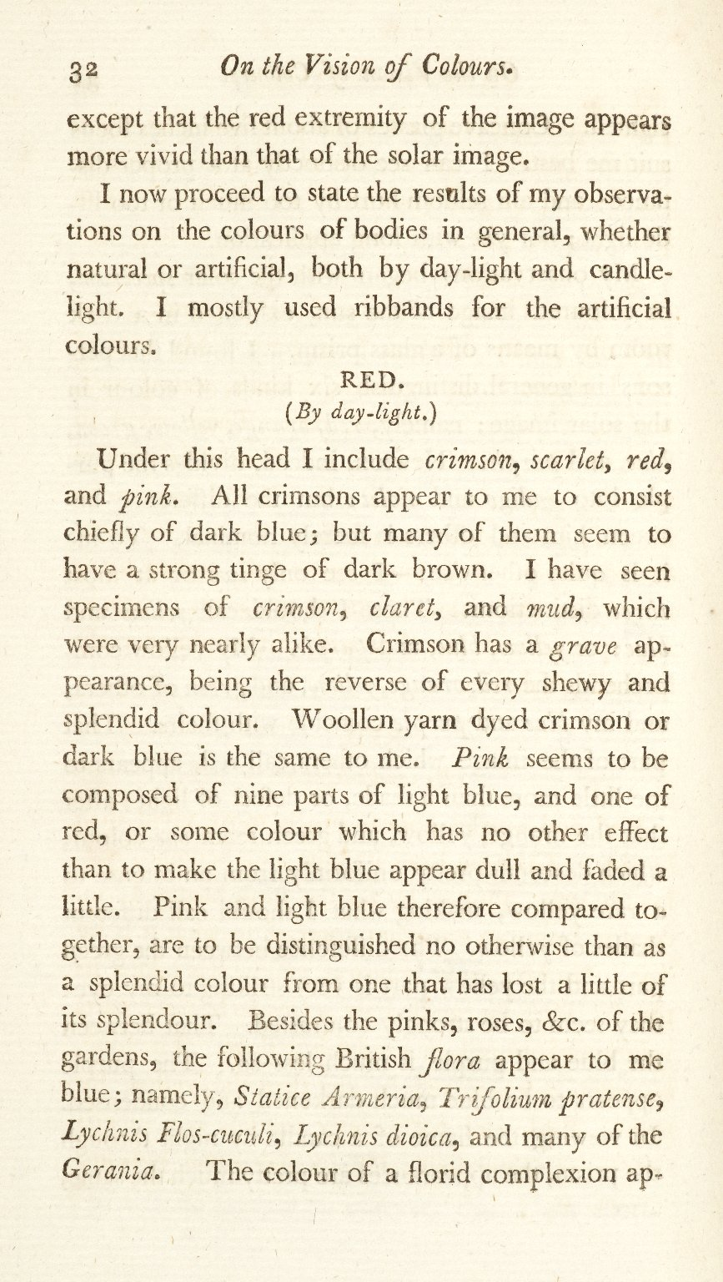
-------------
Image1
-------------
Field Data
Image Number JRL0923582dc
Reference Number J200061
Link to Catalogue <A href=http://man-fe.hosted.exlibrisgroup.com/MU_VU1:BLENDED:44MAN_ALMA_DS21150417930001631>UoM online catalogue.</a>
Image Title Extraordinary Facts relating to the Vision of Colours
Parent Work Title Memoirs of the Literary and Philosophical Society of Manchester
Creator Dalton, John, 1766-1844
Creator Role Author
Date Created 1798
Publication Details Manchester: Printed by George Nicholson for Cadell and Davies, London
Volume 5, Part 1
Page/Sheet 32
Image Sequence Number 5-1-032
Description Paper on 'Extraordinary Facts relating to the Vision of Colours: with observations' by John Dalton. Read October 31st 1794 by John Dalton to the Manchester Literary and Philosophical Society.
Language Code eng-GB
Subject Chemistry
Category of Material Printed
Time Period Covered 18th Century CE
Item Height 221 mm
Item Width 135 mm
Current Repository The University of Manchester Library, U.K.
Provenance Joule, James Prescott, 1818-1889, former owner
Rights Holder - Image The University of Manchester Library
Rights holder - Work The University of Manchester Library
Date Captured (yyyy-mm-dd) 2009-02-16
Multi Page Number 32
Image Creation Technique Digital capture by Heritage Imaging, The University of Manchester Library
Date Image Added (yyyy-mm) 2011-03
Metadata Language eng-GB

Slide 4
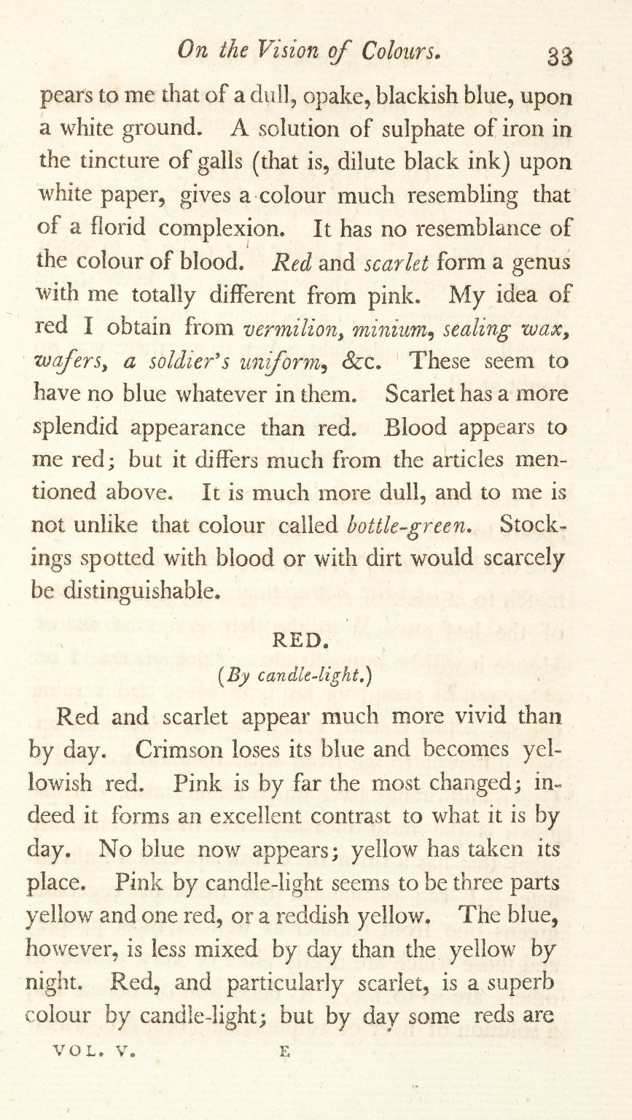
-------------
Image1
-------------
Field Data
Image Number JRL0923583dc
Reference Number J200061
Link to Catalogue <A href=http://man-fe.hosted.exlibrisgroup.com/MU_VU1:BLENDED:44MAN_ALMA_DS21150417930001631>UoM online catalogue.</a>
Image Title Extraordinary Facts relating to the Vision of Colours
Parent Work Title Memoirs of the Literary and Philosophical Society of Manchester
Creator Dalton, John, 1766-1844
Creator Role Author
Date Created 1798
Publication Details Manchester: Printed by George Nicholson for Cadell and Davies, London
Volume 5, Part 1
Page/Sheet 33
Image Sequence Number 5-1-033
Description Paper on 'Extraordinary Facts relating to the Vision of Colours: with observations' by John Dalton. Read October 31st 1794 by John Dalton to the Manchester Literary and Philosophical Society.
Language Code eng-GB
Subject Chemistry
Category of Material Printed
Time Period Covered 18th Century CE
Item Height 221 mm
Item Width 135 mm
Current Repository The University of Manchester Library, U.K.
Provenance Joule, James Prescott, 1818-1889, former owner
Rights Holder - Image The University of Manchester Library
Rights holder - Work The University of Manchester Library
Date Captured (yyyy-mm-dd) 2009-02-16
Multi Page Number 33
Image Creation Technique Digital capture by Heritage Imaging, The University of Manchester Library
Date Image Added (yyyy-mm) 2011-03
Metadata Language eng-GB

Slide 5
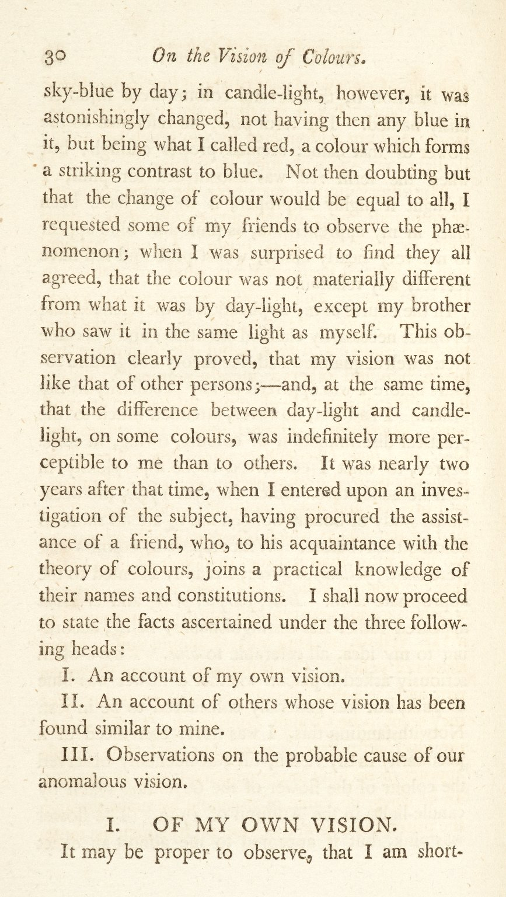
-------------
Image1
-------------
Field Data
Image Number JRL0923580dc
Reference Number J200061
Link to Catalogue <A href=http://man-fe.hosted.exlibrisgroup.com/MU_VU1:BLENDED:44MAN_ALMA_DS21150417930001631>UoM online catalogue.</a>
Image Title Extraordinary Facts relating to the Vision of Colours
Parent Work Title Memoirs of the Literary and Philosophical Society of Manchester
Creator Dalton, John, 1766-1844
Creator Role Author
Date Created 1798
Publication Details Manchester: Printed by George Nicholson for Cadell and Davies, London
Volume 5, Part 1
Page/Sheet 30
Image Sequence Number 5-1-030
Description Paper on 'Extraordinary Facts relating to the Vision of Colours: with observations' by John Dalton. Read October 31st 1794 by John Dalton to the Manchester Literary and Philosophical Society.
Language Code eng-GB
Subject Chemistry
Category of Material Printed
Time Period Covered 18th Century CE
Item Height 221 mm
Item Width 135 mm
Current Repository The University of Manchester Library, U.K.
Provenance Joule, James Prescott, 1818-1889, former owner
Rights Holder - Image The University of Manchester Library
Rights holder - Work The University of Manchester Library
Date Captured (yyyy-mm-dd) 2009-02-16
Multi Page Number 30
Image Creation Technique Digital capture by Heritage Imaging, The University of Manchester Library
Date Image Added (yyyy-mm) 2011-03
Metadata Language eng-GB

Slide 6
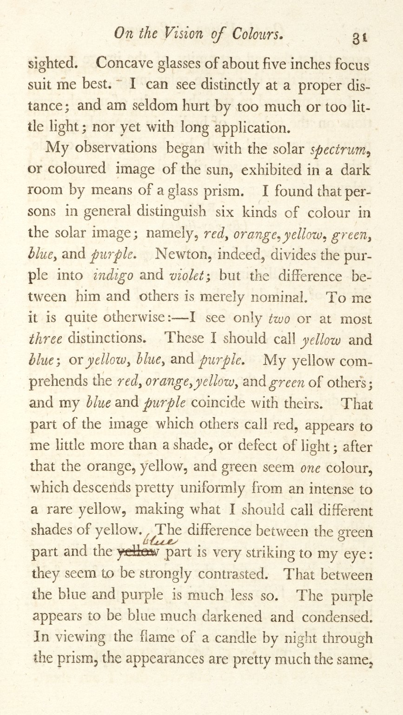
-------------
Image1
-------------
Field Data
Image Number JRL0923581dc
Reference Number J200061
Link to Catalogue <A href=http://man-fe.hosted.exlibrisgroup.com/MU_VU1:BLENDED:44MAN_ALMA_DS21150417930001631>UoM online catalogue.</a>
Image Title Extraordinary Facts relating to the Vision of Colours
Parent Work Title Memoirs of the Literary and Philosophical Society of Manchester
Creator Dalton, John, 1766-1844
Creator Role Author
Date Created 1798
Publication Details Manchester: Printed by George Nicholson for Cadell and Davies, London
Volume 5, Part 1
Page/Sheet 31
Image Sequence Number 5-1-031
Description Paper on 'Extraordinary Facts relating to the Vision of Colours: with observations' by John Dalton. Read October 31st 1794 by John Dalton to the Manchester Literary and Philosophical Society.
Language Code eng-GB
Subject Chemistry
Category of Material Printed
Time Period Covered 18th Century CE
Item Height 221 mm
Item Width 135 mm
Current Repository The University of Manchester Library, U.K.
Provenance Joule, James Prescott, 1818-1889, former owner
Rights Holder - Image The University of Manchester Library
Rights holder - Work The University of Manchester Library
Date Captured (yyyy-mm-dd) 2009-02-16
Multi Page Number 31
Image Creation Technique Digital capture by Heritage Imaging, The University of Manchester Library
Date Image Added (yyyy-mm) 2011-03
Metadata Language eng-GB

Slide 7
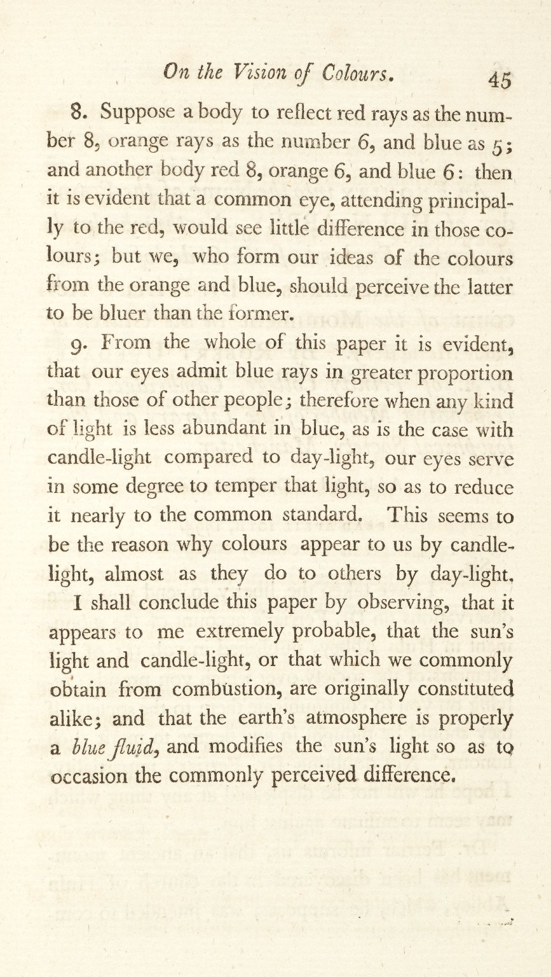
-------------
Image1
-------------
Field Data
Image Number JRL0923595dc
Reference Number J200061
Link to Catalogue <A href=http://man-fe.hosted.exlibrisgroup.com/MU_VU1:BLENDED:44MAN_ALMA_DS21150417930001631>UoM online catalogue.</a>
Image Title Extraordinary Facts relating to the Vision of Colours
Parent Work Title Memoirs of the Literary and Philosophical Society of Manchester
Creator Dalton, John, 1766-1844
Creator Role Author
Date Created 1798
Publication Details Manchester: Printed by George Nicholson for Cadell and Davies, London
Volume 5, Part 1
Page/Sheet 45
Image Sequence Number 5-1-045
Description Paper on 'Extraordinary Facts relating to the Vision of Colours: with observations' by John Dalton. Read October 31st 1794 by John Dalton to the Manchester Literary and Philosophical Society.
Language Code eng-GB
Subject Chemistry
Category of Material Printed
Time Period Covered 18th Century CE
Item Height 221 mm
Item Width 135 mm
Current Repository The University of Manchester Library, U.K.
Provenance Joule, James Prescott, 1818-1889, former owner
Rights Holder - Image The University of Manchester Library
Rights holder - Work The University of Manchester Library
Date Captured (yyyy-mm-dd) 2009-02-16
Multi Page Number 45
Image Creation Technique Digital capture by Heritage Imaging, The University of Manchester Library
Date Image Added (yyyy-mm) 2011-03
Metadata Language eng-GB

Slide 8
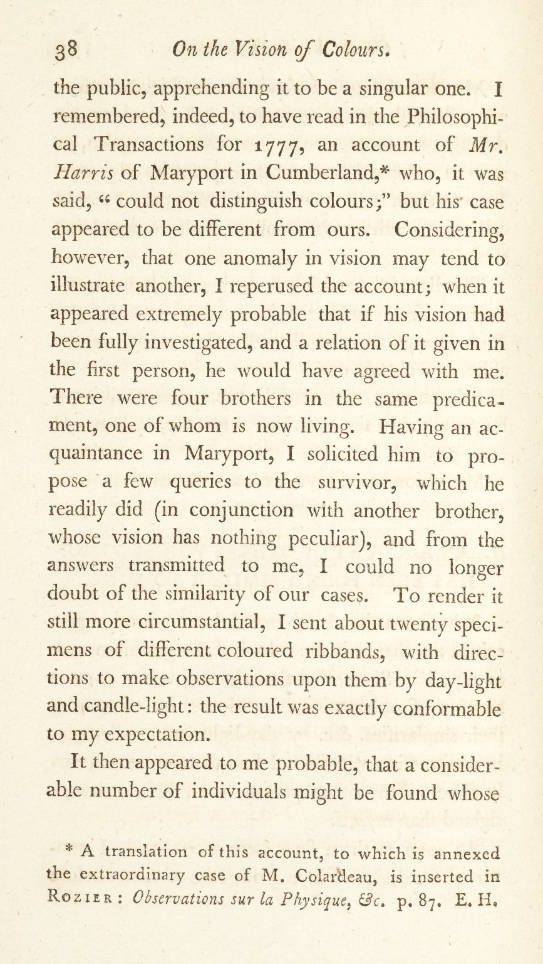
-------------
Image1
-------------
Field Data
Image Number JRL0923588dc
Reference Number J200061
Link to Catalogue <A href=http://man-fe.hosted.exlibrisgroup.com/MU_VU1:BLENDED:44MAN_ALMA_DS21150417930001631>UoM online catalogue.</a>
Image Title Extraordinary Facts relating to the Vision of Colours
Parent Work Title Memoirs of the Literary and Philosophical Society of Manchester
Creator Dalton, John, 1766-1844
Creator Role Author
Date Created 1798
Publication Details Manchester: Printed by George Nicholson for Cadell and Davies, London
Volume 5, Part 1
Page/Sheet 38
Image Sequence Number 5-1-038
Description Paper on 'Extraordinary Facts relating to the Vision of Colours: with observations' by John Dalton. Read October 31st 1794 by John Dalton to the Manchester Literary and Philosophical Society.
Language Code eng-GB
Subject Chemistry
Category of Material Printed
Time Period Covered 18th Century CE
Item Height 221 mm
Item Width 135 mm
Current Repository The University of Manchester Library, U.K.
Provenance Joule, James Prescott, 1818-1889, former owner
Rights Holder - Image The University of Manchester Library
Rights holder - Work The University of Manchester Library
Date Captured (yyyy-mm-dd) 2009-02-16
Multi Page Number 38
Image Creation Technique Digital capture by Heritage Imaging, The University of Manchester Library
Date Image Added (yyyy-mm) 2011-03
Metadata Language eng-GB

Slide 9
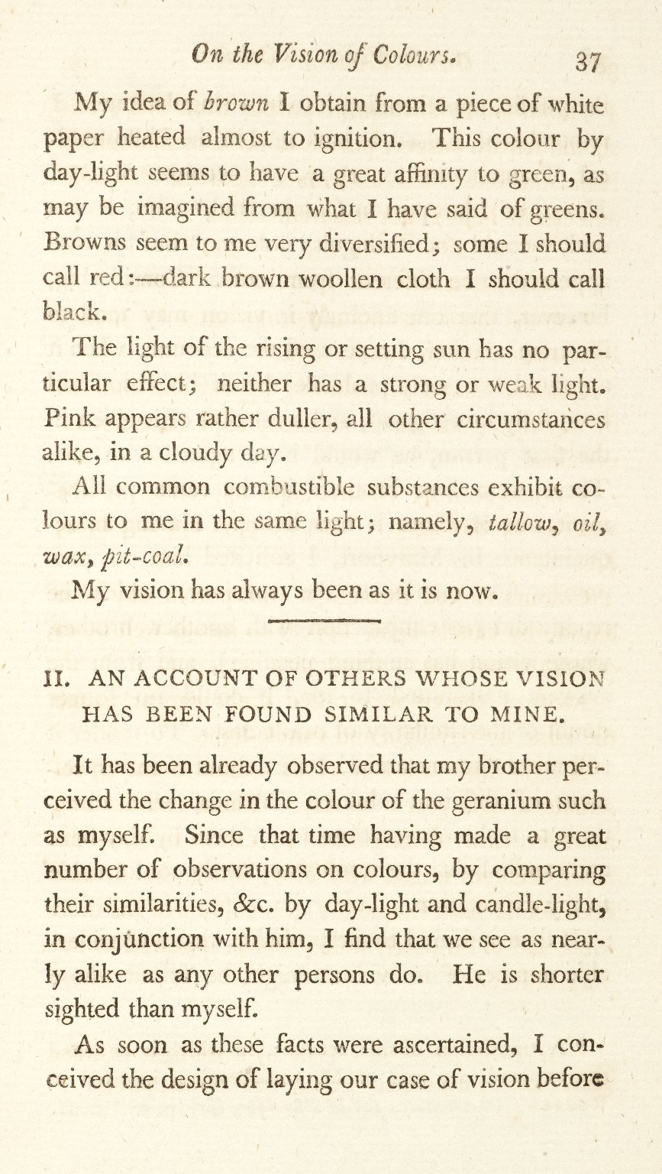
-------------
Image1
-------------
Field Data
Image Number JRL0923587dc
Reference Number J200061
Link to Catalogue <A href=http://man-fe.hosted.exlibrisgroup.com/MU_VU1:BLENDED:44MAN_ALMA_DS21150417930001631>UoM online catalogue.</a>
Image Title Extraordinary Facts relating to the Vision of Colours
Parent Work Title Memoirs of the Literary and Philosophical Society of Manchester
Creator Dalton, John, 1766-1844
Creator Role Author
Date Created 1798
Publication Details Manchester: Printed by George Nicholson for Cadell and Davies, London
Volume 5, Part 1
Page/Sheet 37
Image Sequence Number 5-1-037
Description Paper on 'Extraordinary Facts relating to the Vision of Colours: with observations' by John Dalton. Read October 31st 1794 by John Dalton to the Manchester Literary and Philosophical Society.
Language Code eng-GB
Subject Chemistry
Category of Material Printed
Time Period Covered 18th Century CE
Item Height 221 mm
Item Width 135 mm
Current Repository The University of Manchester Library, U.K.
Provenance Joule, James Prescott, 1818-1889, former owner
Rights Holder - Image The University of Manchester Library
Rights holder - Work The University of Manchester Library
Date Captured (yyyy-mm-dd) 2009-02-16
Multi Page Number 37
Image Creation Technique Digital capture by Heritage Imaging, The University of Manchester Library
Date Image Added (yyyy-mm) 2011-03
Metadata Language eng-GB

Slide 10
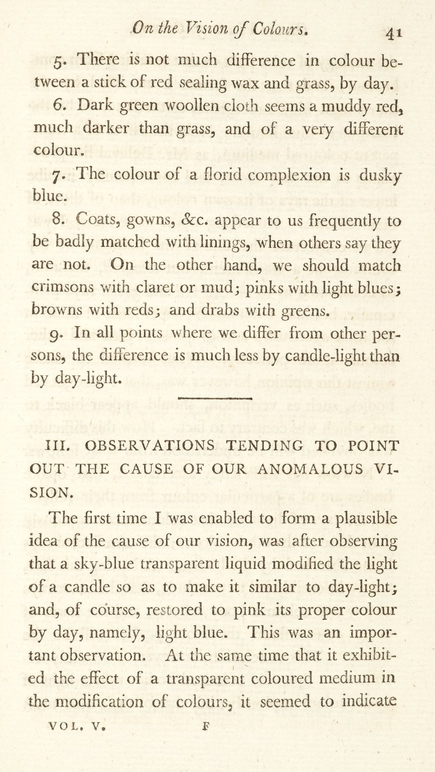
-------------
Image1
-------------
Field Data
Image Number JRL0923591dc
Reference Number J200061
Link to Catalogue <A href=http://man-fe.hosted.exlibrisgroup.com/MU_VU1:BLENDED:44MAN_ALMA_DS21150417930001631>UoM online catalogue.</a>
Image Title Extraordinary Facts relating to the Vision of Colours
Parent Work Title Memoirs of the Literary and Philosophical Society of Manchester
Creator Dalton, John, 1766-1844
Creator Role Author
Date Created 1798
Publication Details Manchester: Printed by George Nicholson for Cadell and Davies, London
Volume 5, Part 1
Page/Sheet 41
Image Sequence Number 5-1-041
Description Paper on 'Extraordinary Facts relating to the Vision of Colours: with observations' by John Dalton. Read October 31st 1794 by John Dalton to the Manchester Literary and Philosophical Society.
Language Code eng-GB
Subject Chemistry
Category of Material Printed
Time Period Covered 18th Century CE
Item Height 221 mm
Item Width 135 mm
Current Repository The University of Manchester Library, U.K.
Provenance Joule, James Prescott, 1818-1889, former owner
Rights Holder - Image The University of Manchester Library
Rights holder - Work The University of Manchester Library
Date Captured (yyyy-mm-dd) 2009-02-16
Multi Page Number 41
Image Creation Technique Digital capture by Heritage Imaging, The University of Manchester Library
Date Image Added (yyyy-mm) 2011-03
Metadata Language eng-GB

Slide 11
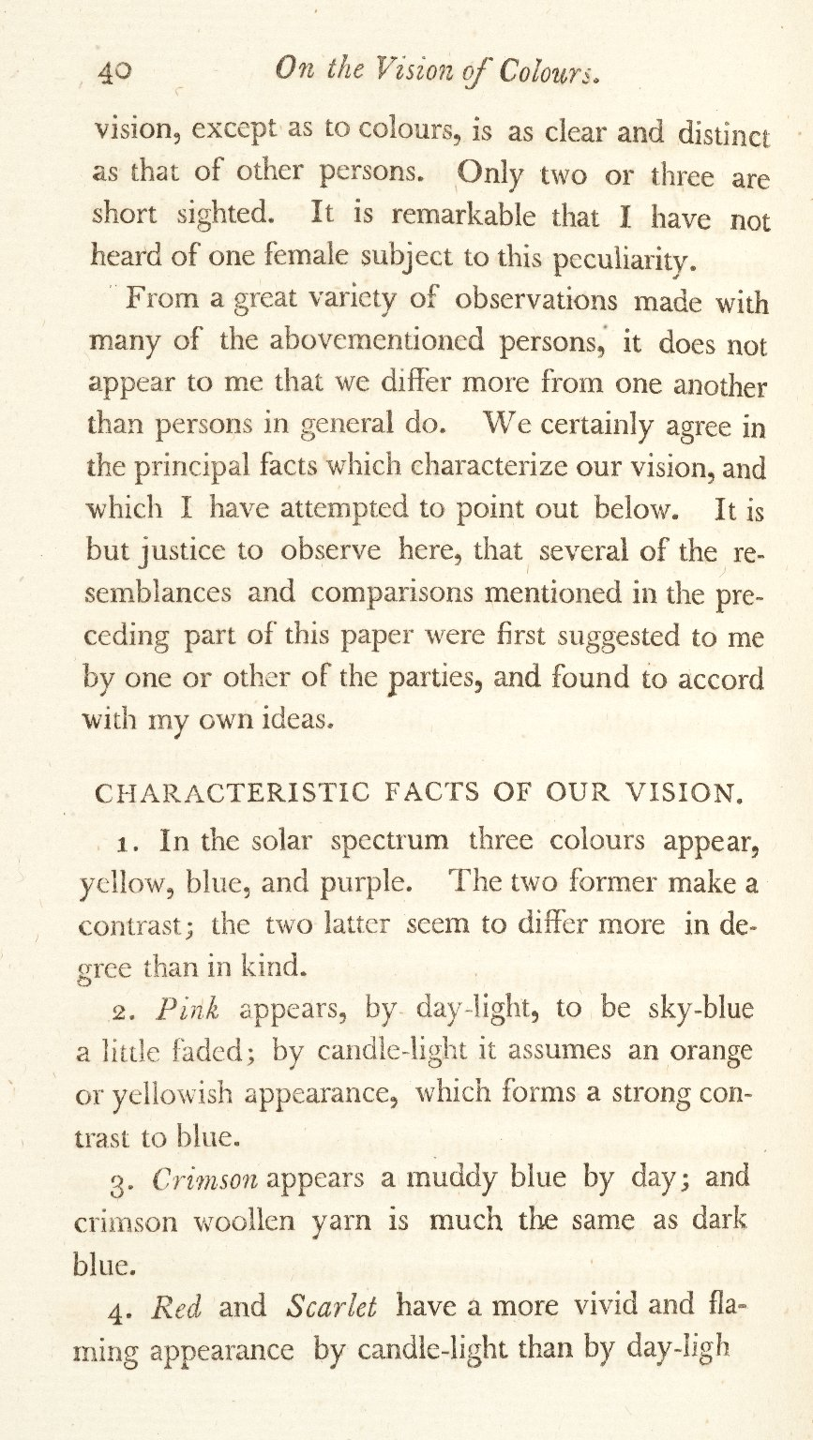
-------------
Image1
-------------
Field Data
Image Number JRL0923590dc
Reference Number J200061
Link to Catalogue <A href=http://man-fe.hosted.exlibrisgroup.com/MU_VU1:BLENDED:44MAN_ALMA_DS21150417930001631>UoM online catalogue.</a>
Image Title Extraordinary Facts relating to the Vision of Colours
Parent Work Title Memoirs of the Literary and Philosophical Society of Manchester
Creator Dalton, John, 1766-1844
Creator Role Author
Date Created 1798
Publication Details Manchester: Printed by George Nicholson for Cadell and Davies, London
Volume 5, Part 1
Page/Sheet 40
Image Sequence Number 5-1-040
Description Paper on 'Extraordinary Facts relating to the Vision of Colours: with observations' by John Dalton. Read October 31st 1794 by John Dalton to the Manchester Literary and Philosophical Society.
Language Code eng-GB
Subject Chemistry
Category of Material Printed
Time Period Covered 18th Century CE
Item Height 221 mm
Item Width 135 mm
Current Repository The University of Manchester Library, U.K.
Provenance Joule, James Prescott, 1818-1889, former owner
Rights Holder - Image The University of Manchester Library
Rights holder - Work The University of Manchester Library
Date Captured (yyyy-mm-dd) 2009-02-16
Multi Page Number 40
Image Creation Technique Digital capture by Heritage Imaging, The University of Manchester Library
Date Image Added (yyyy-mm) 2011-03
Metadata Language eng-GB

Slide 12
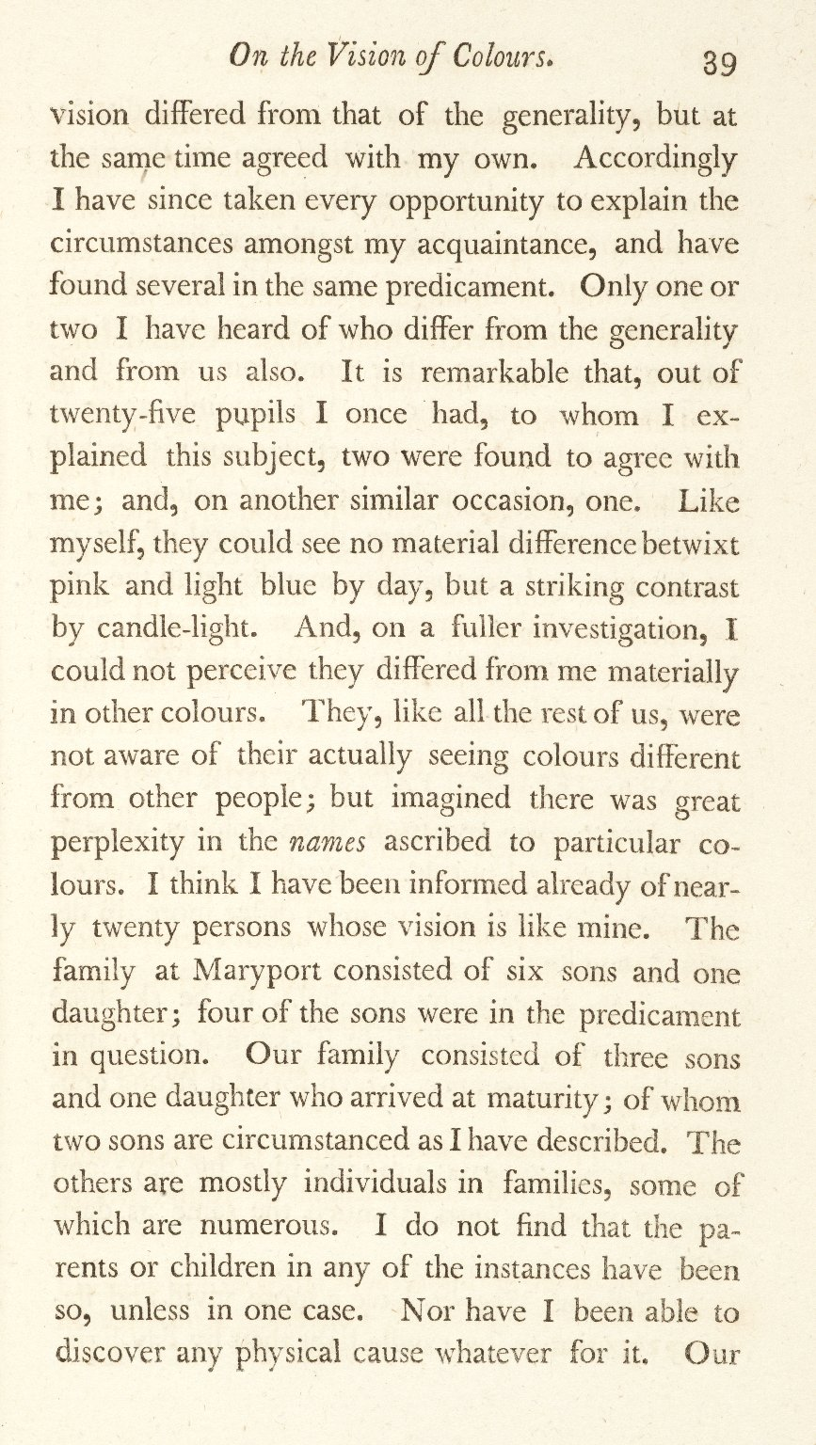
-------------
Image1
-------------
Field Data
Image Number JRL0923589dc
Reference Number J200061
Link to Catalogue <A href=http://man-fe.hosted.exlibrisgroup.com/MU_VU1:BLENDED:44MAN_ALMA_DS21150417930001631>UoM online catalogue.</a>
Image Title Extraordinary Facts relating to the Vision of Colours
Parent Work Title Memoirs of the Literary and Philosophical Society of Manchester
Creator Dalton, John, 1766-1844
Creator Role Author
Date Created 1798
Publication Details Manchester: Printed by George Nicholson for Cadell and Davies, London
Volume 5, Part 1
Page/Sheet 39
Image Sequence Number 5-1-039
Description Paper on 'Extraordinary Facts relating to the Vision of Colours: with observations' by John Dalton. Read October 31st 1794 by John Dalton to the Manchester Literary and Philosophical Society.
Language Code eng-GB
Subject Chemistry
Category of Material Printed
Time Period Covered 18th Century CE
Item Height 221 mm
Item Width 135 mm
Current Repository The University of Manchester Library, U.K.
Provenance Joule, James Prescott, 1818-1889, former owner
Rights Holder - Image The University of Manchester Library
Rights holder - Work The University of Manchester Library
Date Captured (yyyy-mm-dd) 2009-02-16
Multi Page Number 39
Image Creation Technique Digital capture by Heritage Imaging, The University of Manchester Library
Date Image Added (yyyy-mm) 2011-03
Metadata Language eng-GB

Slide 13
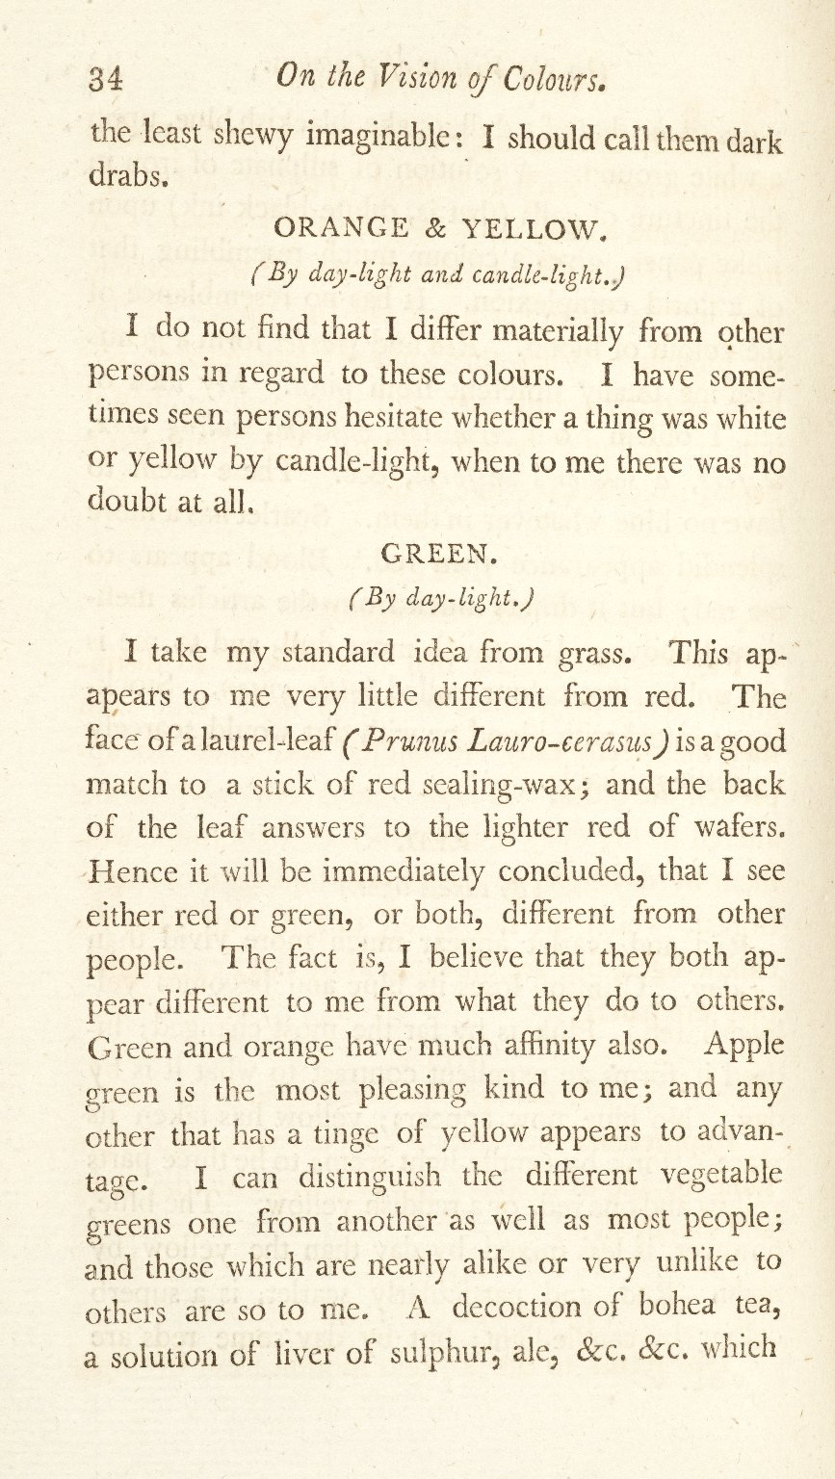
-------------
Image1
-------------
Field Data
Image Number JRL0923584dc
Reference Number J200061
Link to Catalogue <A href=http://man-fe.hosted.exlibrisgroup.com/MU_VU1:BLENDED:44MAN_ALMA_DS21150417930001631>UoM online catalogue.</a>
Image Title Extraordinary Facts relating to the Vision of Colours
Parent Work Title Memoirs of the Literary and Philosophical Society of Manchester
Creator Dalton, John, 1766-1844
Creator Role Author
Date Created 1798
Publication Details Manchester: Printed by George Nicholson for Cadell and Davies, London
Volume 5, Part 1
Page/Sheet 34
Image Sequence Number 5-1-034
Description Paper on 'Extraordinary Facts relating to the Vision of Colours: with observations' by John Dalton. Read October 31st 1794 by John Dalton to the Manchester Literary and Philosophical Society.
Language Code eng-GB
Subject Chemistry
Category of Material Printed
Time Period Covered 18th Century CE
Item Height 221 mm
Item Width 135 mm
Current Repository The University of Manchester Library, U.K.
Provenance Joule, James Prescott, 1818-1889, former owner
Rights Holder - Image The University of Manchester Library
Rights holder - Work The University of Manchester Library
Date Captured (yyyy-mm-dd) 2009-02-16
Multi Page Number 34
Image Creation Technique Digital capture by Heritage Imaging, The University of Manchester Library
Date Image Added (yyyy-mm) 2011-03
Metadata Language eng-GB

Slide 14
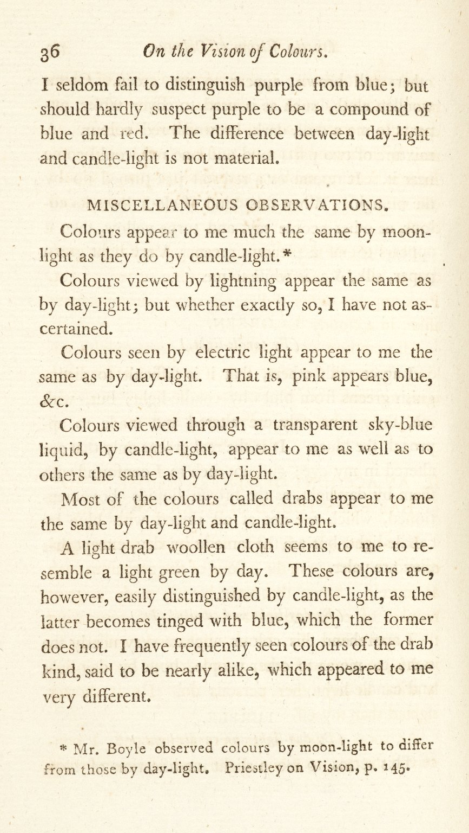
-------------
Image1
-------------
Field Data
Image Number JRL0923586dc
Reference Number J200061
Link to Catalogue <A href=http://man-fe.hosted.exlibrisgroup.com/MU_VU1:BLENDED:44MAN_ALMA_DS21150417930001631>UoM online catalogue.</a>
Image Title Extraordinary Facts relating to the Vision of Colours
Parent Work Title Memoirs of the Literary and Philosophical Society of Manchester
Creator Dalton, John, 1766-1844
Creator Role Author
Date Created 1798
Publication Details Manchester: Printed by George Nicholson for Cadell and Davies, London
Volume 5, Part 1
Page/Sheet 36
Image Sequence Number 5-1-036
Description Paper on 'Extraordinary Facts relating to the Vision of Colours: with observations' by John Dalton. Read October 31st 1794 by John Dalton to the Manchester Literary and Philosophical Society.
Language Code eng-GB
Subject Chemistry
Category of Material Printed
Time Period Covered 18th Century CE
Item Height 221 mm
Item Width 135 mm
Current Repository The University of Manchester Library, U.K.
Provenance Joule, James Prescott, 1818-1889, former owner
Rights Holder - Image The University of Manchester Library
Rights holder - Work The University of Manchester Library
Date Captured (yyyy-mm-dd) 2009-02-16
Multi Page Number 36
Image Creation Technique Digital capture by Heritage Imaging, The University of Manchester Library
Date Image Added (yyyy-mm) 2011-03
Metadata Language eng-GB

Slide 15
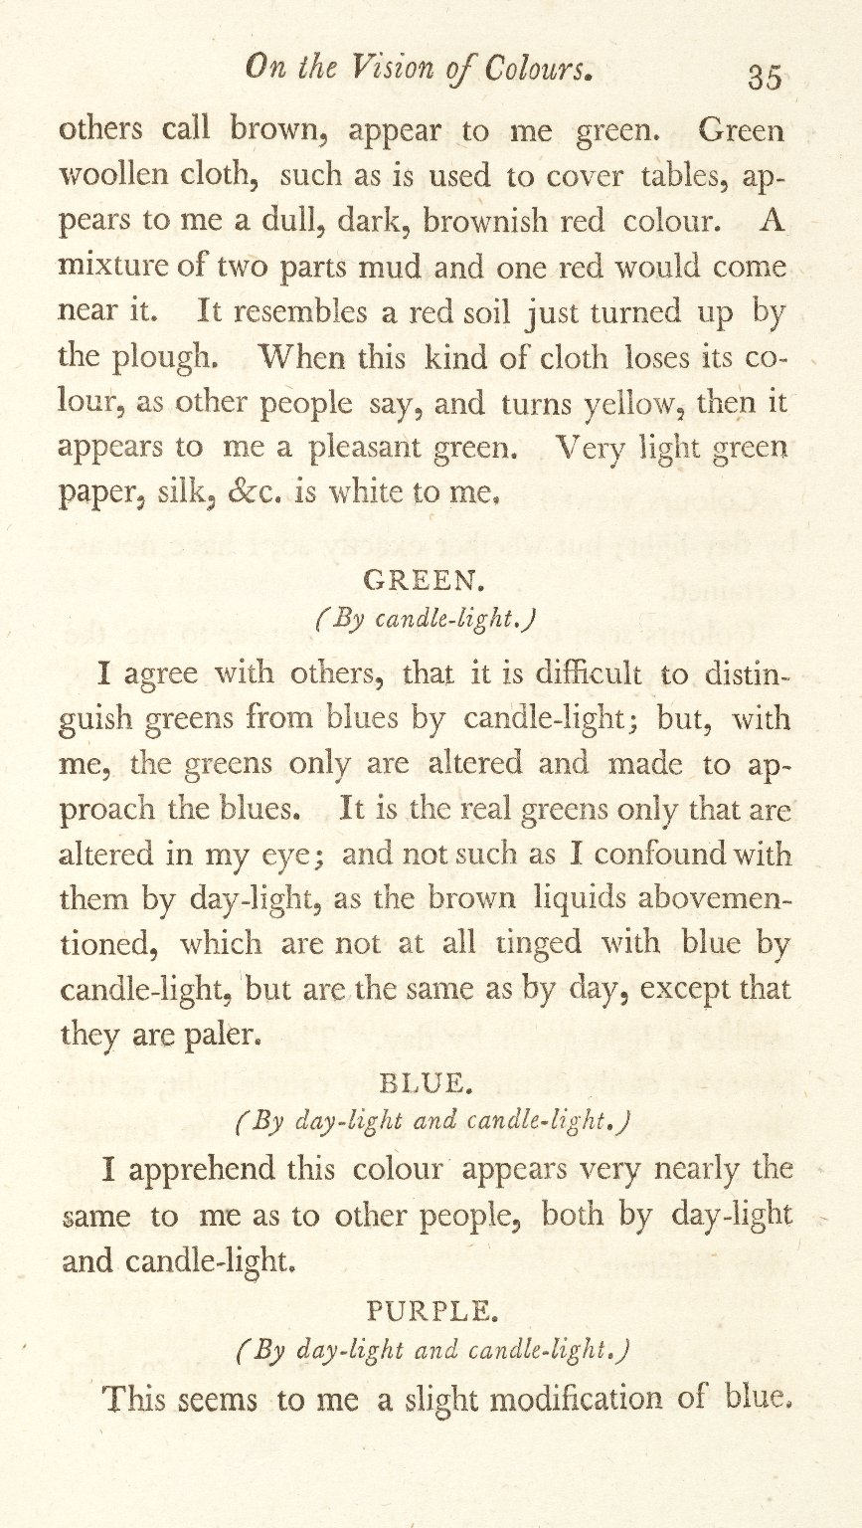
-------------
Image1
-------------
Field Data
Image Number JRL0923585dc
Reference Number J200061
Link to Catalogue <A href=http://man-fe.hosted.exlibrisgroup.com/MU_VU1:BLENDED:44MAN_ALMA_DS21150417930001631>UoM online catalogue.</a>
Image Title Extraordinary Facts relating to the Vision of Colours
Parent Work Title Memoirs of the Literary and Philosophical Society of Manchester
Creator Dalton, John, 1766-1844
Creator Role Author
Date Created 1798
Publication Details Manchester: Printed by George Nicholson for Cadell and Davies, London
Volume 5, Part 1
Page/Sheet 35
Image Sequence Number 5-1-035
Description Paper on 'Extraordinary Facts relating to the Vision of Colours: with observations' by John Dalton. Read October 31st 1794 by John Dalton to the Manchester Literary and Philosophical Society.
Language Code eng-GB
Subject Chemistry
Category of Material Printed
Time Period Covered 18th Century CE
Item Height 221 mm
Item Width 135 mm
Current Repository The University of Manchester Library, U.K.
Provenance Joule, James Prescott, 1818-1889, former owner
Rights Holder - Image The University of Manchester Library
Rights holder - Work The University of Manchester Library
Date Captured (yyyy-mm-dd) 2009-02-16
Multi Page Number 35
Image Creation Technique Digital capture by Heritage Imaging, The University of Manchester Library
Date Image Added (yyyy-mm) 2011-03
Metadata Language eng-GB

Slide 16
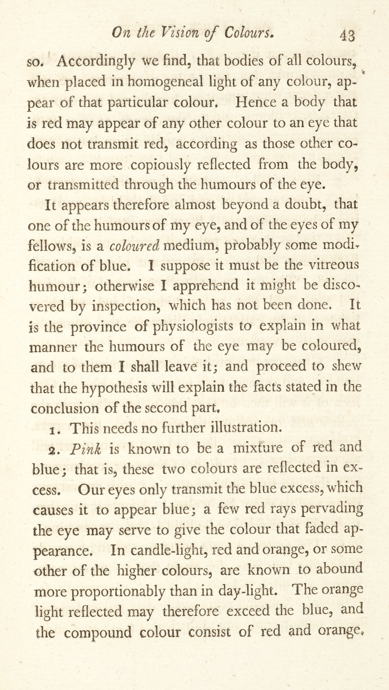
-------------
Image1
-------------
Field Data
Image Number JRL0923593dc
Reference Number J200061
Link to Catalogue <A href=http://man-fe.hosted.exlibrisgroup.com/MU_VU1:BLENDED:44MAN_ALMA_DS21150417930001631>UoM online catalogue.</a>
Image Title Extraordinary Facts relating to the Vision of Colours
Parent Work Title Memoirs of the Literary and Philosophical Society of Manchester
Creator Dalton, John, 1766-1844
Creator Role Author
Date Created 1798
Publication Details Manchester: Printed by George Nicholson for Cadell and Davies, London
Volume 5, Part 1
Page/Sheet 43
Image Sequence Number 5-1-043
Description Paper on 'Extraordinary Facts relating to the Vision of Colours: with observations' by John Dalton. Read October 31st 1794 by John Dalton to the Manchester Literary and Philosophical Society.
Language Code eng-GB
Subject Chemistry
Category of Material Printed
Time Period Covered 18th Century CE
Item Height 221 mm
Item Width 135 mm
Current Repository The University of Manchester Library, U.K.
Provenance Joule, James Prescott, 1818-1889, former owner
Rights Holder - Image The University of Manchester Library
Rights holder - Work The University of Manchester Library
Date Captured (yyyy-mm-dd) 2009-02-16
Multi Page Number 43
Image Creation Technique Digital capture by Heritage Imaging, The University of Manchester Library
Date Image Added (yyyy-mm) 2011-03
Metadata Language eng-GB

Slide 17
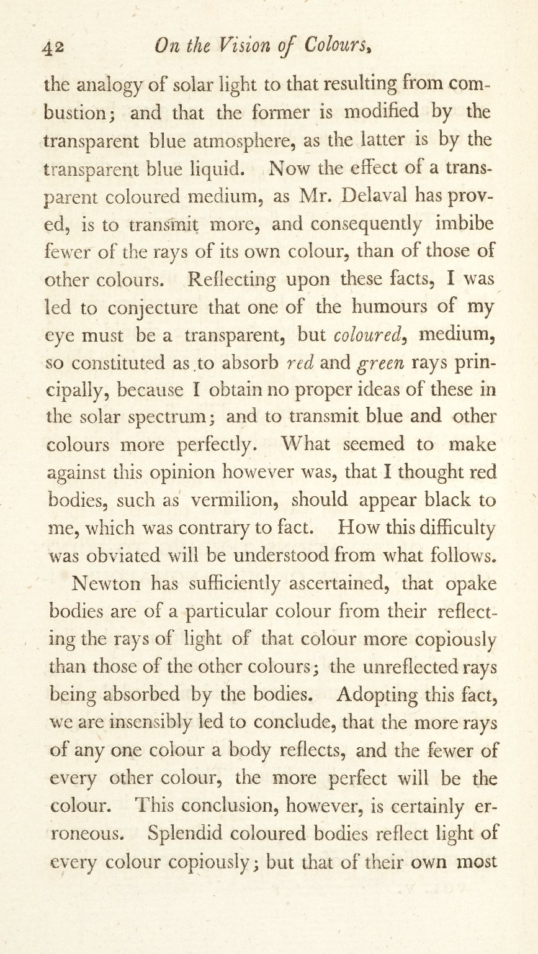
-------------
Image1
-------------
Field Data
Image Number JRL0923592dc
Reference Number J200061
Link to Catalogue <A href=http://man-fe.hosted.exlibrisgroup.com/MU_VU1:BLENDED:44MAN_ALMA_DS21150417930001631>UoM online catalogue.</a>
Image Title Extraordinary Facts relating to the Vision of Colours
Parent Work Title Memoirs of the Literary and Philosophical Society of Manchester
Creator Dalton, John, 1766-1844
Creator Role Author
Date Created 1798
Publication Details Manchester: Printed by George Nicholson for Cadell and Davies, London
Volume 5, Part 1
Page/Sheet 42
Image Sequence Number 5-1-042
Description Paper on 'Extraordinary Facts relating to the Vision of Colours: with observations' by John Dalton. Read October 31st 1794 by John Dalton to the Manchester Literary and Philosophical Society.
Language Code eng-GB
Subject Chemistry
Category of Material Printed
Time Period Covered 18th Century CE
Item Height 221 mm
Item Width 135 mm
Current Repository The University of Manchester Library, U.K.
Provenance Joule, James Prescott, 1818-1889, former owner
Rights Holder - Image The University of Manchester Library
Rights holder - Work The University of Manchester Library
Date Captured (yyyy-mm-dd) 2009-02-16
Multi Page Number 42
Image Creation Technique Digital capture by Heritage Imaging, The University of Manchester Library
Date Image Added (yyyy-mm) 2011-03
Metadata Language eng-GB

Slide 18
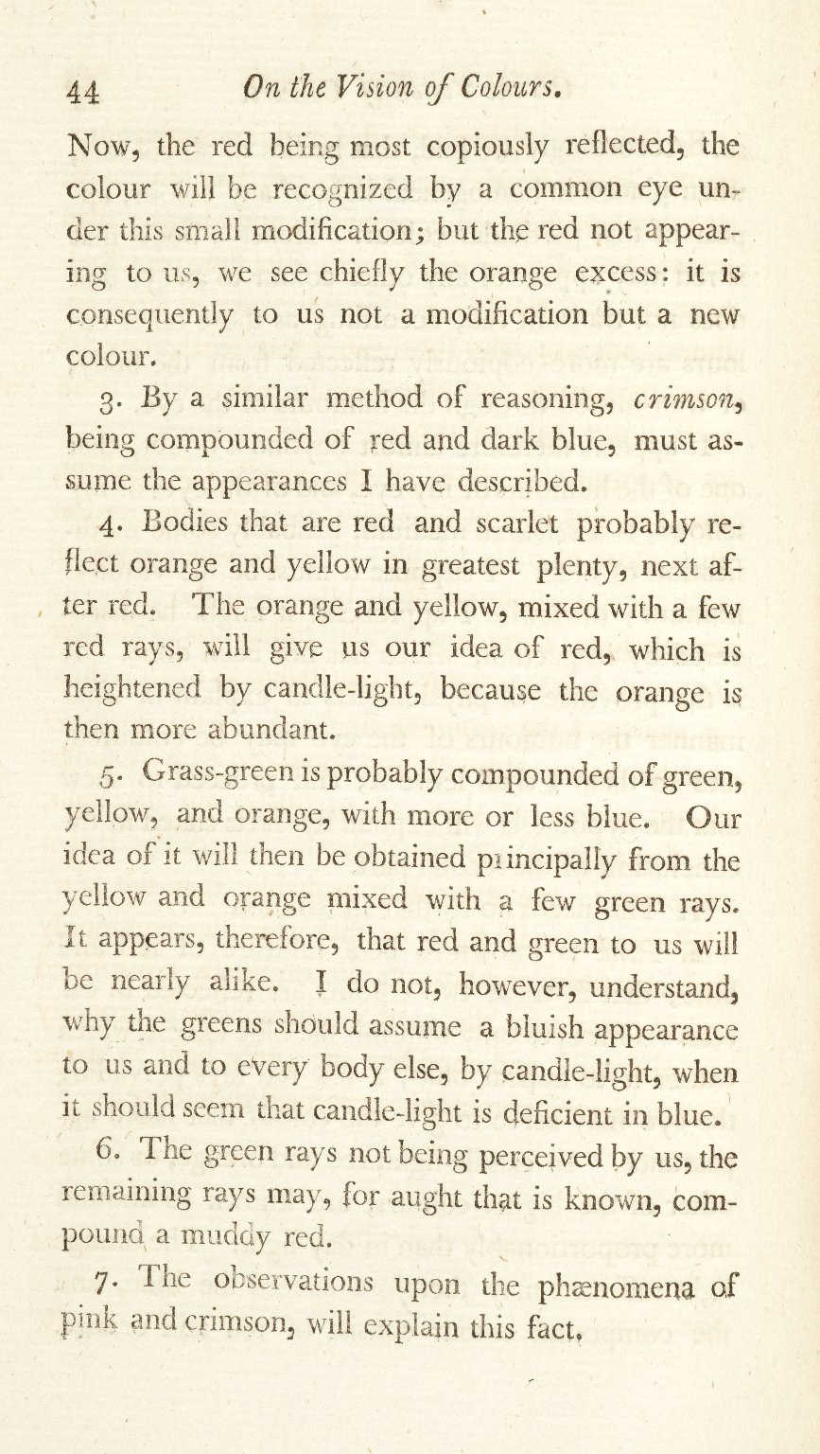
-------------
Image1
-------------
Field Data
Image Number JRL0923594dc
Reference Number J200061
Link to Catalogue <A href=http://man-fe.hosted.exlibrisgroup.com/MU_VU1:BLENDED:44MAN_ALMA_DS21150417930001631>UoM online catalogue.</a>
Image Title Extraordinary Facts relating to the Vision of Colours
Parent Work Title Memoirs of the Literary and Philosophical Society of Manchester
Creator Dalton, John, 1766-1844
Creator Role Author
Date Created 1798
Publication Details Manchester: Printed by George Nicholson for Cadell and Davies, London
Volume 5, Part 1
Page/Sheet 44
Image Sequence Number 5-1-044
Description Paper on 'Extraordinary Facts relating to the Vision of Colours: with observations' by John Dalton. Read October 31st 1794 by John Dalton to the Manchester Literary and Philosophical Society.
Language Code eng-GB
Subject Chemistry
Category of Material Printed
Time Period Covered 18th Century CE
Item Height 221 mm
Item Width 135 mm
Current Repository The University of Manchester Library, U.K.
Provenance Joule, James Prescott, 1818-1889, former owner
Rights Holder - Image The University of Manchester Library
Rights holder - Work The University of Manchester Library
Date Captured (yyyy-mm-dd) 2009-02-16
Multi Page Number 44
Image Creation Technique Digital capture by Heritage Imaging, The University of Manchester Library
Date Image Added (yyyy-mm) 2011-03
Metadata Language eng-GB

