Slide 6
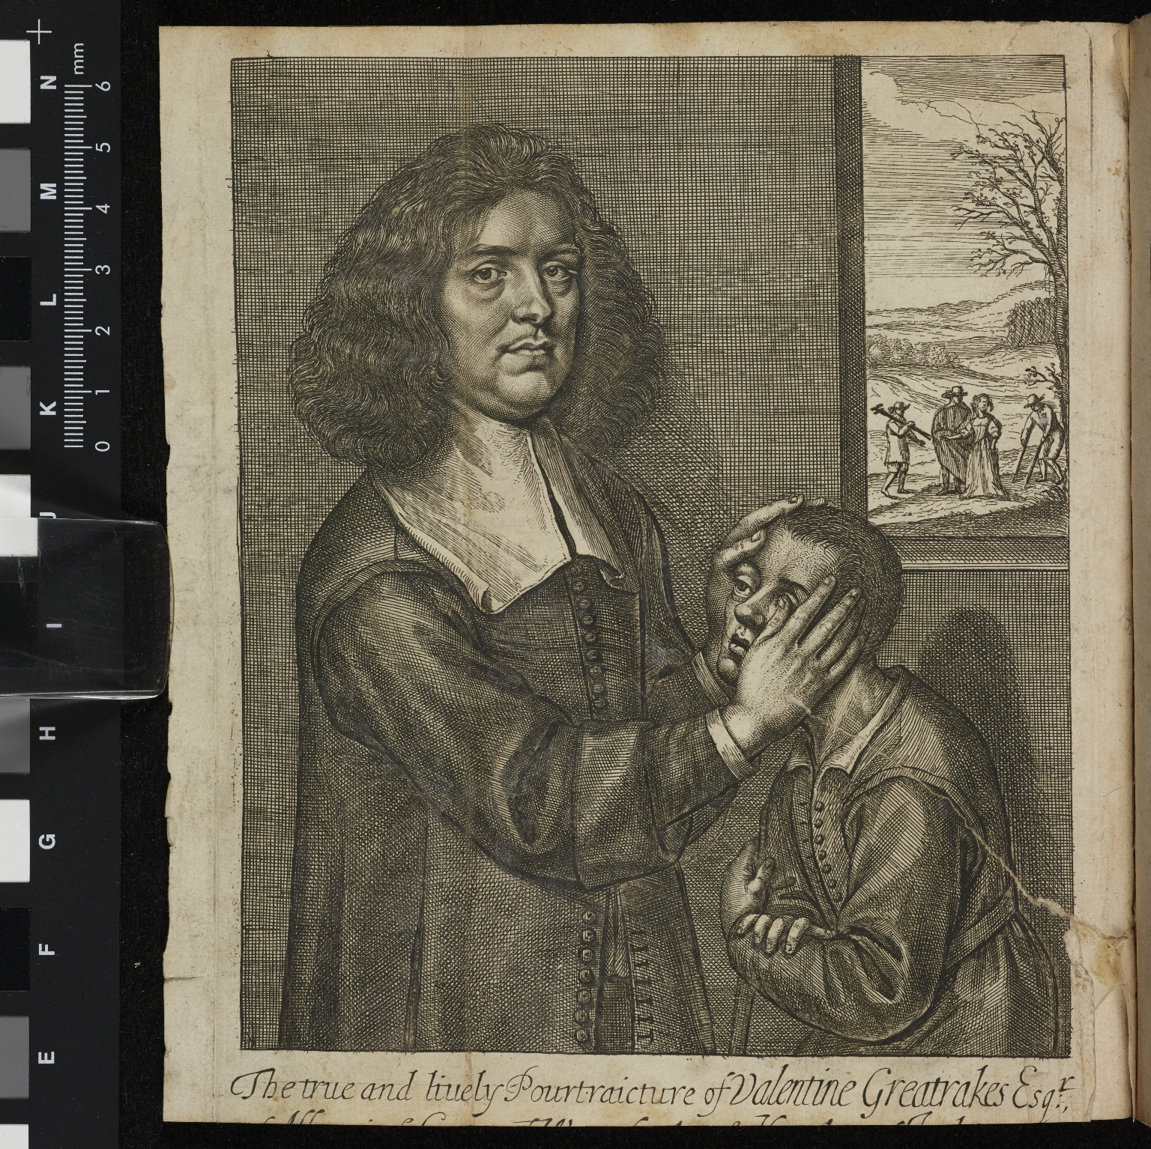
-------------
Image1
-------------
Field Data
Image Number JRL15091987
Reference Number UCC D944.2
Link to Catalogue <A href="http://man-fe.hosted.exlibrisgroup.com/MU_VU1:44MAN_ALMA_DS21199152400001631">UOM online catalogue.</a>
Image Title Illustrated frontispiece
Parent Work Title A brief account of Mr Valentine Greatrak's, and divers of the strange cures by him latelyperformed. / Written by himself in a letter addressed to the Honourable Robert Boyle Esq. whereunto are annexed the testimonials of several eminent and worthy persons of the chief matters of fact therein related.
Creator Greatrakes, Valentine, 1629-1683
Creator Role Author
Date Created 1666
Publication Details London: printed for J. Starkey, at the Mitre in Fleet-street, between the Middle Temple-Gate and Temple-Bar.
Page/Sheet Frontispiece
Language Code eng-GB
Language English
Subject Spiritual healing -- Early works to 1800
Subject Healers -- Great Britain -- Early works to 1800
Category of Material Printed
Sub-Category Portraits
Technique Used Engraving
Medium Ink
Support Paper
Time Period Covered 17th Century CE
Current Repository The University of Manchester Library, U.K.
Rights Holder - Image The University of Manchester Library
Rights holder - Work The University of Manchester Library
Image Creation Technique Digital capture by Heritage Imaging, The University of Manchester Library
Metadata Language eng-GB
Educational Notes Magic, Witches and Devils in the Early Modern World

