Slide 1
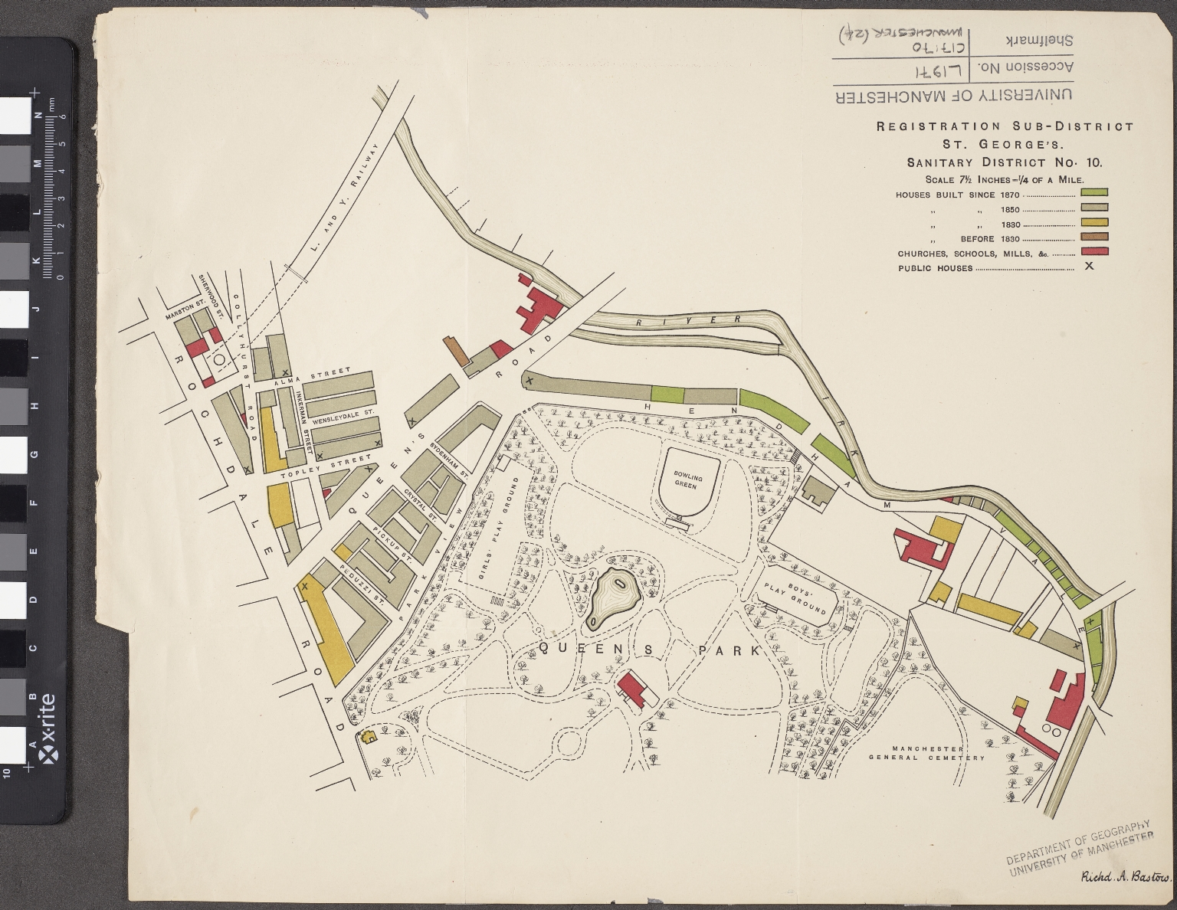
-------------
Image1
-------------
Field Data
Image Number JRL18043959
Reference Number Map Collection (Flat) C17:70 Manchester (24)
Series Title Report on the Health of the City of Manchester, 1880
Parent Work Title Registration Sub-District. St. George's. Sanitary District No. 10
Alternative Parent Work Title St. George's
Creator Manchester (England) City Council
Creator Role Author
Creator Bastow, Richard Austin, 1839-1920
Creator Role Surveyor
Date Created 1880
Publication Details Manchester: MCC
Scale 71/2 inches = 1/4 of a mile
Language Code eng-GB
Language Name English
Subject Public health--England
Subject Sanitation--England
Subject Manchester (England)--Maps
Subject Manchester (England)--Buildings, structures, etc.--Maps
Category of Material Printed
Support Paper
Time Period Covered 19th Century CE
Places Covered England: Greater Manchester: Manchester
Item Height 350 mm
Item Width 400 mm
Current Repository The University of Manchester Library, U.K.
Rights Holder - Image The University of Manchester Library
Rights holder - Work The University of Manchester Library
Access Rights <a rel="license" href="http://creativecommons.org/licenses/by-nc-sa/4.0/"><img alt="Creative Commons License" style="border-width:0" src="https://i.creativecommons.org/l/by-nc-sa/4.0/88x31.png" /></a><br />This work is licensed under a <a rel="license" href="http://creativecommons.org/licenses/by-nc-sa/4.0/">Creative Commons Attribution-NonCommercial-ShareAlike 4.0 International License.</a> Copyright of The University of Manchester
Date Captured (yyyy-mm-dd) 2018-04-26
Image Creation Technique Digital capture by Heritage Imaging, The University of Manchester Library
Academic Project Lead Martin Dodge
Date Image Added (yyyy-mm) 2018-05
Educational Notes Project: Victorian Sanitary Survey Maps for central Manchester
Metadata Language eng-GB

Slide 2
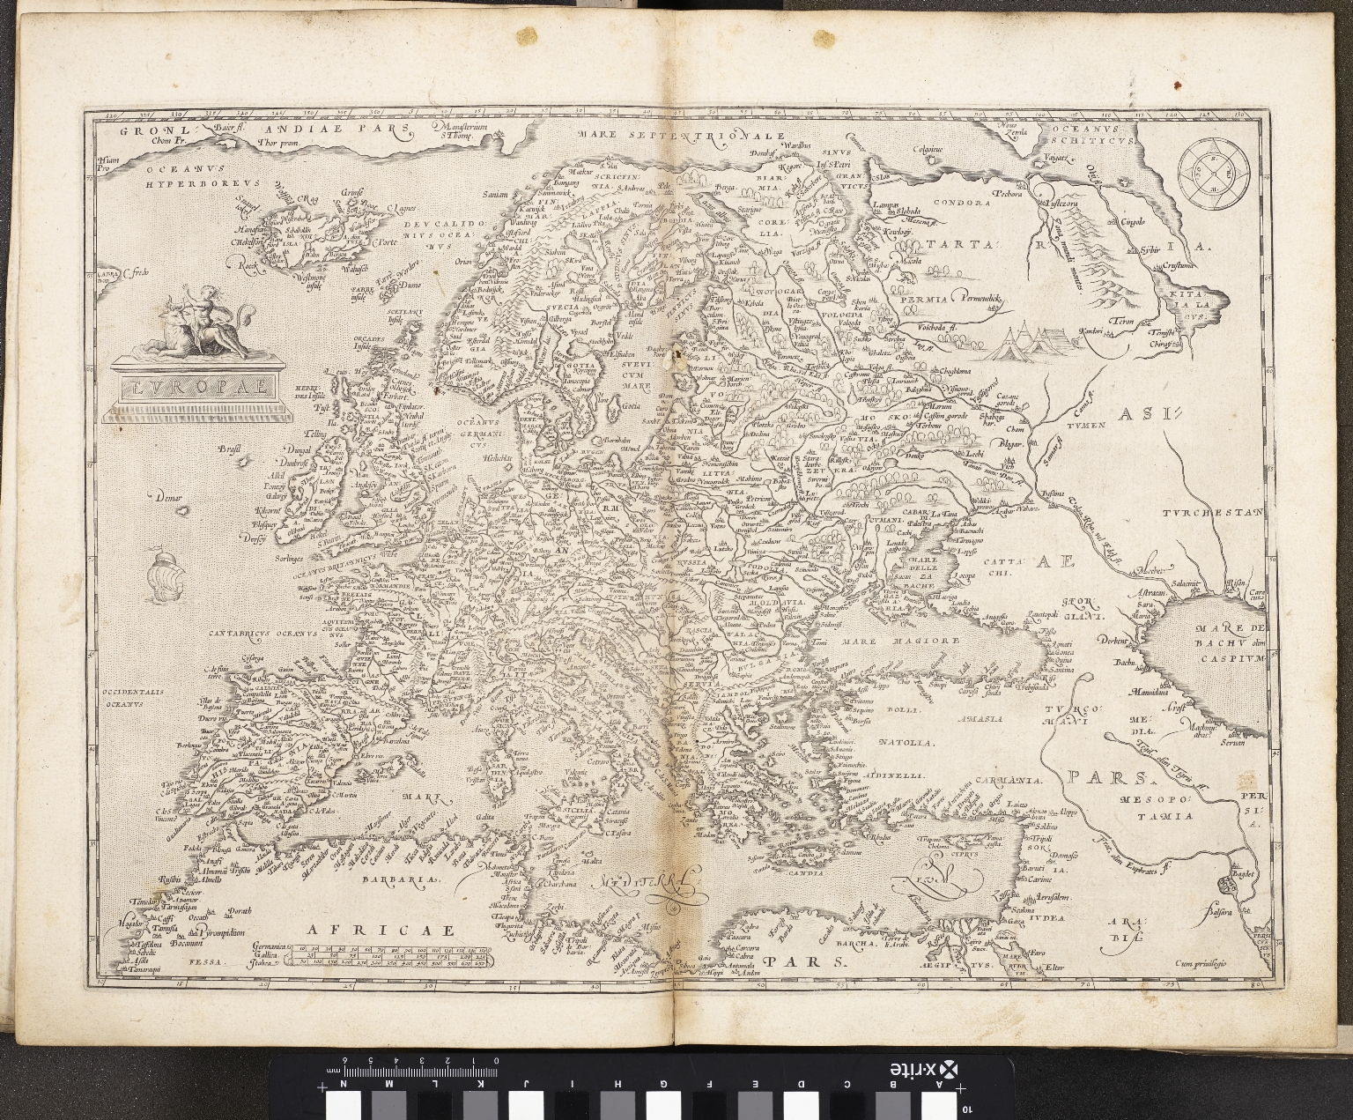
-------------
Image1
-------------
Field Data
Image Number JRL17062650
Reference Number Spencer 3905
Link to Catalogue <A href="http://www.librarysearch.manchester.ac.uk/MU_VU1:BLENDED:44MAN_ALMA_DS21152633310001631">UoM online catalogue</a>
Image Title Europe
Parent Work Title Theatrum Orbis Terrarum
Creator Ortelius, Abraham, 1527-1598
Creator Role Author
Date Created 1592
Publication Details Antwerp
Page/Sheet Plate 5
Image Sequence Number P005
Description Map of Europe.
Language Code lat
Language Name Latin
Category of Material Printed
Sub-Category Maps
Technique Used Printing (process)
Medium Ink
Support Paper
Creation Site Belgium: Antwerp
Item Height 400 mm
Item Width 510 mm
Current Repository The University of Manchester Library, U.K.
Provenance Spencer, George John Spencer, Earl, 1758-1834, former owner
Rights Holder - Image The University of Manchester Library
Rights holder - Work The University of Manchester Library
Access Rights <a rel="license" href="http://creativecommons.org/licenses/by-nc-sa/4.0/"><img alt="Creative Commons License" style="border-width:0" src="https://i.creativecommons.org/l/by-nc-sa/4.0/88x31.png" /></a><br />This work is licensed under a <a rel="license" href="http://creativecommons.org/licenses/by-nc-sa/4.0/">Creative Commons Attribution-NonCommercial-ShareAlike 4.0 International License.</a> Copyright of The University of Manchester
Date Captured (yyyy-mm-dd) 2017-06-28
Image Creation Technique Digital capture by Heritage Imaging, The University of Manchester Library
Academic Project Lead Julianne Simpson
Date Image Added (yyyy-mm) 2017-09
Educational Notes The Reformation Exhibition
Metadata Language eng-GB

Slide 3
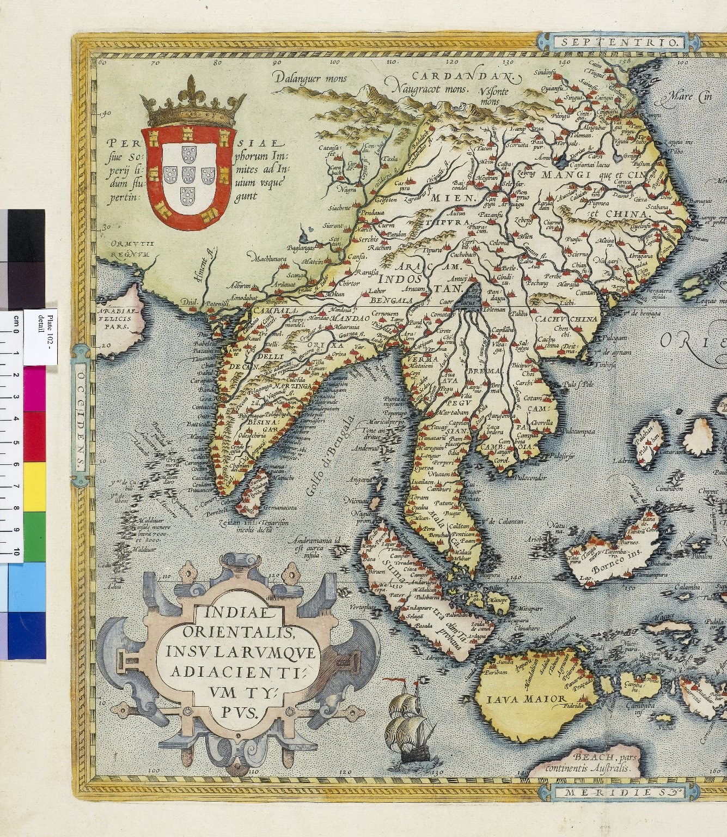
-------------
Image1
-------------
Field Data
Image Number JRL0805478dc
Reference Number 3905
Image Title Detail of India and South East Asia
Parent Work Title Theatrum Orbis Terrarum
Creator Ortelius, Abraham
Creator Role Cartographer
Date Created 1592
Publication Details Antwerp : Christophe Plantin
Page/Sheet Plate 102
Description Detail from plate 102: a map of India and South East Asia.
Category of Material Printed
Sub-Category Maps
Support Paper
Time Period Covered 16th Century CE
Places Covered China
Places Covered India
Item Height 345 mm
Item Width 510 mm
Current Repository The University of Manchester Library, U.K.
Rights Holder - Image The University of Manchester Library
Rights holder - Work The University of Manchester Library
Date Captured (yyyy-mm-dd) 2008-02-29
Image Creation Technique Digital capture by Gten
Date Image Added (yyyy-mm) 2008-08
Metadata Language eng-GB

Slide 4
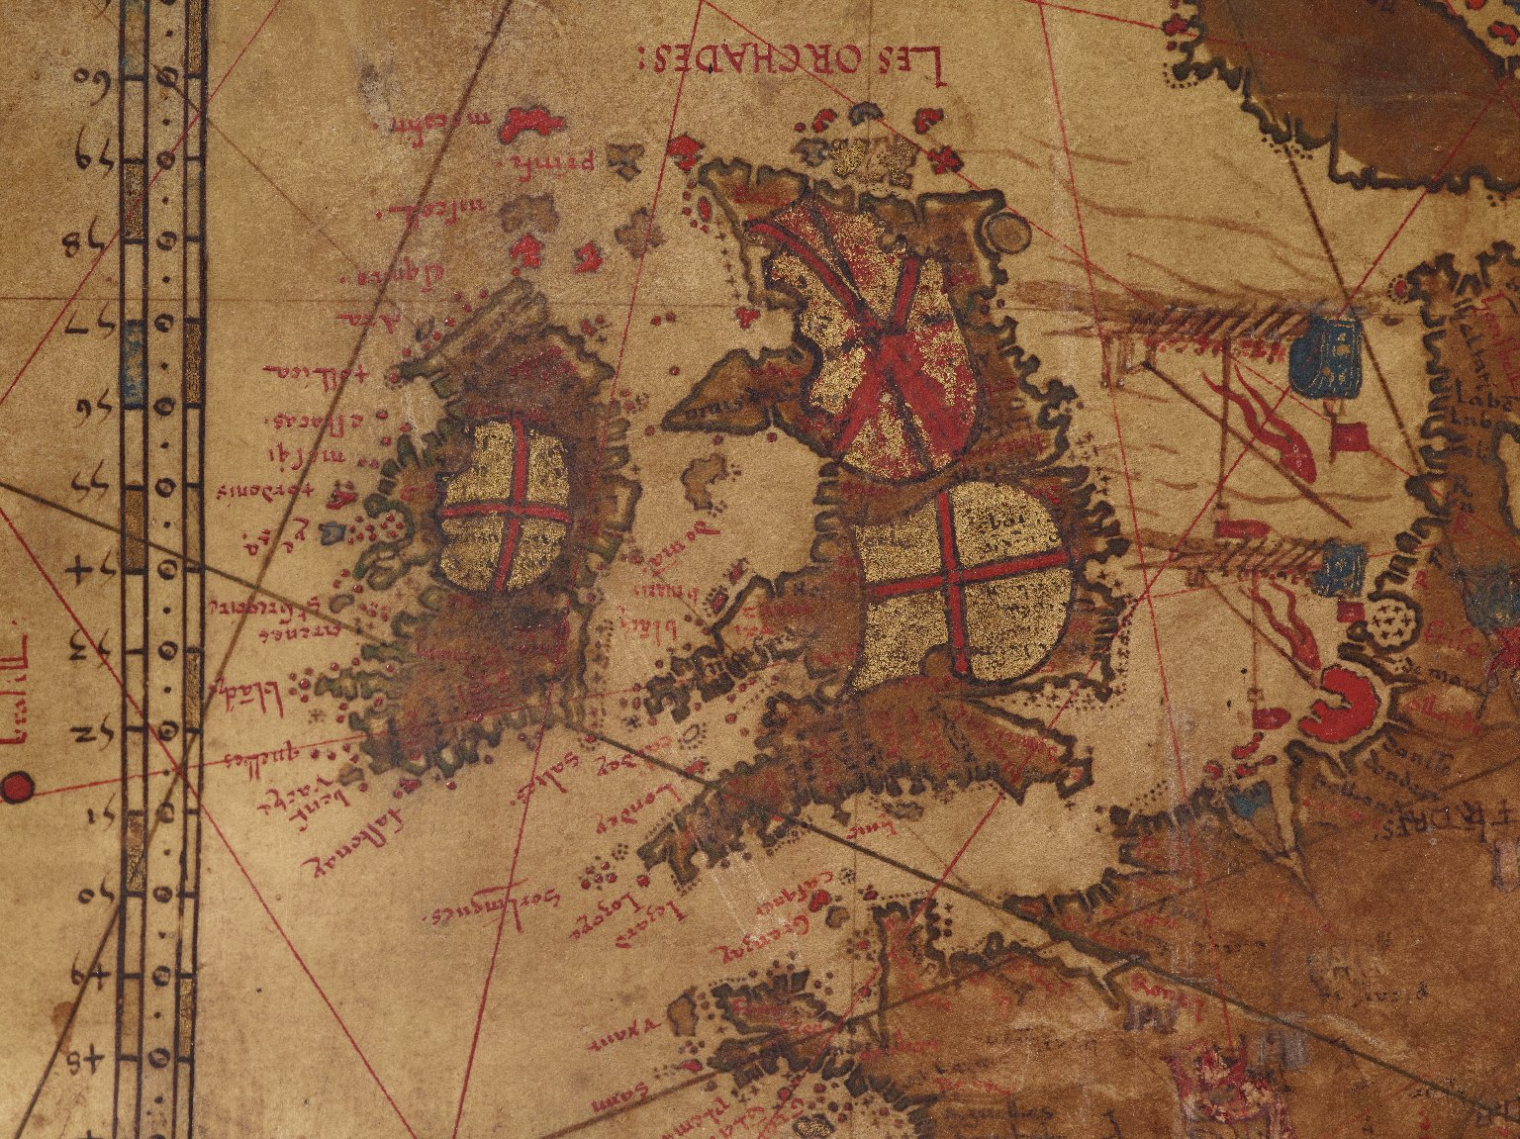
-------------
Image1
-------------
Field Data
Image Number JRL1118340
Reference Number French MS 1*
Image Title England, Scotland & Ireland
Parent Work Title Mappemonde
Translated Parent Work Title Map of the World
Creator Desceliers, Pierre
Creator Role Author
Date Created 1546
Page/Sheet Detail
Description Detail: England, Scotland and Ireland. The St George Cross appears on both England and Ireland. A shield with the cross of St Andrew covers Scotland.
Language Code fre-FR
Category of Material Manuscripts
Sub-Category Maps
Technique Used Painting
Support Parchment
Creation Site France
Time Period Covered 16th Century CE
Places Covered England
Places Covered Ireland
Places Covered Scotland
Item Height Map: 2600 mm
Item Width Map: 1300 mm
Current Repository The University of Manchester Library, U.K.
Provenance Jomard, M. E. F., former owner
Provenance Bibliotheca Lindesiana
Rights Holder - Image The University of Manchester Library
Rights holder - Work The University of Manchester Library
Date Captured (yyyy-mm-dd) 2011-02-21
Image Creation Technique Digital capture by Heritage Imaging, The University of Manchester Library
Date Image Added (yyyy-mm) 2011-04
Metadata Language eng-GB

Slide 5
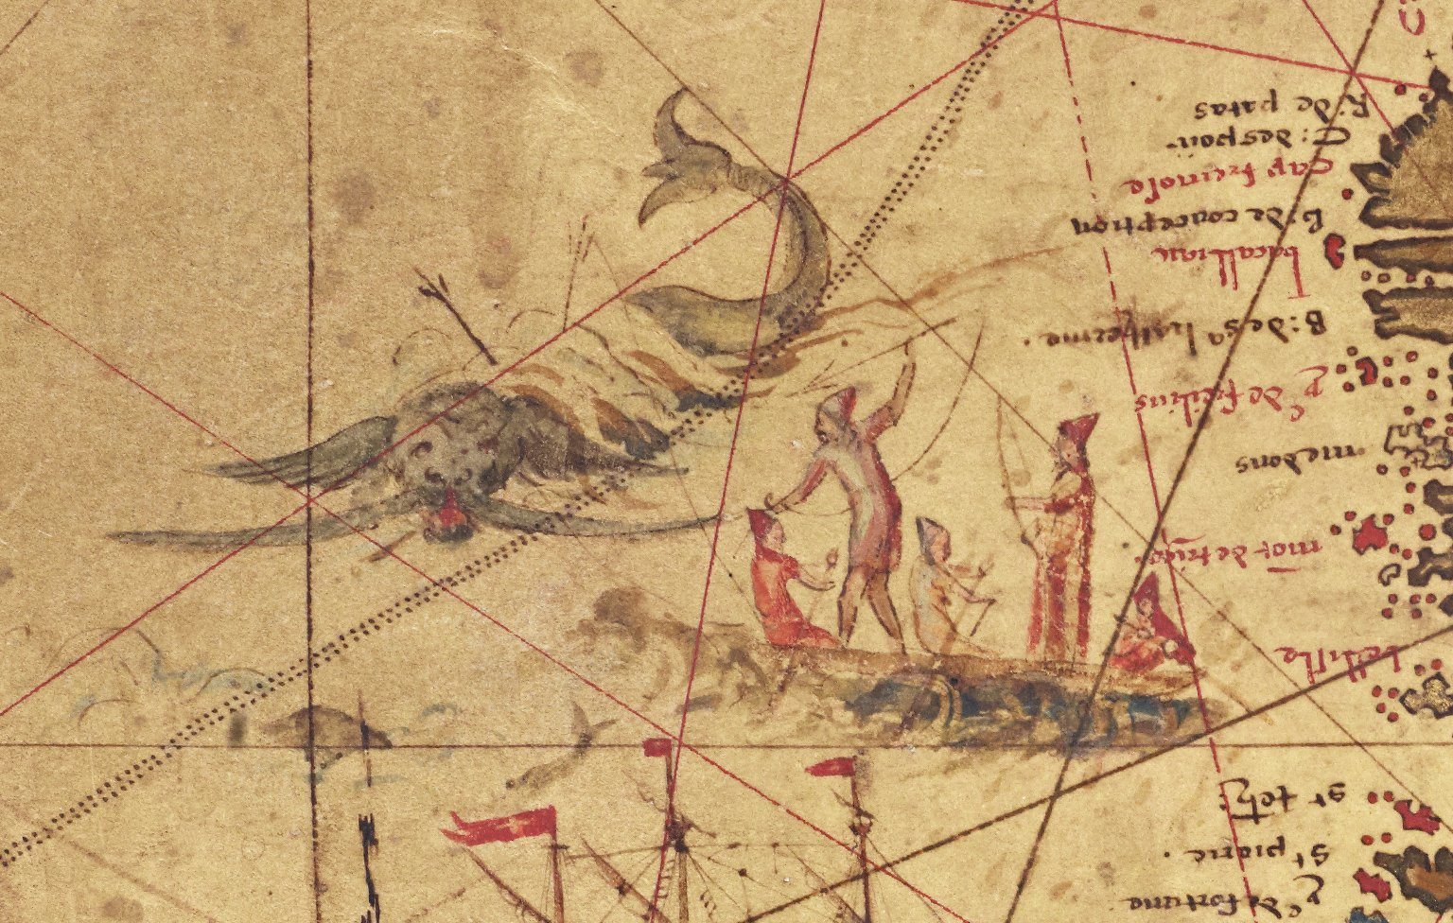
-------------
Image1
-------------
Field Data
Image Number JRL1118338
Reference Number French MS 1*
Image Title Whalers off the north coast of Newfoundland
Parent Work Title Mappemonde
Translated Parent Work Title Map of the World
Creator Desceliers, Pierre
Creator Role Author
Date Created 1546
Page/Sheet Detail
Description Detail: five men in a fishing boat harpooning a whale off the north coast of Newfoundland
Language Code fre-FR
Category of Material Manuscripts
Sub-Category Maps
Technique Used Painting
Support Parchment
Creation Site France
Time Period Covered 16th Century CE
Places Covered Canada: Newfoundland
Item Height Map: 2600 mm
Item Width Map: 1300 mm
Current Repository The University of Manchester Library, U.K.
Provenance Jomard, M. E. F., former owner
Provenance Bibliotheca Lindesiana
Rights Holder - Image The University of Manchester Library
Rights holder - Work The University of Manchester Library
Date Captured (yyyy-mm-dd) 2011-02-21
Image Creation Technique Digital capture by Heritage Imaging, The University of Manchester Library
Date Image Added (yyyy-mm) 2011-04
Metadata Language eng-GB

Slide 6
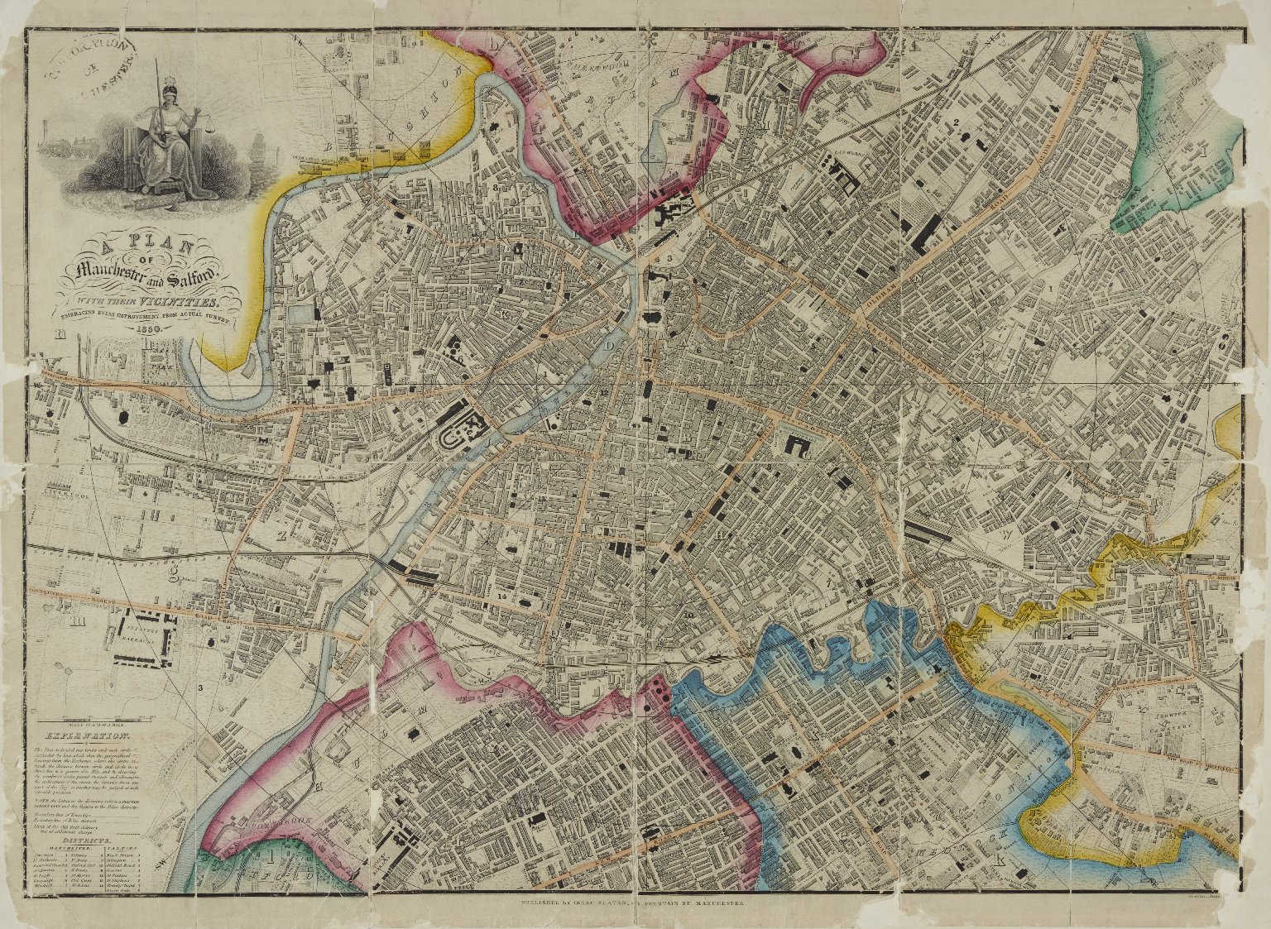
-------------
Image1
-------------
Field Data
Image Number 1850 Slater(Coloured)
Reference Number GB127.Local Studies Street Map Collection/1850 Slater coloured
Image Title Manchester and Salford
Parent Work Title A Plan of Manchester and Salford with Vicinities
Creator Slater, Isaac
Creator Role Engraver
Date Created 1850
Publication Details Manchester: Isaac Slater, 55 Fountain St.
Description Plan of Manchester and Salford. Illustration: Justice seated, blindfolded and holding scales; in the background, a train (left) and a ship (right). Shows parts of Cheetham Hill, Cheetwood, Broughton, Hulme, Newton and Chorlton upon Medlock. Coloured. Scale of a 1/4 of a mile.
Language Code eng-GB
Language Name English
Category of Material Printed
Sub-Category Illustration
Technique Used Engraving (printing process)
Support Paper
Time Period Covered 19th Century CE
Places Covered England: Greater Manchester: Salford
Places Covered England: Greater Manchester: Manchester
Item Height 450 mm
Item Width 600 mm
Current Repository Manchester Archives and Local Studies
Rights Holder - Image Manchester Libraries, Information and Archives, Manchester City Council
Rights holder - Work Manchester Libraries, Information and Archives, Manchester City Council
Notes All image requests to be directed to <a href="http://www.manchester.gov.uk/info/448/archives_and_local_history/7378/access_our_archives_rare_books_and_collections/3">Manchester Archives and Local Studies</a>
Date Captured (yyyy-mm-dd) 2010-04-15
Image Creation Technique Digital capture by Heritage Imaging, The University of Manchester Library
Date Image Added (yyyy-mm) 2012-11
Metadata Language eng-GB

Slide 7
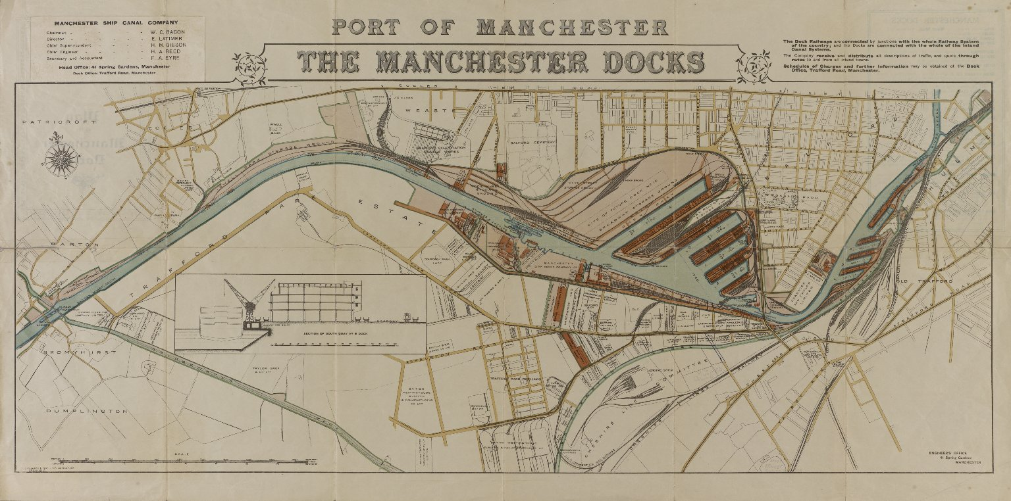
-------------
Image1
-------------
Field Data
Image Number JRL1300198
Reference Number Map Collection
Link to Catalogue <A href=http://man-fe.hosted.exlibrisgroup.com/MU_VU1:LSCOP_ALMA:44MAN_ALMA_DS21202456690001631>UoM online catalogue.</a>
Image Title Port of Manchester
Alternative Image Title Manchester docks
Parent Work Title Port of Manchester: the Manchester docks
Alternative Parent Work Title Port of Manchester [cartographic material] : plan of the Manchester docks
Date Created 1913
Publication Details [Manchester]: [Manchester Ship Canal Co.]
Description Map: port of Manchester. Inset diagram showing section of South Quay, No. 9 dock. Statement of responsibilty: Manchester Ship Canal Company. In bottom right-hand corner: 'Engineer's Office, 41 Spring Gardens, Manchester'. Coloured. Scale: 1 inch = approx. 650 feet.
Language Code eng-GB
Subject Manchester Ship Canal (England)
Category of Material Printed
Sub-Category Maps
Time Period Covered 20th Century CE
Places Covered England: Greater Manchester: Trafford
Places Covered England: Greater Manchester: Salford
Places Covered England: Greater Manchester: Manchester
Item Height Map: 340 mm
Item Height Sheet: 450 mm
Item Width Map: 850 mm
Item Width Sheet: 890 mm
Current Repository The University of Manchester Library, U.K.
Rights Holder - Image The University of Manchester Library
Rights holder - Work The University of Manchester Library
Date Captured (yyyy-mm-dd) 2012-09-28
Image Creation Technique Digital capture by Heritage Imaging, The University of Manchester Library
Date Image Added (yyyy-mm) 2012-11
Metadata Language eng-GB

Slide 8
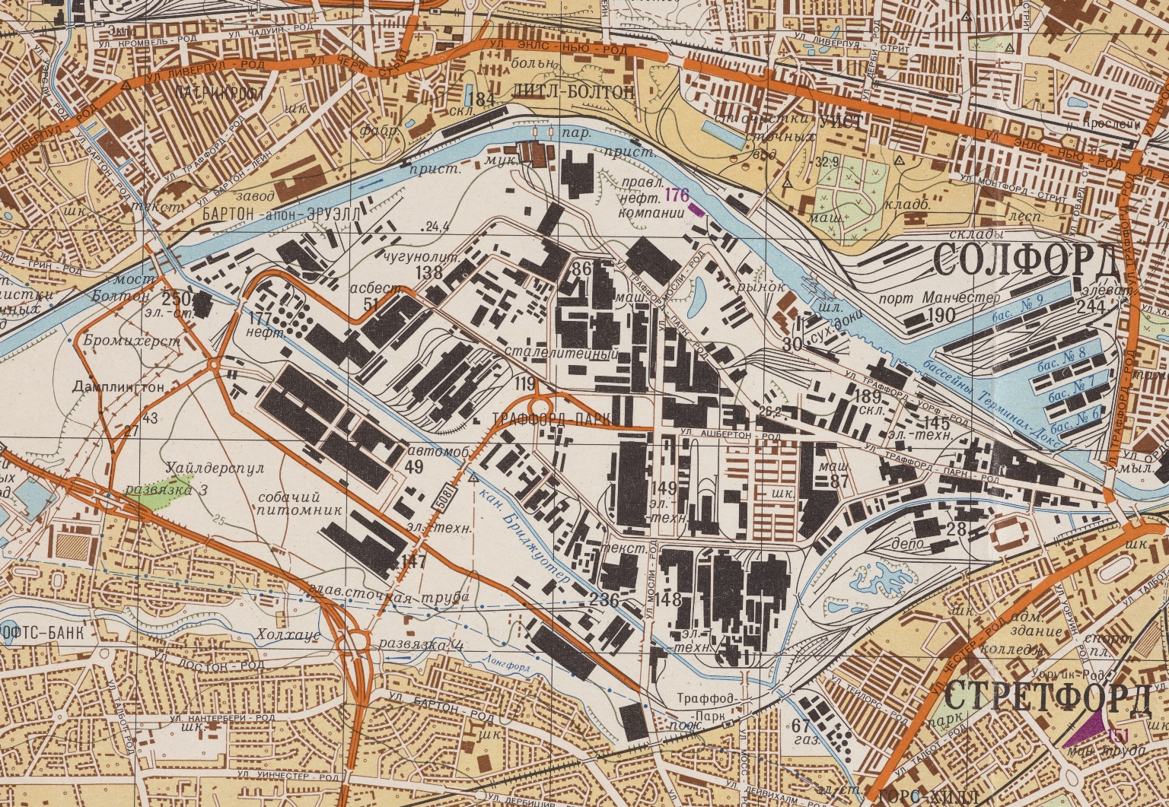
-------------
Image1
-------------
Field Data
Image Number JRL18031542
Reference Number Manchester Map Collection: C17:41
Image Title Soviet military map of West and South West Manchester
Parent Work Title Soviet military map of Manchester and surrounding areas
Creator Military Topographic Directorate (VTU)
Creator Role Cartographer
Date Created 1975
Page/Sheet Sheet 3
Scale 1:25,000
Image Sequence Number 003
Description Detail from Soviet military map of West and South West Manchester and surrounding areas: Salford, Altrincham, Lymm, Sale. Scale: 1:25,000. Labelled in Cyrillic. Important buildings are identified by three criteria: government and communications (purple), military (green), and military-industrial (black).
Language Code rus
Language Name Russian
Subject Military history
Subject Russia--History
Category of Material Printed
Support Paper
Time Period Covered 20th Century CE
Item Height 930 mm
Item Width 830 mm
Current Repository The University of Manchester Library, U.K.
Rights Holder - Image The University of Manchester Library
Rights holder - Work The University of Manchester Library
Date Captured (yyyy-mm-dd) 2018-03-15
Image Creation Technique Digital capture by Heritage Imaging, The University of Manchester Library
Date Image Added (yyyy-mm) 2018-04
Metadata Language eng-GB

Slide 9
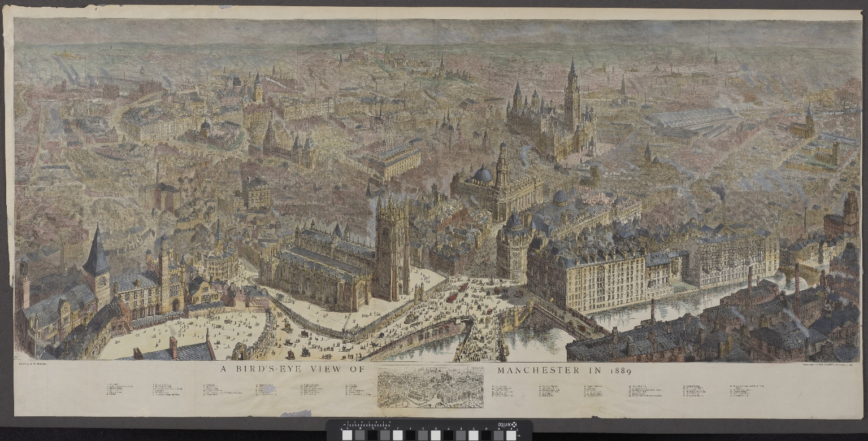
-------------
Image1
-------------
Field Data
Image Number JRL18082507
Reference Number Map Collection (Flat) C17:70 Manchester (23)
Parent Work Title A Bird's-eye view of Manchester in 1889
Creator Brewer, Henry William, 1836-1903
Creator Role Illustrator
Date Created 1889
Description Bird's Eye View Manchester 1889 by H. W. Brewer. Detailed view of nineteenth century Manchester, England. In the bottom margin there is a key to 70 different places of interest: 1. Cathedral, 2. Exchange Station Approach, 3. Victoria Bridge, 4. Victoria Terrace, 5. Victoria Street, 6. Salford, 7. Blackfriars Bridge, 8. St Mary's Church, 9. Grosvenor Buildings and Hotel, 10. Deansgate, 11. St Mary's Gate, 12. Victoria Buildings Hotel, 13. Exchange, 14. Market Place, 15. Courier Office, 16. Corporation Street, 17. Civil Service Stores - Wholesale Department, 18. Fennel Street, 19. Grammar School, 20. Old College, 21. Smithfield, 22. Great Ancoats Street, 23. Ancoats Hall, 24. St Andrew's Church, 25. Nicholl's Hospital, 26. Ardwick Green, 27. London Road Station, 28. Portland Place, 29. City Police Courts, 30. Rochdale Canal, 31. Infirmary, 32. Piccadilly, 33. Lewis, 34. Watts' Warehouse, 35. Victoria Park, 36. Church of the Holy Name, 37. Eye Hospital, 38. Victoria University - Owens College, 39. Chorlton Town Hall, 40. School of Art, 41. Independent Church, 42. Grosvenor, 43. Square All Saints' Church, 44. Presbyterian Church, 45. St James's Church, 46. Post Office, 47. Reform Club, 48. Royal Institution, 49. Athenaeum, 50. Town Hall, 51. St James's Hall, 52. St Peter's Church, 53. Reference Library, 54. Albert Memorial, 55. St Ann's Church, 56. St Mary's Roman Catholic Church, 57. Free Trade Hall, 58. Theatre Royal, 59. Young Men's Christian Association, 60. Central Station, 61. St Philip's Church, 62. Holy Trinity Church 63. St Mary Moss Lane 64. Alexandra Park 65. Bridgwater Viaduct 66. Bridgwater Canal Knott Mill Station 67. St Matthew's Church 68. Tonman Market 69. Dean's Gate Market 70. St John's Church. Hand coloured wood engraving.
Keyword Bird's eye view; Maps; Panoramas; Art; Illustration; Manchester, England; Architecture; Buildings and Structures; Churches; Cathedrals; Hotels and Lodges;
Language Code eng-GB
Language Name English
Subject Sanitation--England
Subject Manchester (England)--Maps
Subject Manchester (England)--Buildings, structures, etc.--Maps
Subject Panoramas--England
Subject Panoramic views--1860-1890
Category of Material Printed
Sub-Category Maps
Technique Used Engraving (printing process)
Technique Used Drawing (image-making)
Support Paper
Time Period Covered 19th Century CE
Places Covered England: Greater Manchester: Manchester
Item Height 1200 mm
Item Width 580 mm
Current Repository The University of Manchester Library, U.K.
Rights Holder - Image The University of Manchester Library
Rights holder - Work The University of Manchester Library
Access Rights <a rel="license" href="http://creativecommons.org/licenses/by-nc-sa/4.0/"><img alt="Creative Commons License" style="border-width:0" src="https://i.creativecommons.org/l/by-nc-sa/4.0/88x31.png" /></a><br />This work is licensed under a <a rel="license" href="http://creativecommons.org/licenses/by-nc-sa/4.0/">Creative Commons Attribution-NonCommercial-ShareAlike 4.0 International License.</a> Copyright of The University of Manchester
Date Captured (yyyy-mm-dd) 2018-08-30
Image Creation Technique Digital capture by Heritage Imaging, The University of Manchester Library
Date Image Added (yyyy-mm) 2018-09
Metadata Language eng-GB

Slide 10
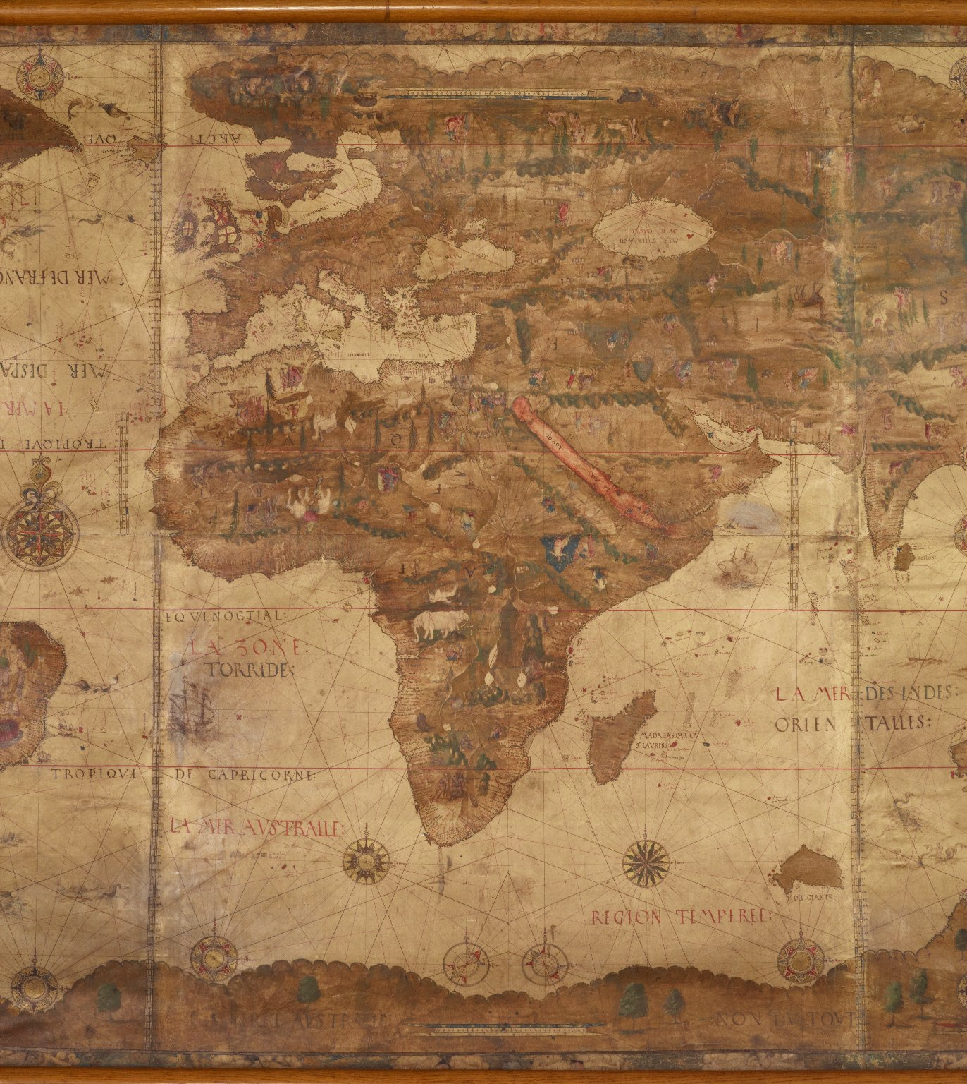
-------------
Image1
-------------
Field Data
Image Number JRL1120286
Reference Number French MS 1*
Image Title Europe & Africa
Parent Work Title Mappemonde
Translated Parent Work Title Map of the World
Creator Desceliers, Pierre
Creator Role Author
Date Created 1546
Page/Sheet Detail
Description Detail: middle third of map, showing Europe and Africa
Language Code fre-FR
Category of Material Manuscripts
Sub-Category Maps
Support Parchment
Creation Site France
Time Period Covered 16th Century CE
Places Covered Europe
Places Covered Africa
Item Height Map: 2600 mm
Item Width Map: 1300 mm
Current Repository The University of Manchester Library, U.K.
Rights Holder - Image The University of Manchester Library
Rights holder - Work The University of Manchester Library
Date Captured (yyyy-mm-dd) 2011-02-21
Image Creation Technique Digital capture by Heritage Imaging, The University of Manchester Library
Date Image Added (yyyy-mm) 2011-04
Metadata Language eng-GB

