Slide 1
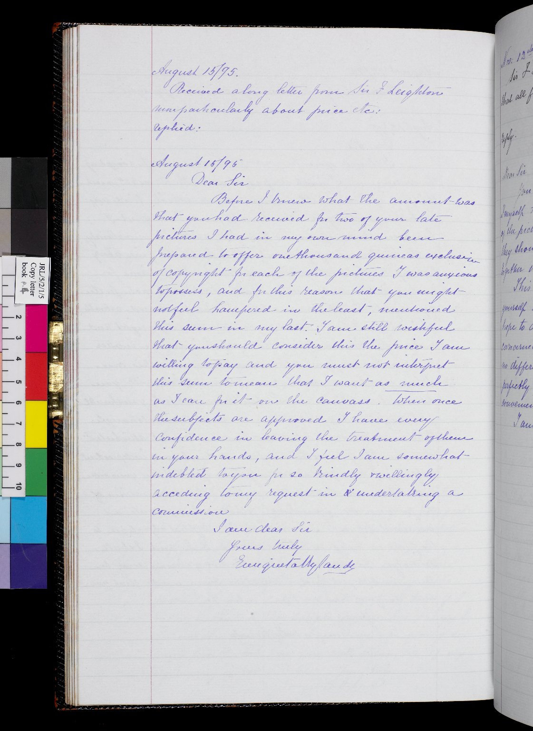
-------------
Image1
-------------
Field Data
Image Number JRL0802268dc
Reference Number JRL/5/2/1/5
Image Title Letter to Sir Frederic Leighton
Parent Work Title Letter copy-book
Creator Rylands, Enriqueta
Creator Role Author
Date Created 1895-08
Description Copy of a letter sent by Enriqueta Rylands to Sir Frederic Leighton regarding panels he was to paint for her at her home, Longford Hall in Manchester.
Language Code eng-GB
Subject Letters
Subject Art
Category of Material Archives
Sub-Category Correspondence
Technique Used Handwriting
Support Paper
Time Period Covered 19th Century CE
Item Height 322 mm
Item Width 200 mm
Current Repository The University of Manchester Library, U.K.
Rights Holder - Image University of Manchester Library
Rights holder - Work The University of Manchester Library
Access Rights <a rel="license" href="http://creativecommons.org/licenses/by-nc-sa/4.0/"><img alt="Creative Commons License" style="border-width:0" src="https://i.creativecommons.org/l/by-nc-sa/4.0/88x31.png"></a>
Date Captured (yyyy-mm-dd) 2007-11-02
Image Creation Technique Digital capture by Gten
Date Image Added (yyyy-mm) 2008-01
Metadata Language eng-GB

Slide 2
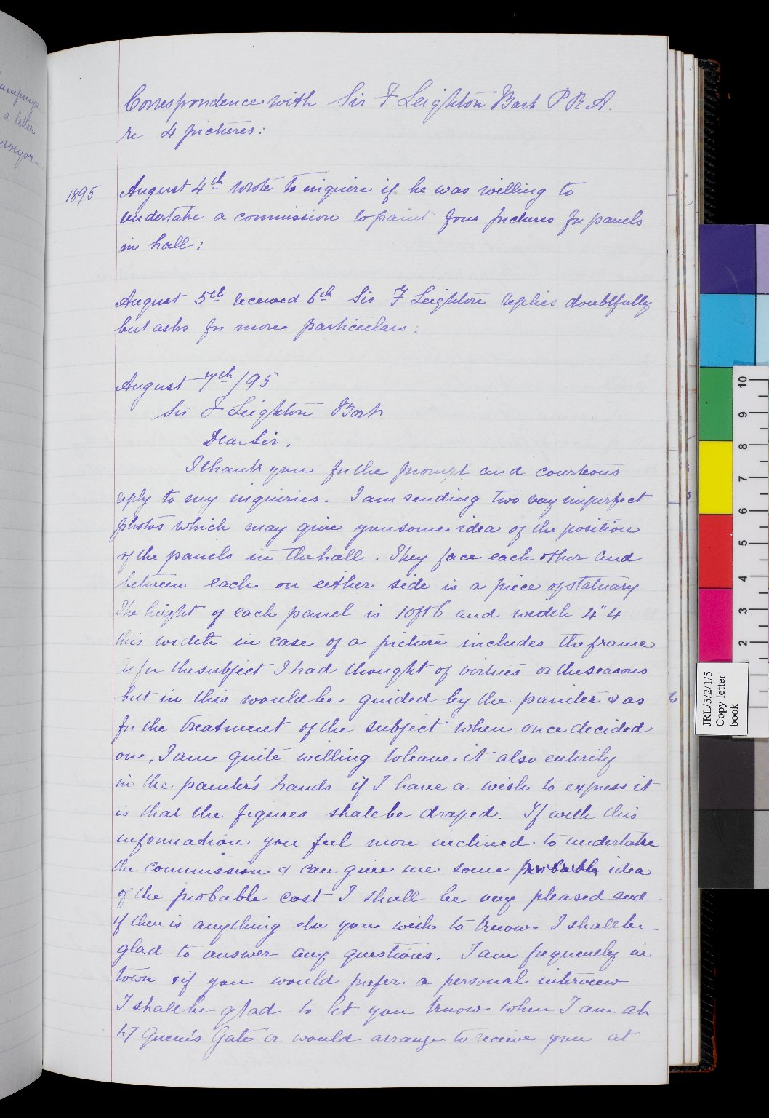
-------------
Image1
-------------
Field Data
Image Number JRL0802265dc
Reference Number JRL/5/2/1/5
Image Title Letter to Sir Frederic Leighton
Parent Work Title Letter copy-book
Creator Rylands, Enriqueta
Creator Role Author
Date Created 1895-08
Description Copy of a letter sent by Enriqueta Rylands to Sir Frederic Leighton regarding panels he was to paint for her at her home, Longford Hall in Manchester.
Language Code eng-GB
Subject Art
Subject Letters
Category of Material Archives
Sub-Category Correspondence
Technique Used Handwriting
Support Paper
Time Period Covered 19th Century CE
Item Height 322 mm
Item Width 200 mm
Current Repository The University of Manchester Library, U.K.
Rights Holder - Image University of Manchester Library
Rights holder - Work The University of Manchester Library
Access Rights <a rel="license" href="http://creativecommons.org/licenses/by-nc-sa/4.0/"><img alt="Creative Commons License" style="border-width:0" src="https://i.creativecommons.org/l/by-nc-sa/4.0/88x31.png"></a>
Date Captured (yyyy-mm-dd) 2007-11-02
Image Creation Technique Digital capture by Gten
Date Image Added (yyyy-mm) 2008-01
Metadata Language eng-GB

Slide 3
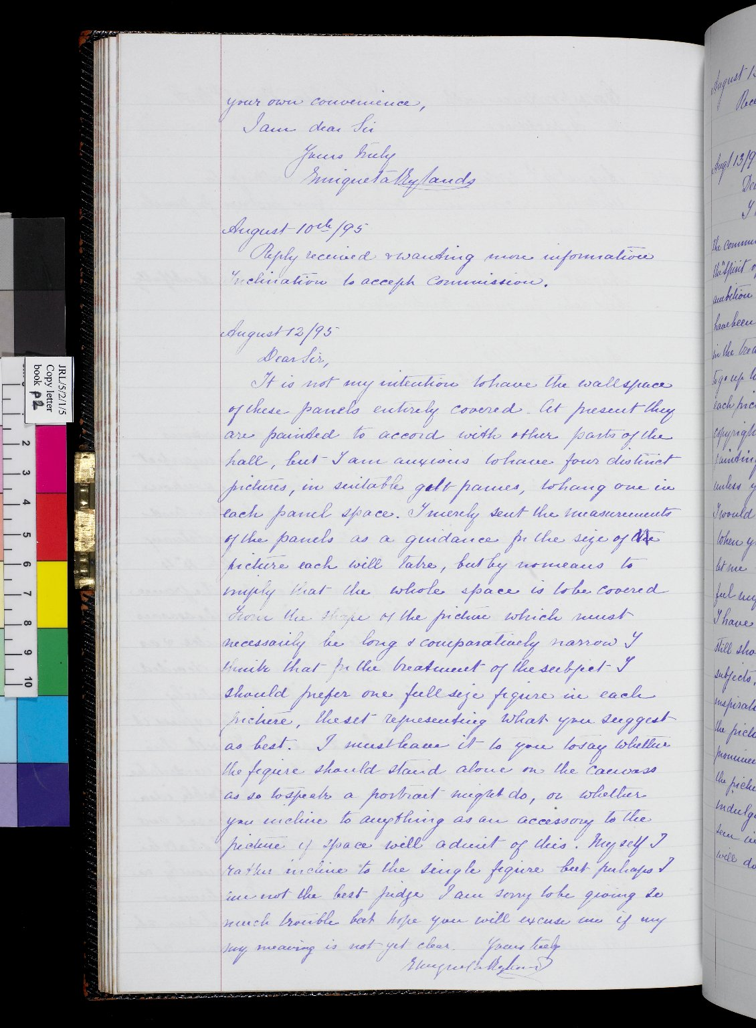
-------------
Image1
-------------
Field Data
Image Number JRL0802266dc
Reference Number JRL/5/2/1/5
Image Title Letter to Sir Frederic Leighton
Parent Work Title Letter copy-book
Creator Rylands, Enriqueta
Creator Role Author
Date Created 1895-08
Description Copy of a letter sent by Enriqueta Rylands to Sir Frederic Leighton regarding panels he was to paint for her at her home, Longford Hall in Manchester.
Language Code eng-GB
Subject Art
Subject Letters
Category of Material Archives
Sub-Category Correspondence
Technique Used Handwriting
Support Paper
Time Period Covered 19th Century CE
Item Height 322 mm
Item Width 200 mm
Current Repository The University of Manchester Library, U.K.
Rights Holder - Image University of Manchester Library
Rights holder - Work The University of Manchester Library
Access Rights <a rel="license" href="http://creativecommons.org/licenses/by-nc-sa/4.0/"><img alt="Creative Commons License" style="border-width:0" src="https://i.creativecommons.org/l/by-nc-sa/4.0/88x31.png"></a>
Date Captured (yyyy-mm-dd) 2007-11-02
Image Creation Technique Digital capture by Gten
Date Image Added (yyyy-mm) 2008-01
Metadata Language eng-GB

Slide 4
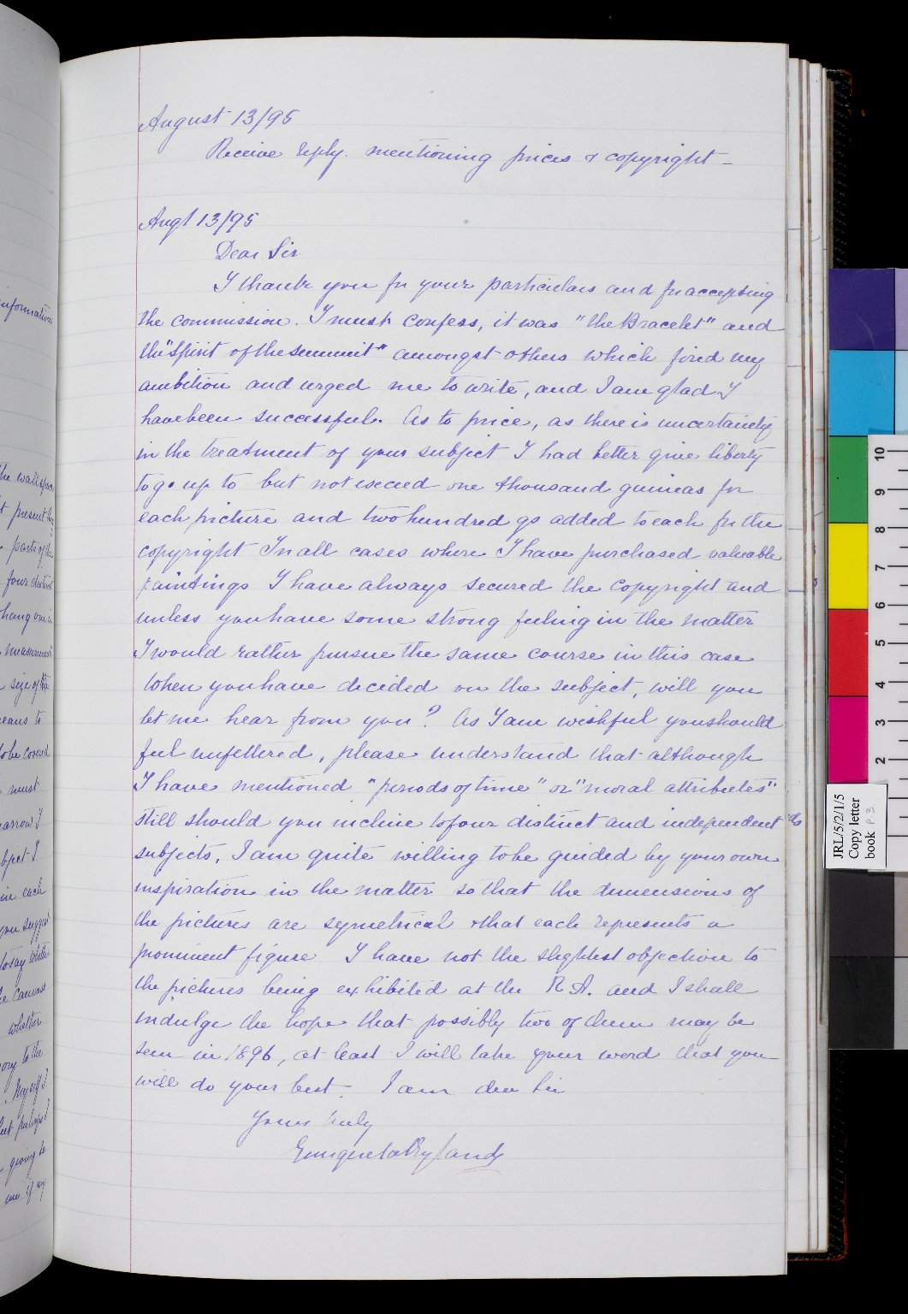
-------------
Image1
-------------
Field Data
Image Number JRL0802267dc
Reference Number JRL/5/2/1/5
Image Title Letter to Sir Frederic Leighton
Parent Work Title Letter copy-book
Creator Rylands, Enriqueta
Creator Role Author
Date Created 1985-08
Description Copy of a letter sent by Enriqueta Rylands to Sir Frederic Leighton regarding panels he was to paint for her at her home, Longford Hall in Manchester.
Language Code eng-GB
Subject Art
Subject Letters
Category of Material Archives
Sub-Category Correspondence
Technique Used Handwriting
Support Paper
Time Period Covered 19th Century CE
Item Height 322 mm
Item Width 200 mm
Current Repository The University of Manchester Library, U.K.
Rights Holder - Image University of Manchester Library
Rights holder - Work The University of Manchester Library
Access Rights <a rel="license" href="http://creativecommons.org/licenses/by-nc-sa/4.0/"><img alt="Creative Commons License" style="border-width:0" src="https://i.creativecommons.org/l/by-nc-sa/4.0/88x31.png"></a>
Date Captured (yyyy-mm-dd) 2007-11-02
Image Creation Technique Digital capture by Gten
Date Image Added (yyyy-mm) 2008-01
Metadata Language eng-GB

Slide 5
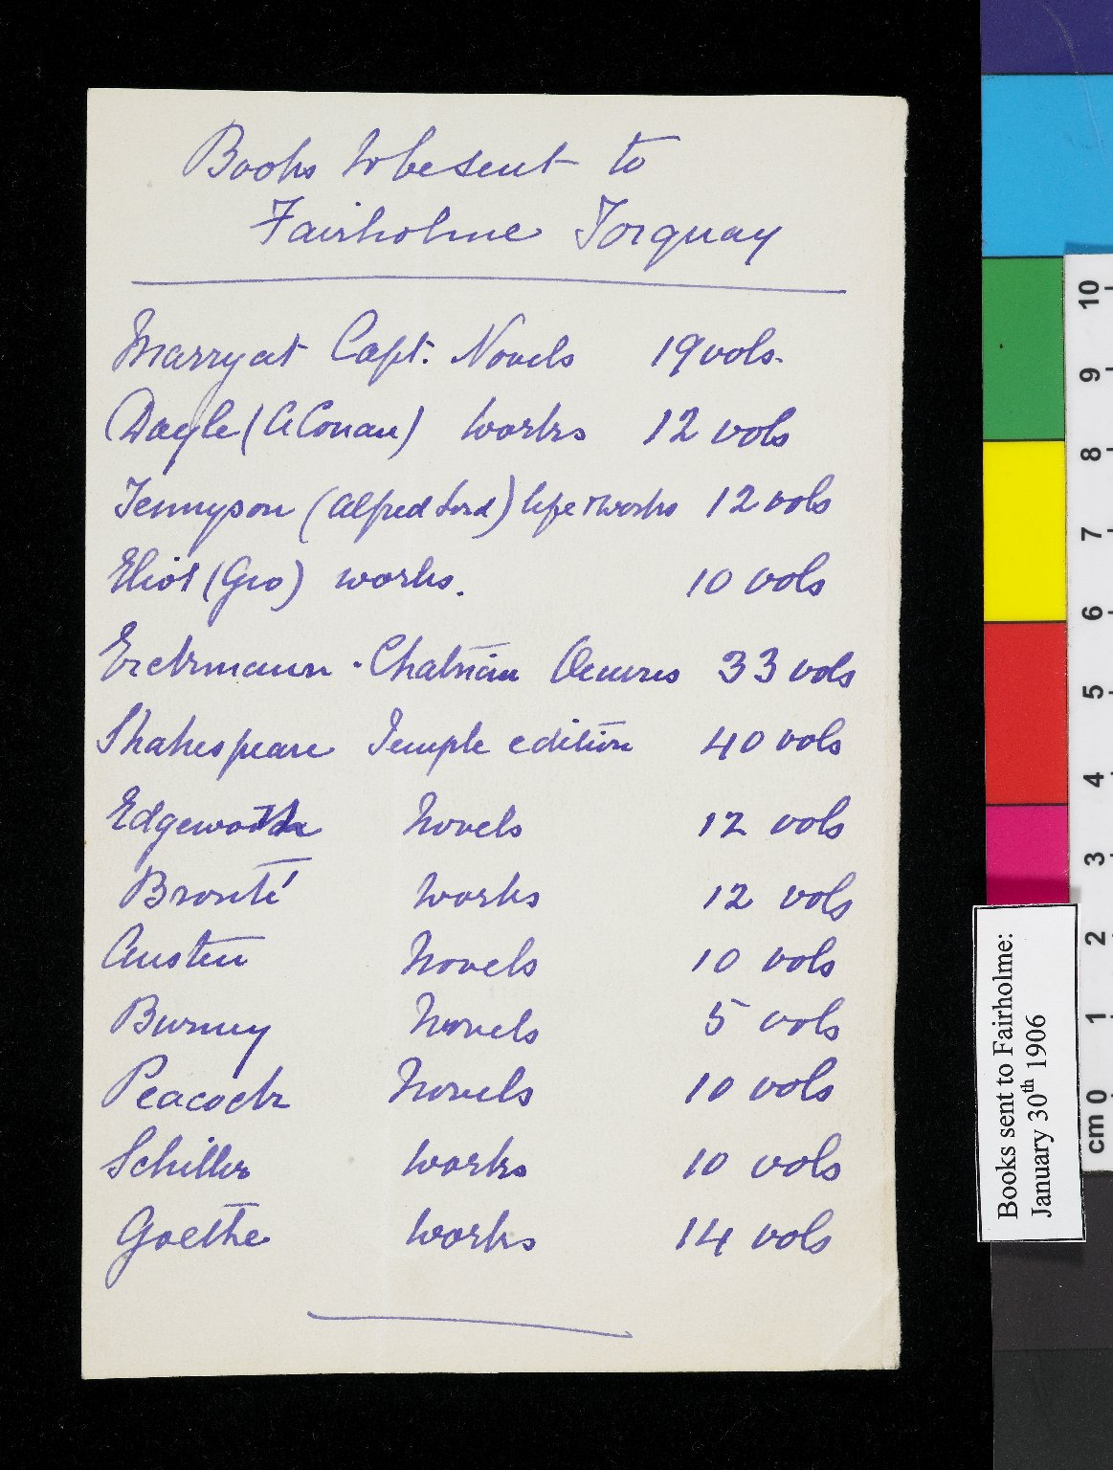
-------------
Image1
-------------
Field Data
Image Number JRL0803336dc
Reference Number JRL/6/1/7/16
Image Title Books sent to Fairholme
Creator Rylands, Enriqueta
Creator Role Author
Date Created 1906-01-30
Description List of books sent to Fairholme, Enriqueta Rylands' house in Torquay, including works by Tennyson, Eliot, Shakespeare, the Brontës, Austen, Goethe and Schiller.
Subject Private libraries
Category of Material Archives
Technique Used Handwriting
Support Paper
Time Period Covered 20th Century CE
Item Height 158 mm
Item Width 100 mm
Current Repository The University of Manchester Library, U.K.
Provenance Private papers
Rights Holder - Image University of Manchester Library
Rights holder - Work The University of Manchester Library
Access Rights <a rel="license" href="http://creativecommons.org/licenses/by-nc-sa/4.0/"><img alt="Creative Commons License" style="border-width:0" src="https://i.creativecommons.org/l/by-nc-sa/4.0/88x31.png"></a>
Date Captured (yyyy-mm-dd) 2007-12-14
Image Creation Technique Digital capture by Gten
Date Image Added (yyyy-mm) 2008-04
Metadata Language eng-GB

Slide 6
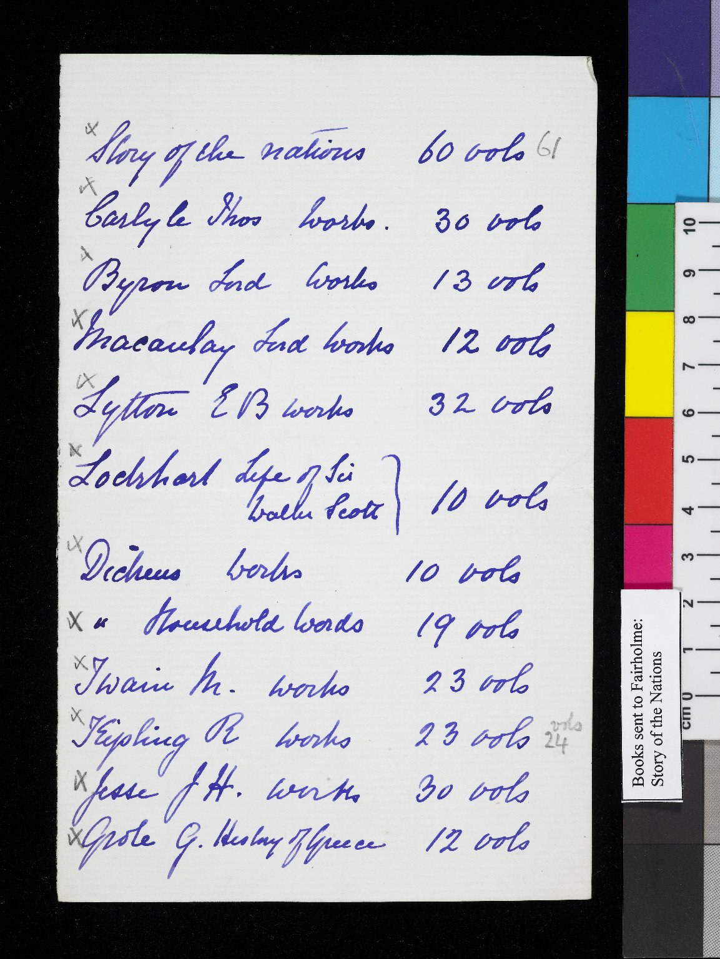
-------------
Image1
-------------
Field Data
Image Number JRL0803337dc
Reference Number JRL/6/1/7/16
Image Title Books sent to Fairholme
Creator Rylands, Enriqueta
Creator Role Author
Date Created 1906-01-30
Description List of books sent to Fairholme, Enriqueta Rylands' house in Torquay. The list begins with 'Story of the Nations' and includes works by Carlyle, Byron, Dickens, Twain and Kipling.
Subject Private libraries
Category of Material Archives
Technique Used Handwriting
Support Paper
Time Period Covered 20th Century CE
Item Height 178 mm
Item Width 113 mm
Current Repository The University of Manchester Library, U.K.
Provenance Private papers
Rights Holder - Image University of Manchester Library
Rights holder - Work The University of Manchester Library
Access Rights <a rel="license" href="http://creativecommons.org/licenses/by-nc-sa/4.0/"><img alt="Creative Commons License" style="border-width:0" src="https://i.creativecommons.org/l/by-nc-sa/4.0/88x31.png"></a>
Date Captured (yyyy-mm-dd) 2007-12-14
Image Creation Technique Digital capture by Gten
Date Image Added (yyyy-mm) 2008-04
Metadata Language eng-GB

Slide 7
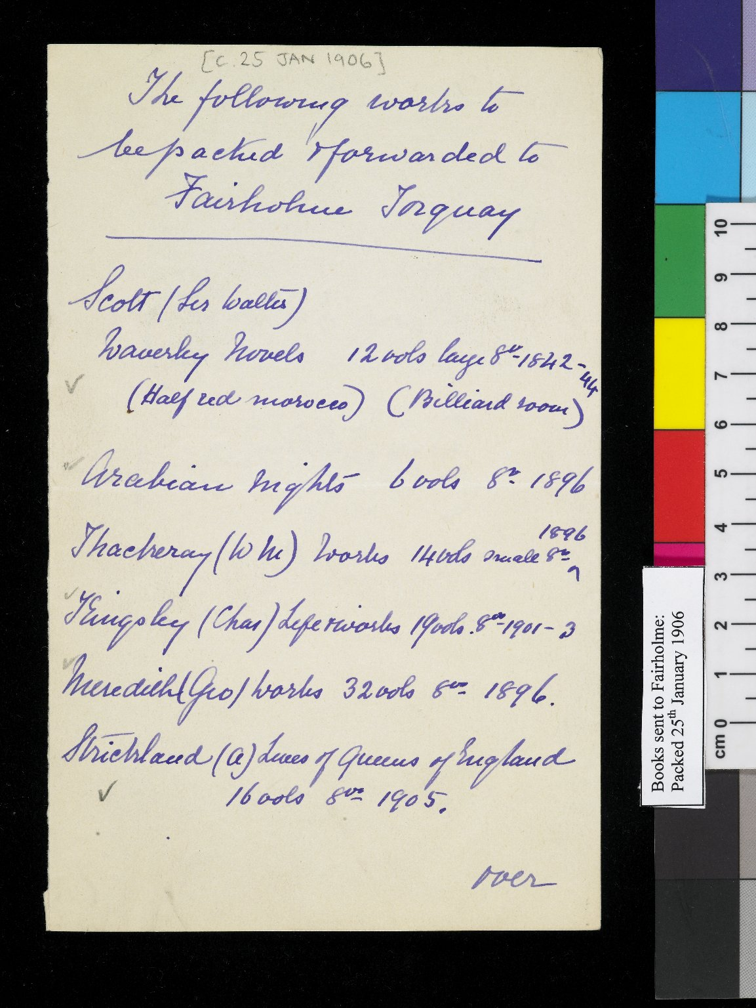
-------------
Image1
-------------
Field Data
Image Number JRL0803338dc
Reference Number JRL/6/1/7/16
Image Title Books sent to Fairholme
Creator Rylands, Enriqueta
Creator Role Author
Date Created 1906-01-25
Description List of books sent to Fairholme, Enriqueta Rylands' house in Torquay. The list includes works by Kinglsley, Scott and Thackeray, and 'The Arabian Niights'.
Subject Private libraries
Category of Material Archives
Technique Used Handwriting
Support Paper
Time Period Covered 20th Century CE
Item Height 176 mm
Item Width 110 mm
Current Repository The University of Manchester Library, U.K.
Provenance Private papers
Rights Holder - Image University of Manchester Library
Rights holder - Work The University of Manchester Library
Access Rights <a rel="license" href="http://creativecommons.org/licenses/by-nc-sa/4.0/"><img alt="Creative Commons License" style="border-width:0" src="https://i.creativecommons.org/l/by-nc-sa/4.0/88x31.png"></a>
Date Captured (yyyy-mm-dd) 2007-12-14
Image Creation Technique Digital capture by Gten
Date Image Added (yyyy-mm) 2008-04
Metadata Language eng-GB

Slide 8
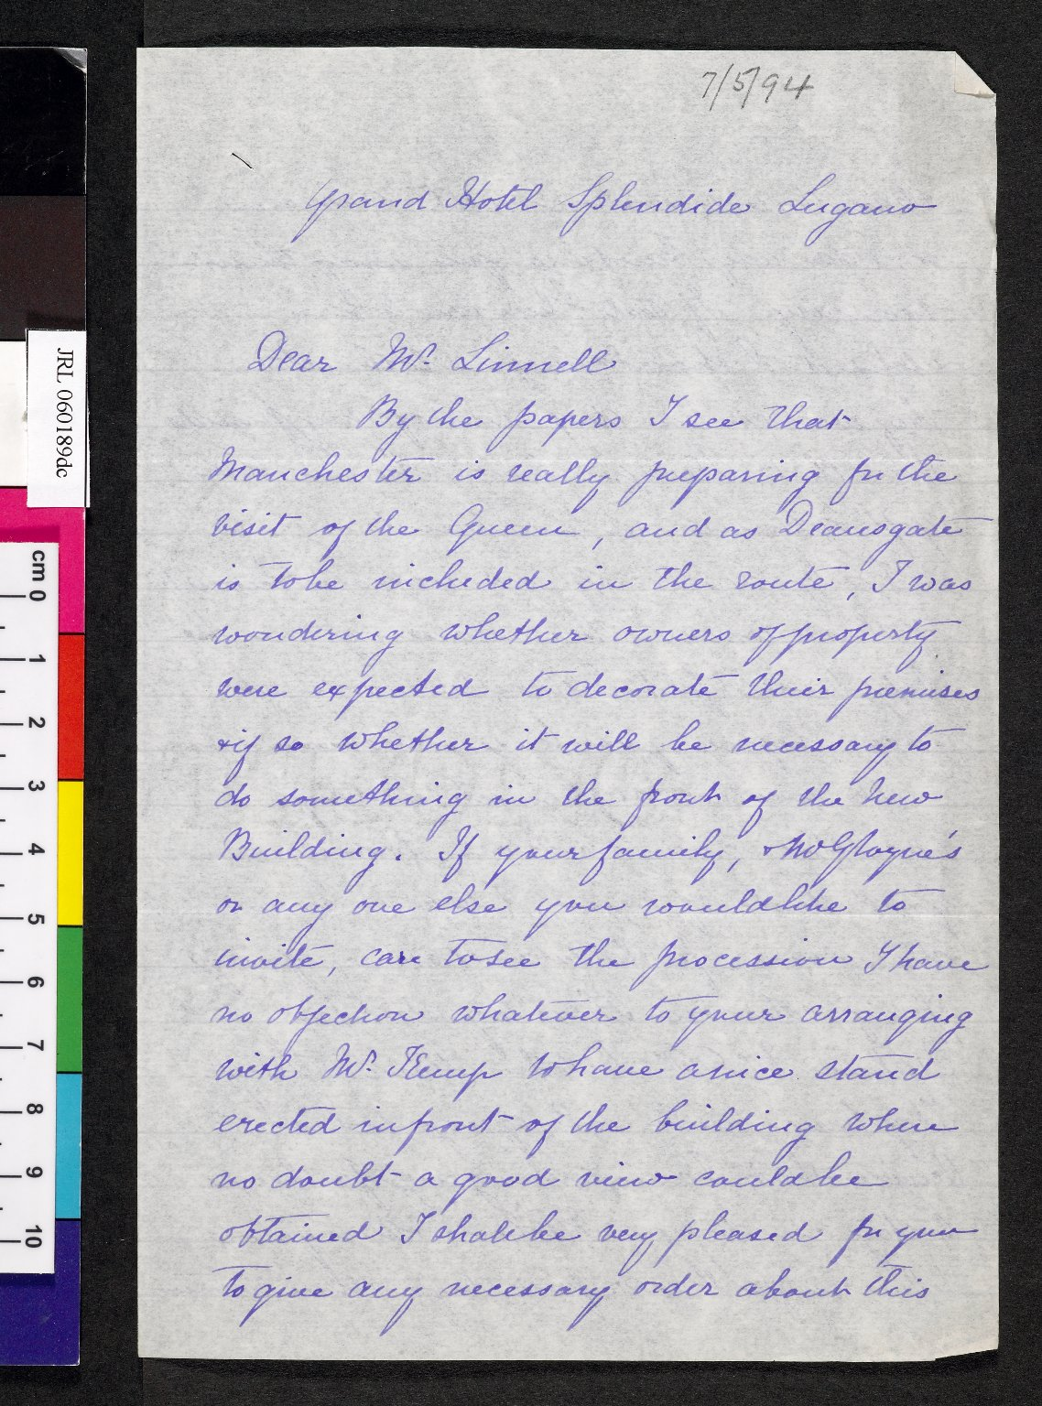
-------------
Image1
-------------
Field Data
Image Number JRL060189dc
Reference Number JRL/4/1/3/1
Image Title Letter from Enriqueta Rylands to William Linnell
Creator Rylands, Enriqueta
Creator Role Author
Date Created 1894-05-07
Page/Sheet 1
Image Sequence Number 001
Description Letter from Mrs Rylands to Mr William Linnell regarding a proposed visit by Queen Victoria to Manchester. Mrs Rylands offers to decorate the porch of the new library and suggests he might like to build a platform affording a good view of the procession along Deansgate. William Linnell was a senior director of Rylands & Sons. He advised Mrs Rylands during the building of the John Rylands Library and was a trustee from 1899 until his death in 1901.
Language Code eng-GB
Subject Library buildings
Subject John Rylands Library
Category of Material Archives
Sub-Category Correspondence
Technique Used Handwriting
Support Paper
Creation Site Switzerland: Lugano
Time Period Covered 19th Century CE
Places Covered England: Greater Manchester: Manchester
People Covered Linnell, William, 1837-1901
Item Height 204 mm
Item Width 134 mm
Current Repository The University of Manchester Library, U.K.
Provenance Private papers
Rights Holder - Image The University of Manchester Library
Rights holder - Work The University of Manchester Library
Access Rights <a rel="license" href="http://creativecommons.org/licenses/by-nc-sa/4.0/"><img alt="Creative Commons License" style="border-width:0" src="https://i.creativecommons.org/l/by-nc-sa/4.0/88x31.png"></a>
Date Captured (yyyy-mm-dd) 2005-12-08
Image Creation Technique Digital capture by Gten
Date Image Added (yyyy-mm) 2006-02
Metadata Language eng-GB

Slide 9
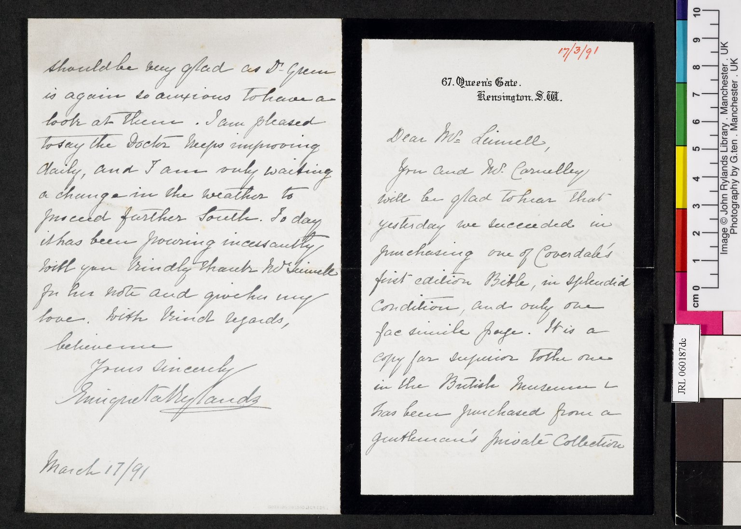
-------------
Image1
-------------
Field Data
Image Number JRL060187dc
Reference Number JRL/4/1/3/1
Image Title Letter from Enriqueta Rylands to William Linnell
Creator Rylands, Enriqueta
Creator Role Author
Date Created 1891-03-17
Page/Sheet 1 and 4
Image Sequence Number 001
Description Letter from Mrs Rylands to William Linnnell relating the purchase of a first edition Coverdale bible for the Library. William Linnell was a senior director of Rylands & Sons. He advised Mrs Rylands during the building of the John Rylands Library and was a trustee from 1899 until his death in 1901. The letter is written on mourning paper; the first page has a black border.
Language Code eng-GB
Subject John Rylands Library
Category of Material Archives
Sub-Category Correspondence
Technique Used Handwriting
Support Paper
Creation Site England: London: Kensington
Time Period Covered 19th Century CE
Places Covered England: Greater Manchester: Manchester
People Covered Linnell, William, 1837-1901
Item Height 172 mm
Item Width 210 mm
Current Repository The University of Manchester Library, U.K.
Provenance Private papers
Rights Holder - Image The University of Manchester Library
Rights holder - Work The University of Manchester Library
Access Rights <a rel="license" href="http://creativecommons.org/licenses/by-nc-sa/4.0/"><img alt="Creative Commons License" style="border-width:0" src="https://i.creativecommons.org/l/by-nc-sa/4.0/88x31.png"></a>
Date Captured (yyyy-mm-dd) 2005-12-08
Image Creation Technique Digital capture by Gten
Date Image Added (yyyy-mm) 2006-02
Metadata Language eng-GB

Slide 10
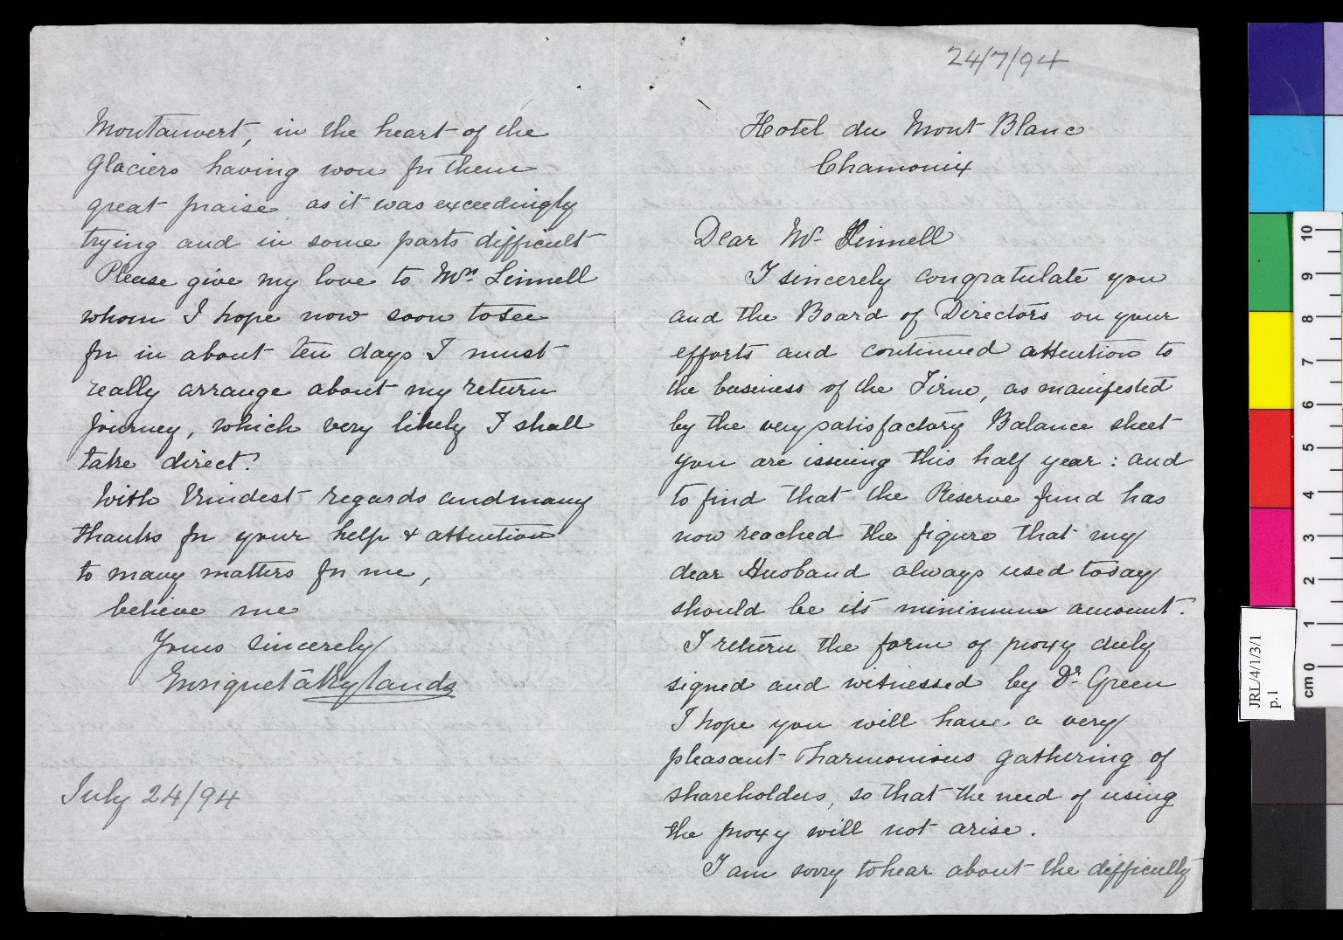
-------------
Image1
-------------
Field Data
Image Number JRL0802263dc
Reference Number JRL/4/1/3/1
Image Title Letter to William Linnell
Creator Rylands, Enriqueta
Creator Role Author
Date Created 1894-06-27
Page/Sheet 1; 4
Image Sequence Number 001
Description Letter from Enriqueta Rylands to William Linnell from Chamonix. She congratulates him on delivering a successful balance sheet for Rylands & Sons. She mentions the difficulty in getting masons to work on the John Rylands Library in summer. She also describes her joy in the mountains and tells him about a young woman from her hotel who was ascending Mont Blanc "alone", but with two guides, one porter, a courier and his guide. The younger women of her party are also keen to make the ascent. William Linnell was a senior director of Rylands & Sons. He advised Mrs Rylands during the building of the John Rylands Library and was a trustee from 1899 until his death in 1901.
Language Code eng-GB
Subject Rylands and Sons Ltd
Subject John Rylands Library
Subject Letters
Category of Material Archives
Sub-Category Correspondence
Technique Used Handwriting
Support Paper
Creation Site France: Chamonix
Time Period Covered 19th Century CE
Places Covered France: Chamonix
People Covered Linnell, William, 1837-1901
Item Height 204 mm
Item Width 268 mm
Current Repository The University of Manchester Library, U.K.
Rights Holder - Image University of Manchester Library
Rights holder - Work The University of Manchester Library
Access Rights <a rel="license" href="http://creativecommons.org/licenses/by-nc-sa/4.0/"><img alt="Creative Commons License" style="border-width:0" src="https://i.creativecommons.org/l/by-nc-sa/4.0/88x31.png"></a>
Date Captured (yyyy-mm-dd) 2007-11-02
Image Creation Technique Digital capture by Gten
Date Image Added (yyyy-mm) 2008-01
Metadata Language eng-GB

Slide 11
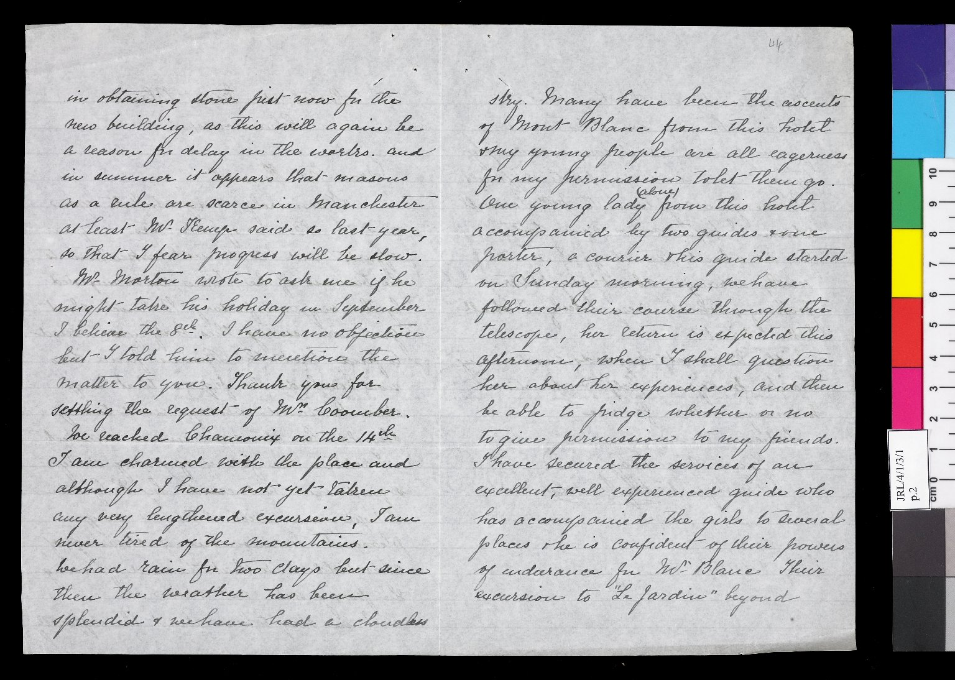
-------------
Image1
-------------
Field Data
Image Number JRL0802264dc
Reference Number JRL/4/1/3/1
Image Title Letter to William Linnell
Creator Rylands, Enriqueta
Creator Role Author
Date Created 1894-06-27
Page/Sheet 2-3
Image Sequence Number 002
Description Letter from Enriqueta Rylands to William Linnell from Chamonix. She congratulates him on delivering a successful balance sheet for Rylands & Sons. She mentions the difficulty in getting masons to work on the John Rylands Library in summer. She also describes her joy in the mountains and tells him about a young woman from her hotel who was ascending Mont Blanc "alone", but with two guides, one porter, a courier and his guide. The younger women of her party are also keen to make the ascent. William Linnell was a senior director of Rylands & Sons. He advised Mrs Rylands during the building of the John Rylands Library and was a trustee from 1899 until his death in 1901.
Language Code eng-GB
Subject Rylands and Sons Ltd
Subject John Rylands Library
Subject Letters
Category of Material Archives
Sub-Category Correspondence
Technique Used Handwriting
Support Paper
Creation Site France: Chamonix
Time Period Covered 19th Century CE
Places Covered France: Chamonix
People Covered Linnell, William, 1837-1901
Item Height 204 mm
Item Width 268 mm
Current Repository The University of Manchester Library, U.K.
Rights Holder - Image University of Manchester Library
Rights holder - Work The University of Manchester Library
Access Rights <a rel="license" href="http://creativecommons.org/licenses/by-nc-sa/4.0/"><img alt="Creative Commons License" style="border-width:0" src="https://i.creativecommons.org/l/by-nc-sa/4.0/88x31.png"></a>
Date Captured (yyyy-mm-dd) 2007-11-02
Image Creation Technique Digital capture by Gten
Date Image Added (yyyy-mm) 2008-01
Metadata Language eng-GB

Slide 12
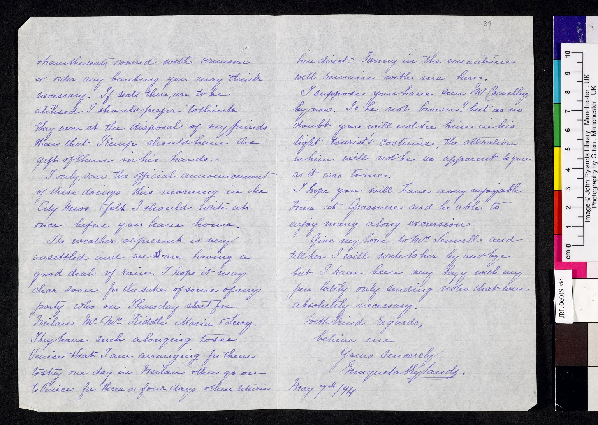
-------------
Image1
-------------
Field Data
Image Number JRL060190dc
Reference Number JRL/4/1/3/1
Image Title Letter from Enriqueta Rylands to William Linnell
Date Created 1894-05-07
Page/Sheet 2-3
Image Sequence Number 002
Description Letter from Mrs Rylands to Mr William Linnell regarding a proposed visit by Queen Victoria to Manchester. Mrs Rylands offers to decorate the porch of the new library and suggests he might like to build a platform affording a good view of the procession along Deansgate. William Linnell was a senior director of Rylands & Sons. He advised Mrs Rylands during the building of the John Rylands Library and was a trustee from 1899 until his death in 1901.
Language Code eng-GB
Subject Library buildings
Subject John Rylands Library
Category of Material Archives
Sub-Category Correspondence
Technique Used Handwriting
Support Paper
Creation Site Switzerland: Lugano
Time Period Covered 19th Century CE
Places Covered England: Greater Manchester: Manchester
People Covered Linnell, William, 1837-1901
Item Height 204 mm
Item Width 268 mm
Current Repository The University of Manchester Library, U.K.
Provenance Private papers
Rights Holder - Image The University of Manchester Library
Rights holder - Work The University of Manchester Library
Access Rights <a rel="license" href="http://creativecommons.org/licenses/by-nc-sa/4.0/"><img alt="Creative Commons License" style="border-width:0" src="https://i.creativecommons.org/l/by-nc-sa/4.0/88x31.png"></a>
Date Captured (yyyy-mm-dd) 2005-12-08
Image Creation Technique Digital capture by Gten
Date Image Added (yyyy-mm) 2006-02
Metadata Language eng-GB

Slide 13
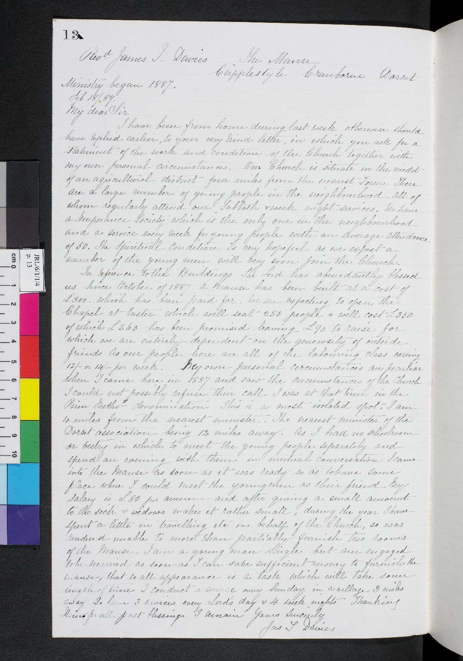
-------------
Image1
-------------
Field Data
Image Number JRL0802274dc
Reference Number JRL/6/1/1/4
Image Title Letter to Mrs Rylands
Parent Work Title Account book relating to ministers
Creator Davis, James, Reverend
Creator Role Author
Creator Rylands, Enriqueta
Creator Role Scribe
Date Created 1889-02-18
Page/Sheet 13
Description Letter from a Rev. James Davis of Cranborne in Dorset to Mrs Rylands, copied by her into her "Account book relating to ministers". Mrs Rylands often gave sums of money to help church ministers in financial difficulties.
Language Code eng-GB
Subject Christianity
Subject Charity
Category of Material Archives
Sub-Category Correspondence
Technique Used Handwriting
Support Paper
Time Period Covered 19th Century CE
Places Covered England: Dorset: Cranborne
Item Height 330 mm
Item Width 208 mm
Current Repository The University of Manchester Library, U.K.
Rights Holder - Image University of Manchester Library
Rights holder - Work The University of Manchester Library
Access Rights <a rel="license" href="http://creativecommons.org/licenses/by-nc-sa/4.0/"><img alt="Creative Commons License" style="border-width:0" src="https://i.creativecommons.org/l/by-nc-sa/4.0/88x31.png"></a>
Date Captured (yyyy-mm-dd) 2007-11-02
Image Creation Technique Digital capture by Gten
Date Image Added (yyyy-mm) 2008-01
Metadata Language eng-GB

