Slide 1
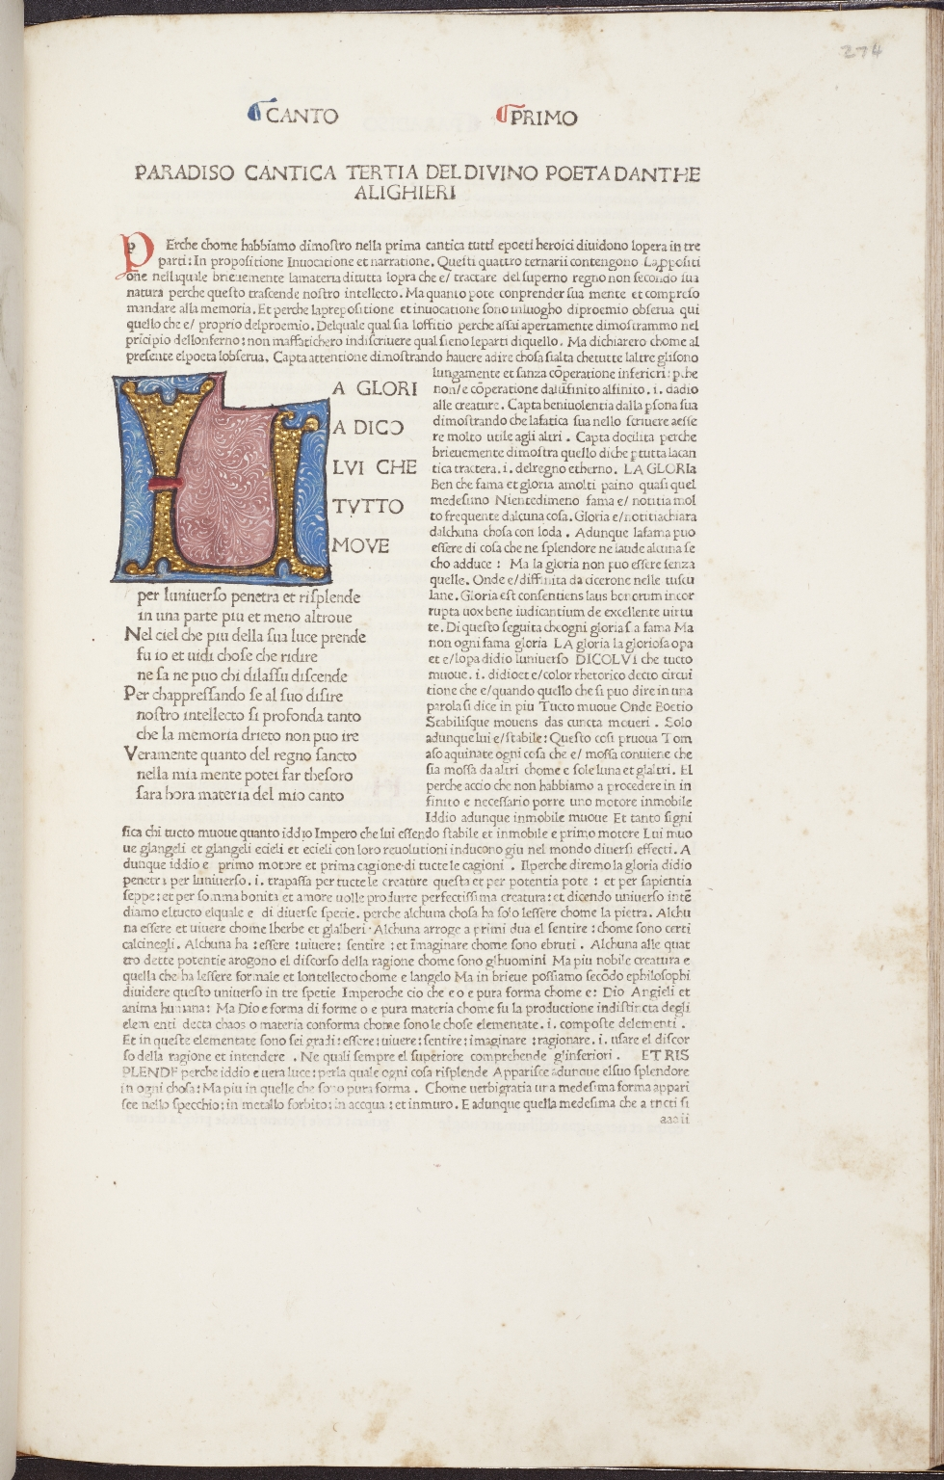
-------------
Image1
-------------
Field Data
Image Number JRL1002348dc
Reference Number Incunable 17280
Link to Catalogue <A href="https://www.librarysearch.manchester.ac.uk/primo-explore/fulldisplay?docid=44MAN_ALMA_DS21210868000001631&context=L&vid=MU_NUI&search_scope=BLENDED&tab=local&lang=en_US">UoM online catalogue</a>
Image Title 3.1.1-3.1.12; Comm. Par. 1
Parent Work Title Comento di Christophoro Landino fiorentino sopra la comedia di Danthe Alighieri poeta fiorentino..
Alternative Parent Work Title La commedia
Alternative Parent Work Title Divina commedia
Translated Parent Work Title Divine Comedy
Creator Dante Alighieri, 1265-1321
Creator Role Author
Creator Landino, Cristoforo, 1424-1504
Creator Role Commentator
Creator Laurentii, Nicolaus active 1475-1486
Creator Role Printer
Display Creator Dante Alighieri, 1265-1321
Date Created 1481-08-30
Publication Details Florence: Nicolaus Laurentii Alamanus
Page/Sheet 274r
Image Sequence Number 274r
Description Dante Alighieri 'La Commedia' (Commentator: Christophorus Landinus). Contains: Marsilius Ficinus: Ad Dantem gratulatio [Latin & Italian]. ISTC No.: id00029000. Folio. 20 copper engravings are known, from designs by Botticelli, to accompany the first 19 Cantos of the Inferno. Contains Par. 1.1 - Par. 1.12. Commentator by Cristoforo Landino on Par. 1. The text of the poem is found on the left hand side of the page, surrounded by the Commentator. The canto number is found in the top margin of the page. Illuminiated initial 'U'. Initial in red ink.
Language ita
Subject Divina commedia (Dante Alighieri)
Subject Literature, Medieval
Subject Epic poetry, Italian--Early works to 1800
Subject Italian literature--15th century
Subject Hell in literature
Subject Christianity
Subject Paradise in literature
Category of Material Printed
Sub-Category Incunabula
Technique Used Illumination (image-making process)
Support Paper
Item Height 434 mm
Item Width 300 mm
Provenance George John Spencer Spencer Earl, 1758-1834, former owner
Rights Holder - Image The University of Manchester Library
Rights Holder - Work The University of Manchester Library
Access Rights <a rel="license" href="http://creativecommons.org/licenses/by-nc-sa/4.0/"><img alt="Creative Commons License" style="border-width:0" src="https://i.creativecommons.org/l/by-nc-sa/4.0/88x31.png" /></a><br />This work is licensed under a <a rel="license" href="http://creativecommons.org/licenses/by-nc-sa/4.0/">Creative Commons Attribution-NonCommercial-ShareAlike 4.0 International License.</a> Copyright of The University of Manchester

Slide 2
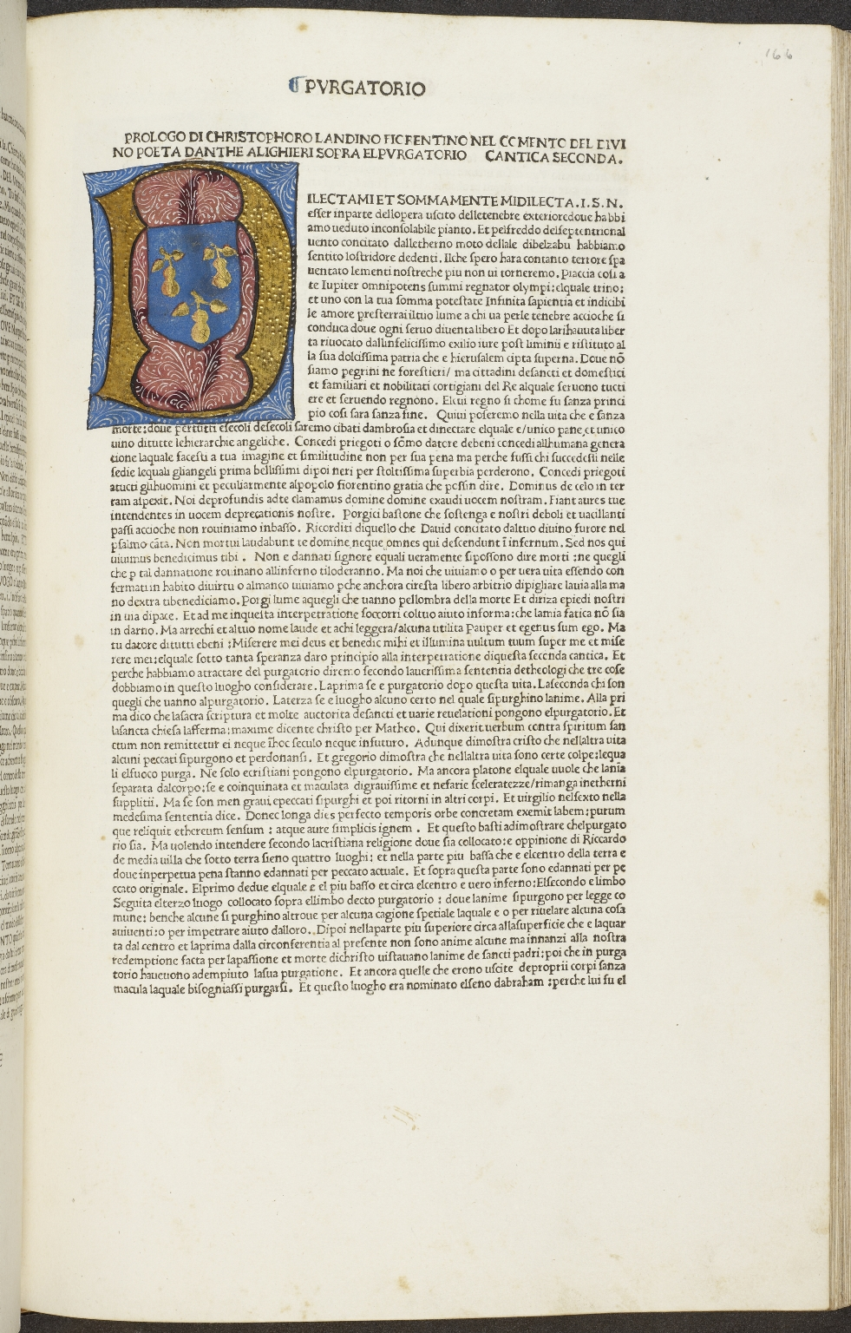
-------------
Image1
-------------
Field Data
Image Number JRL1002132dc
Reference Number Incunable 17280
Link to Catalogue <A href="https://www.librarysearch.manchester.ac.uk/primo-explore/fulldisplay?docid=44MAN_ALMA_DS21210868000001631&context=L&vid=MU_NUI&search_scope=BLENDED&tab=local&lang=en_US">UoM online catalogue</a>
Image Title Prologo sopra el purgatorio
Parent Work Title Comento di Christophoro Landino fiorentino sopra la comedia di Danthe Alighieri poeta fiorentino..
Alternative Parent Work Title La commedia
Alternative Parent Work Title Divina commedia
Translated Parent Work Title Divine Comedy
Creator Dante Alighieri, 1265-1321
Creator Role Author
Creator Landino, Cristoforo, 1424-1504
Creator Role Commentator
Creator Laurentii, Nicolaus active 1475-1486
Creator Role Printer
Display Creator Dante Alighieri, 1265-1321
Date Created 1481-08-30
Publication Details Florence: Nicolaus Laurentii Alamanus
Page/Sheet 166r
Image Sequence Number 166r
Description Dante Alighieri 'La Commedia' (Commentator: Christophorus Landinus). Contains: Marsilius Ficinus: Ad Dantem gratulatio [Latin & Italian]. ISTC No.: id00029000. Folio. 20 copper engravings are known, from designs by Botticelli, to accompany the first 19 Cantos of the Inferno. Prologue to Purgatory by Cristoforo Landino. Illuminated initial 'D'.
Language ita
Subject Divina commedia (Dante Alighieri)
Subject Literature, Medieval
Subject Epic poetry, Italian--Early works to 1800
Subject Italian literature--15th century
Subject Hell in literature
Subject Christianity
Subject Paradise in literature
Category of Material Printed
Sub-Category Incunabula
Technique Used Illumination (image-making process)
Support Paper
Item Height 434 mm
Item Width 300 mm
Provenance George John Spencer Spencer Earl, 1758-1834, former owner
Rights Holder - Image The University of Manchester Library
Rights Holder - Work The University of Manchester Library
Access Rights <a rel="license" href="http://creativecommons.org/licenses/by-nc-sa/4.0/"><img alt="Creative Commons License" style="border-width:0" src="https://i.creativecommons.org/l/by-nc-sa/4.0/88x31.png" /></a><br />This work is licensed under a <a rel="license" href="http://creativecommons.org/licenses/by-nc-sa/4.0/">Creative Commons Attribution-NonCommercial-ShareAlike 4.0 International License.</a> Copyright of The University of Manchester

Slide 3
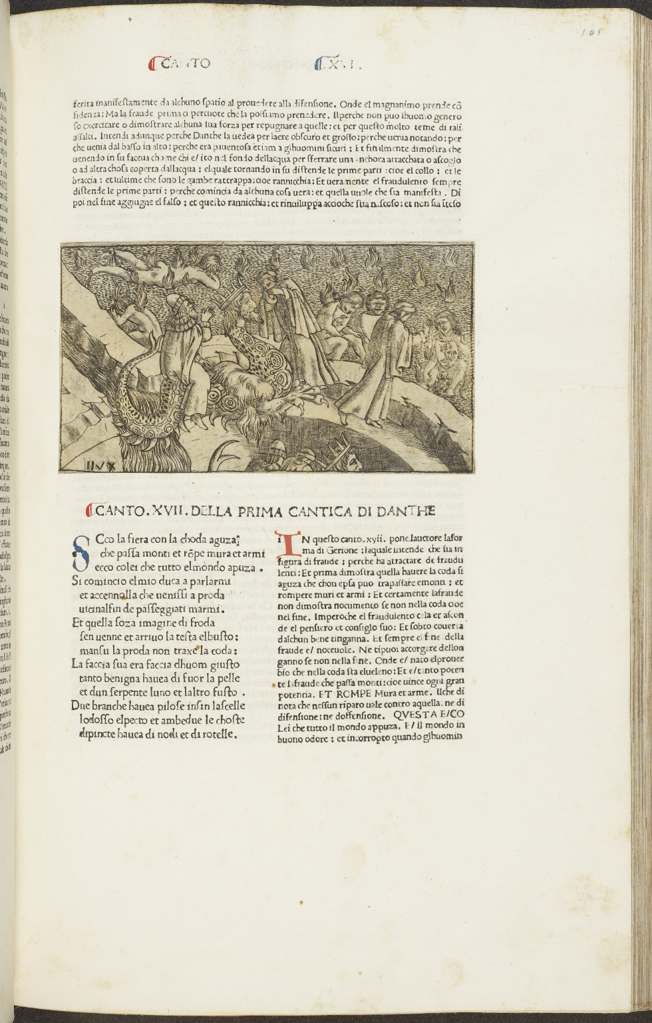
-------------
Image1
-------------
Field Data
Image Number JRL1002002dc
Reference Number Incunable 17280
Link to Catalogue <A href="https://www.librarysearch.manchester.ac.uk/primo-explore/fulldisplay?docid=44MAN_ALMA_DS21210868000001631&context=L&vid=MU_NUI&search_scope=BLENDED&tab=local&lang=en_US">UoM online catalogue</a>
Image Title 1.17.1-1.17.15; Comm. Inf. 16-17
Parent Work Title Comento di Christophoro Landino fiorentino sopra la comedia di Danthe Alighieri poeta fiorentino..
Alternative Parent Work Title La commedia
Alternative Parent Work Title Divina commedia
Translated Parent Work Title Divine Comedy
Creator Dante Alighieri, 1265-1321
Creator Role Author
Creator Landino, Cristoforo, 1424-1504
Creator Role Commentator
Creator Botticelli, Sandro, 1444 or 5-1510
Creator Role Artist
Creator Baldini, Baccio
Creator Role Engraver
Creator Laurentii, Nicolaus active 1475-1486
Creator Role Printer
Display Creator Dante Alighieri, 1265-1321
Date Created 1481-08-30
Publication Details Florence: Nicolaus Laurentii Alamanus
Page/Sheet 101r
Image Sequence Number 101r
Description Dante Alighieri 'La Commedia' (Commentator: Christophorus Landinus). Contains: Marsilius Ficinus: Ad Dantem gratulatio [Latin & Italian]. ISTC No.: id00029000. Folio. 20 copper engravings are known, from designs by Botticelli, to accompany the first 19 Cantos of the Inferno. The top half of the page contains Commentator by Cristoforo Landino on Inf. 16. The bottom half of the page contains Inf. 17.1 - Inf. 17.15. Commentator by Cristoforo Landino on Inf. 17. The text of the poem is found on the left hand column of the page. The canto number is found in the top margin of the page. Copper engraving inserted between end of Inf. 16 and beginning of Inf. 17. Initials in blue and red ink.
Language ita
Subject Divina commedia (Dante Alighieri)
Subject Literature, Medieval
Subject Epic poetry, Italian--Early works to 1800
Subject Italian literature--15th century
Subject Hell in literature
Subject Christianity
Subject Paradise in literature
Category of Material Printed
Sub-Category Incunabula
Sub-Category Illustrated works
Technique Used Engraving (printing process)
Support Paper
Item Height 434 mm
Item Width 300 mm
Provenance George John Spencer Spencer Earl, 1758-1834, former owner
Rights Holder - Image The University of Manchester Library
Rights Holder - Work The University of Manchester Library
Access Rights <a rel="license" href="http://creativecommons.org/licenses/by-nc-sa/4.0/"><img alt="Creative Commons License" style="border-width:0" src="https://i.creativecommons.org/l/by-nc-sa/4.0/88x31.png" /></a><br />This work is licensed under a <a rel="license" href="http://creativecommons.org/licenses/by-nc-sa/4.0/">Creative Commons Attribution-NonCommercial-ShareAlike 4.0 International License.</a> Copyright of The University of Manchester

