Slide 1
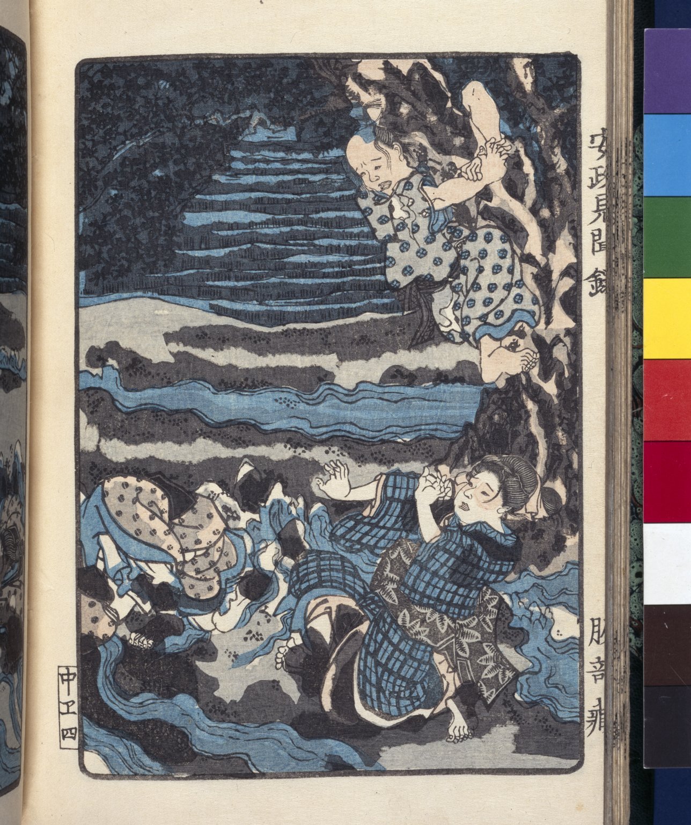
-------------
Image1
-------------
Field Data
Image Number JRL022996tr
Reference Number Japanese 15
Image Title Japanese earthquake
Parent Work Title Ansei Kenmonroku
Translated Parent Work Title Ansei Earthquake
Creator Hattori, Yasunori, active 19th century
Creator Role Author
Creator Utagawa, Yoshiharu, 1828-1888
Creator Role Illustrator
Date Created 1856
Description Illustrated: Japanese people engulfed in an earthquake.
Language Code jpn
Subject Earthquakes
Category of Material Printed
Time Period Covered 19th Century CE
Places Covered Japan
Current Repository The University of Manchester Library, U.K.
Provenance Lindsay family Earls of Crawford and Balcarres, former owner
Rights Holder - Image The University of Manchester Library
Rights holder - Work The University of Manchester Library
References 'Bulletin of the John Rylands University Library of Manchester', Vol. 82, Nos. 2 and 3, 2000.
Notes Finding aids: published catalogue, P.F. Kornicki, `The Japanese Collection in the Bibliotheca Lindesiana', Bulletin of the John Rylands University Library of Manchester, vol. 75, no. 2 (1993), pp. 209-300.
Image Creation Technique Scanned from colour transparency by Gten, May 2005
Metadata Language eng-GB

Slide 2
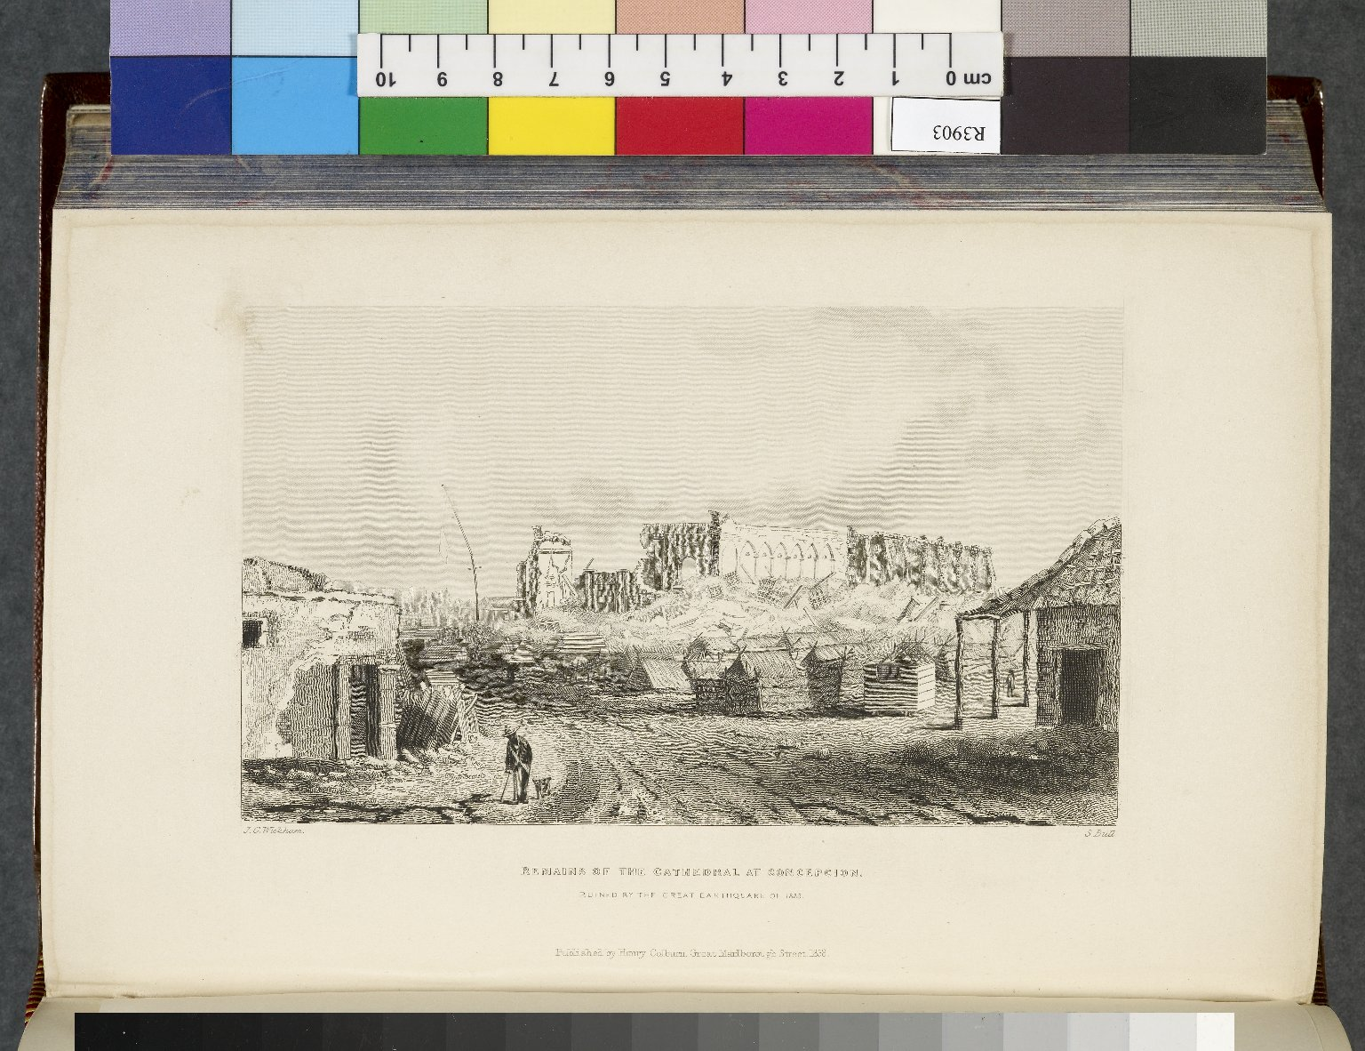
-------------
Image1
-------------
Field Data
Image Number JRL0807595dc
Reference Number R3903
Link to Catalogue <A href=http://man-fe.hosted.exlibrisgroup.com/MU_VU1:BLENDED:44MAN_ALMA_DS21134677540001631>UoM online catalogue.</a>
Image Title Remains of the Cathedral at Concepcion
Parent Work Title Narrative of the surveying voyages of His Majesty's ships Adventure and Beagle, between the years 1826 and 1836, : describing their examination of the southern shores of South America, and the Beagle's circumnavigation of the globe. In three volumes.
Creator Fitzroy, Robert, 1805-1865
Creator Role Author
Creator Wickham, John
Creator Role Artist
Date Created 1839
Publication Details London : H. Colburn
Volume 2
Page/Sheet Opposite page 405
Image Sequence Number 2-405
Description Illustration: Remains of the Cathedral at Concepcion, ruined by the great earthquake of 1835.
Language Code eng-GB
Subject Chile--Description and travel
Subject Church buildings
Subject Earthquakes
Category of Material Printed
Sub-Category Illustrated works
Technique Used Drawing (image-making)
Support Paper
Time Period Covered 19th Century CE
Places Covered Chile: Concepcion
Item Height 223 mm
Item Width 130 mm
Current Repository The University of Manchester Library, U.K.
Rights Holder - Image The University of Manchester Library
Rights holder - Work The University of Manchester Library
Date Captured (yyyy-mm-dd) 2008-05-16
Image Creation Technique Digital capture by Gten
Date Image Added (yyyy-mm) 2008-09
Metadata Language eng-GB

Slide 4
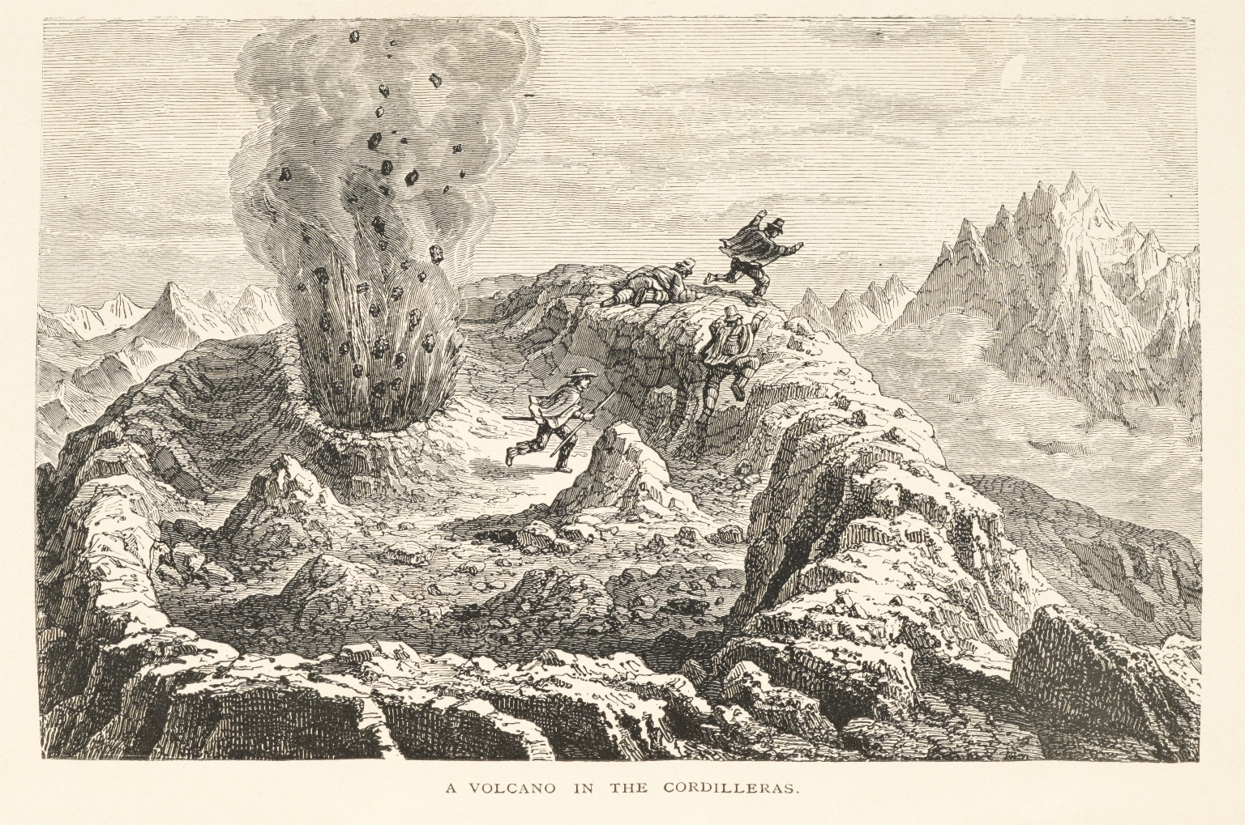
-------------
Image1
-------------
Field Data
Image Number JRL0916414dc
Reference Number R209893
Link to Catalogue <A href=http://man-fe.hosted.exlibrisgroup.com/MU_VU1:BLENDED:44MAN_ALMA_DS21193255760001631>UoM online catalogue.</a>
Image Title Volcano in the Cordilleras
Parent Work Title Journal of researches into the natural history and geology of the countries visited during the voyage of H.M.S. "Beagle" round the world. / by Charles Darwin, M.A., F.R.S. With a biographical introduction.
Creator Darwin, Charles, 1809-1882
Creator Role Author
Date Created 1891
Publication Details London : Ward, Lock 7 Co., Limited
Page/Sheet Plate, opposite page 113
Image Sequence Number 113a
Description Illustration: a volcano in the Cordilleras. Four men are shown running from the eruption of the volcano.
Language Code eng-GB
Subject Volcanoes
Subject Voyages and travels
Category of Material Printed
Sub-Category Illustrated works
Current Repository The University of Manchester Library, U.K.
Rights Holder - Image The University of Manchester Library
Rights holder - Work The University of Manchester Library
Date Captured (yyyy-mm-dd) 2009-04-01
Image Creation Technique Digital capture by Heritage Imaging, The University of Manchester Library
Date Image Added (yyyy-mm) 2011-03
Metadata Language eng-GB

