Slide 1
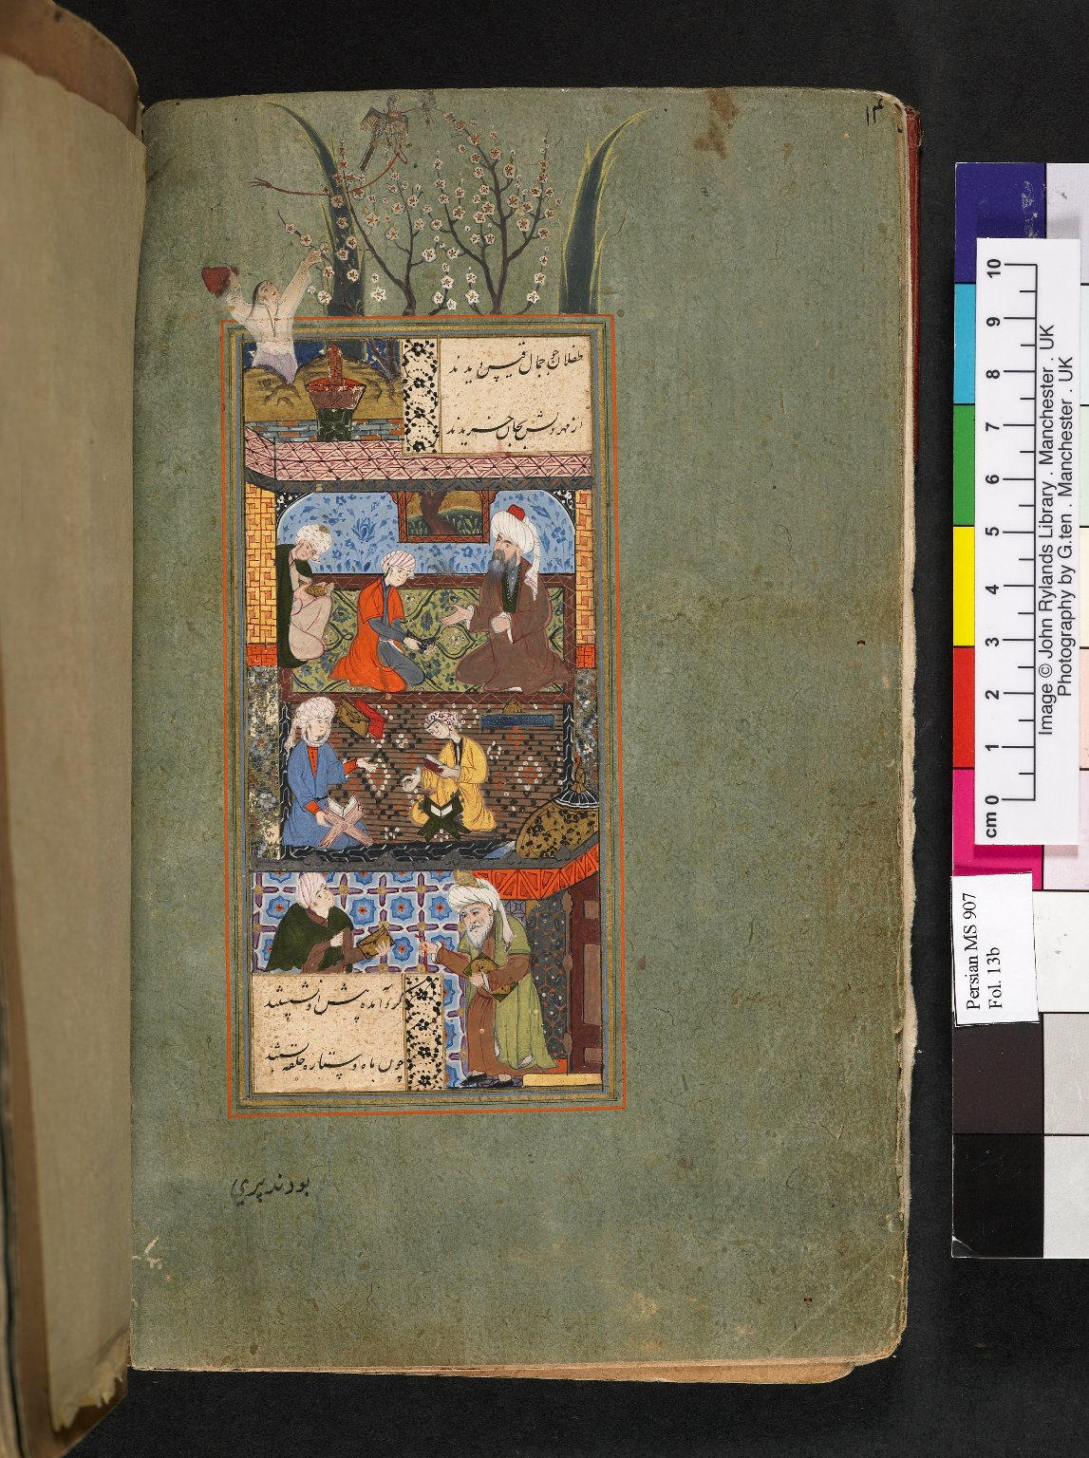
-------------
Image1
-------------
Field Data
Image Number JRL060098dc
Reference Number Persian MS 907
Image Title Layla and Majnun at school
Parent Work Title Layla and Majnun
Creator Hilali
Creator Role Author
Date Created 1561
Page/Sheet 13b
Image Sequence Number 013b
Description A young man attempts to recapture an escaping falcon in the top left hand corner. The face and turban of an old man in the lower right-hand corner have been repainted in the European manner. Miniature dimensions: 187 x 95 mm.
Language Code per
Subject Persian literature
Category of Material Manuscripts
Sub-Category Miniatures (paintings)
Technique Used Painting (image-making)
Support Paper
Style Period Khurasan style
Item Height 238 mm
Item Width 140 mm
Current Repository The University of Manchester Library, U.K.
Rights Holder - Image The University of Manchester Library
Rights holder - Work The University of Manchester Library
References B.W. Robinson, 'Persian Paintings in the John Rylands Library' (1980)
Date Captured (yyyy-mm-dd) 2005-11-08
Image Creation Technique Digital capture by Gten
Date Image Added (yyyy-mm) 2006-01
Metadata Language eng-GB

Slide 2
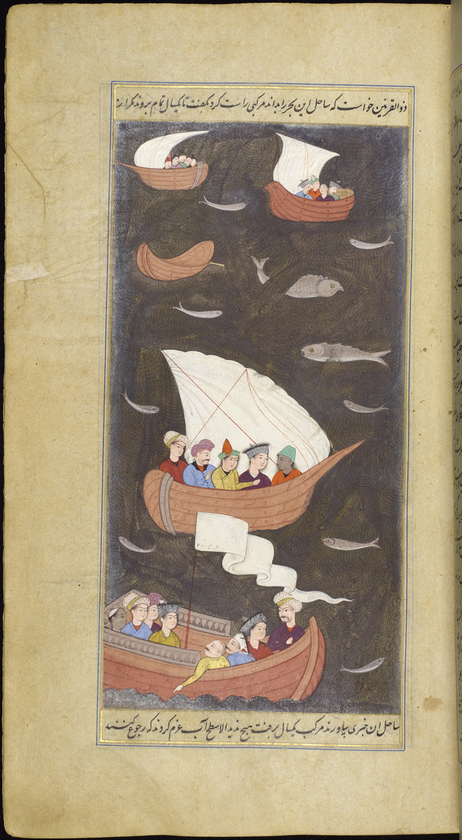
-------------
Image1
-------------
Field Data
Description Leaf-125
Originating Url <a target='_blank' href='https://luna.manchester.ac.uk/luna/servlet/detail/Manchester~91~1~416741~144796?page=124' >Open this Book</a><br>
Copyright Internet Archive Copyright

Slide 3
-------------
Image1
-------------
Field Data
Description Leaf-125
Originating Url <a target='_blank' href='https://luna.manchester.ac.uk/luna/servlet/detail/Manchester~91~1~416741~144796?page=124' >Open this Book</a><br>
Copyright Internet Archive Copyright

