Slide 1
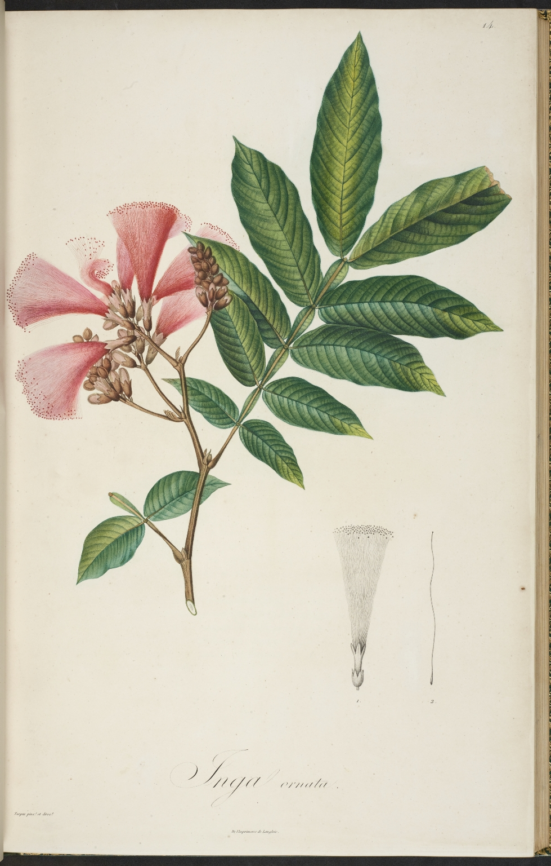
-------------
Image1
-------------
Field Data
Image Number JRL1216182
Reference Number R4683(b).15
Link to Catalogue <A href=https://www.librarysearch.manchester.ac.uk/primo-explore/fulldisplay?docid=44MAN_ALMA_DS21151166800001631&context=L&vid=MU_NUI&search_scope=BLENDED&tab=local&lang=en_US>UoM online catalogue</a>
Image Title Inga ornata
Parent Work Title Mimoses et autres plantes légumineuses du Nouveau Continent; de Humboldt et Bonpland, décrites et publiées par Charles-Sigismond Kunth
Creator Kunth, Karl Sigismund, 1788-1850
Creator Role Author
Creator Turpin, P. J. F. (Pierre Jean François), 1775-1840
Creator Role Illustrator
Date Created 1819
Publication Details Paris: Librairie greque-latineallemande
Page/Sheet Plate 14
Description Plate from drawings by Turpin.
Language Code fre-FR
Language French
Category of Material Printed
Support Paper
Current Repository The University of Manchester Library, U.K.
Rights Holder - Image The University of Manchester Library
Rights holder - Work The University of Manchester Library
Access Rights <a rel="license" href="http://creativecommons.org/licenses/by-nc-sa/4.0/"><img alt="Creative Commons License" style="border-width:0" src="https://i.creativecommons.org/l/by-nc-sa/4.0/88x31.png" /></a><br />This work is licensed under a <a rel="license" href="http://creativecommons.org/licenses/by-nc-sa/4.0/">Creative Commons Attribution-NonCommercial-ShareAlike 4.0 International License.</a> Copyright of The University of Manchester
Date Captured (yyyy-mm-dd) 2012-05-21
Image Creation Technique Digital capture by Heritage Imaging, The University of Manchester Library
Date Image Added (yyyy-mm) 2018-03
Metadata Language eng-GB

